Slide 1
TMP006/007 Thru-Hole Concept
Tommy Santoyo
10/2015

Slide 2
Concept
TMP006 and TMP007 were designed as a through silicon IR sensor that work well for many applications. The need for more focused signal arose as alternate applications were explored and the Thru-hole concept was born. By blinding the device from the top side using a grounded shiny metal shield and putting a .016” gold plated via (gold is a great IR reflector) in the PCB directly under the sensor, more of the desired IR signal is directed to the sensor. The shield also eliminates silicon absorption from the top side of the device as well as signal loss due reflections. With the Thru-hole approach there is no absorption and all the IR signal that enters the via makes it to the sensor. With the plated via the field of view is restricted to about 21° for a .063” thick PCB but will vary with board thickness. Sample boards are available upon request.

Slide 3
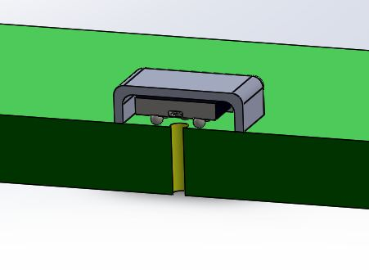
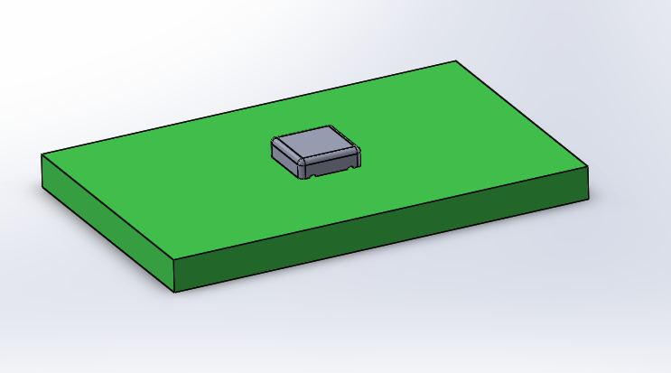
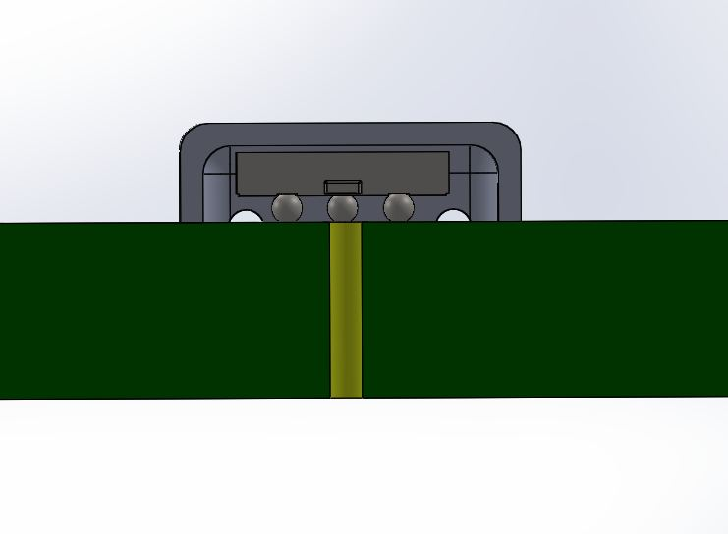
Illustration
Cross Section View
Top View
Shield
Sensor
Gold plated Via

Slide 4
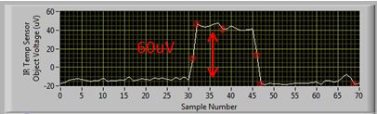
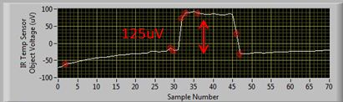
Performance
Unshielded
Shielded Thur-Hole
Human hand introduced ~1” from device

Slide 5
TMP006/007 Thru-hole Benefits
Improved signal
Lower noise
Improved signal-to-noise ratio (SNR)
Resistance to undesired air flow effects
FOV Restriction

