Slide 1
DRV425 – Noise Analysis
Javier Contreras

Slide 2
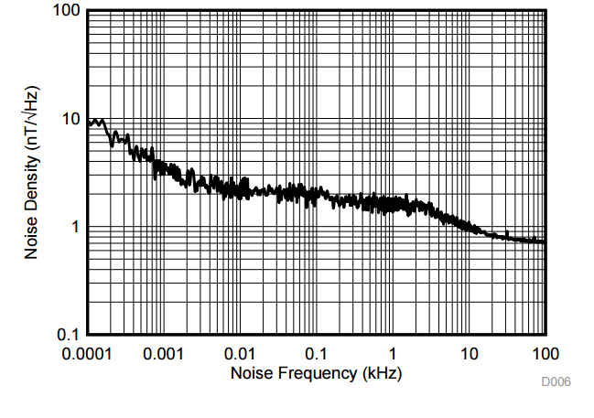
DRV425 Output Noise
The output noise of the DRV425 can be calculated from its noise density curve on page 8 of the datasheet

Slide 3
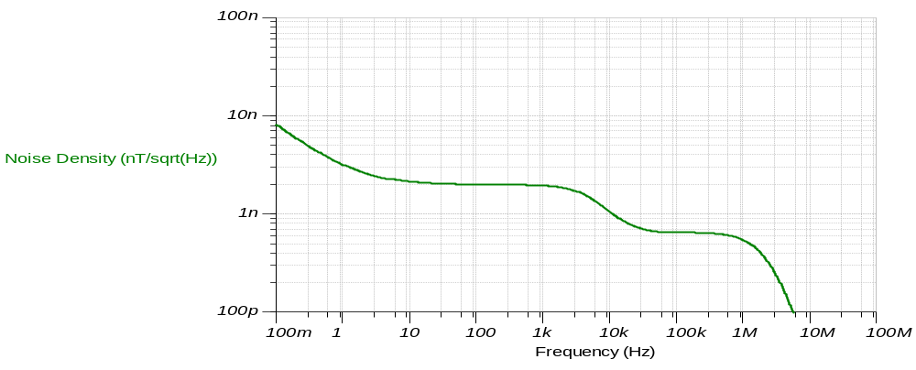
DRV425 Output RMS Noise Estimation
Step 1: Noise density curve derived from TINA (closely matches data sheet curve)

Slide 4
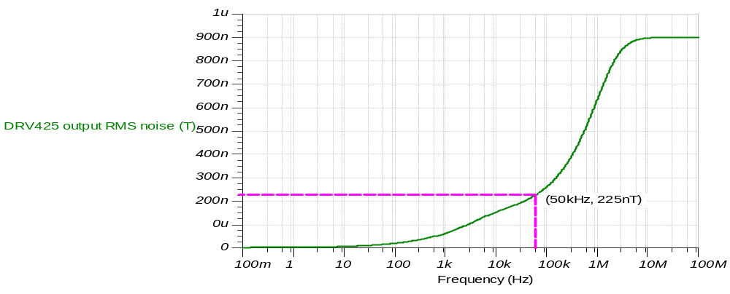

DRV425 Output RMS Noise Estimation (cont.)
Step 2: Integrate noise density over required BW
DRV425 RMS noise at 47kHz ~= 225nT
  peak-to-peak noise (Gaussian):
  6.6 x RMS noise = 1.485uT
Output peak-to-peak noise is 0.041% of full-scale (±1.8mT)

Slide 5
DRV425 Output RMS Noise Lab Results and Conclusion
Tested ADS1278EVM board and hardware in “Zero” Gauss Chamber
Results:
  660uV p-p
  1.352uT p-p = 0.033% (full scale)
  Closely matches 0.041% value
  from simulation
Conclusion:
The DRV425 noise can be reduced by limiting the bandwidth through filtering or averaging.

Slide 6
Thank You

