Slide 1
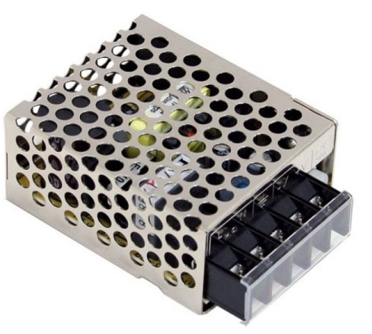
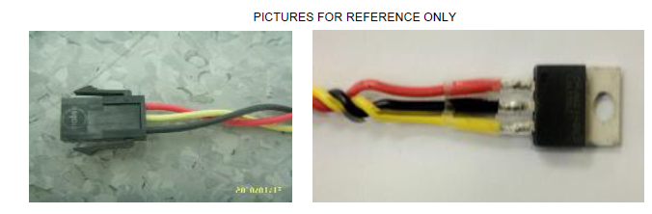
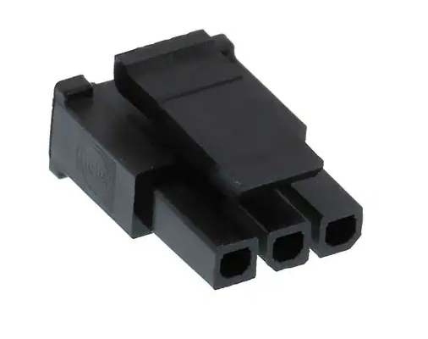
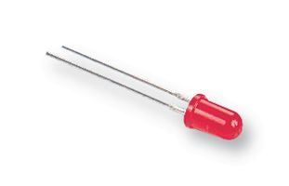
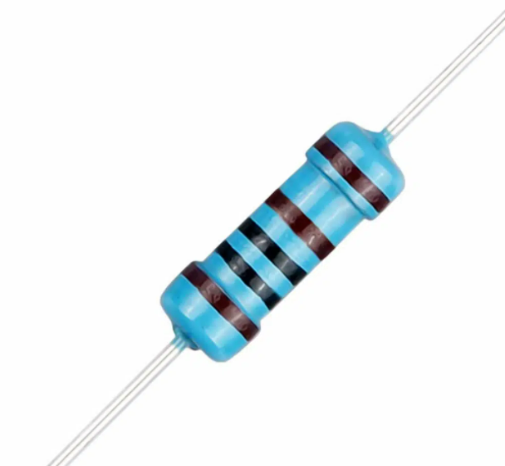
A03021 test jig diagram reference
Molex 43645-0300
May remove the lock
+5V
GND
Mating
DC/DC power supply +5V
Measurement
analysis
ADC
Current failure mode: Faulty part presents 4.3V-5V output.
From datasheet, the chip can afford 10mA load,
need to verify whether the faulty chip can provide at least 5 mA.
When Led is lighting, it means the chip output faulty.
That coves current failure mode.
If you want more reliable jig, may need a data acquisition system.
600 ohms -1k ohms
Test jig
GND

Slide 2
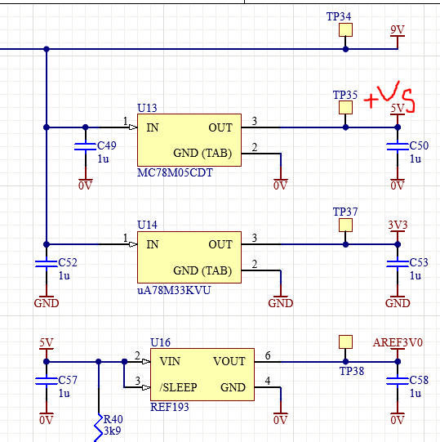
VS power supply side

Slide 3
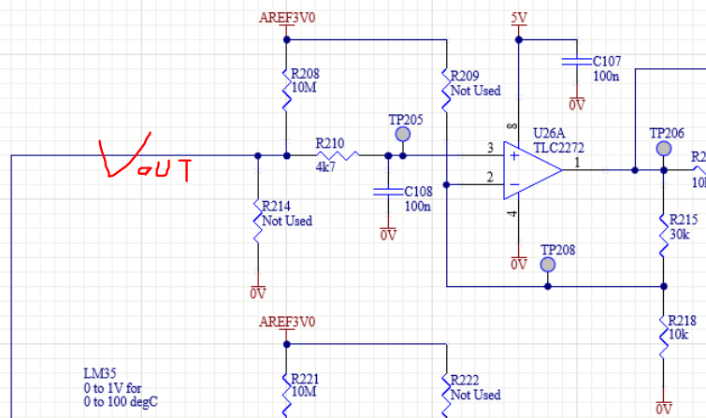
temp input conditioning circuit

