Slide 1
CCS Debug for IWRL6432

Slide 2
Launch .ccxml Configuration

Slide 3
Connect to Cortex_M4

Slide 4
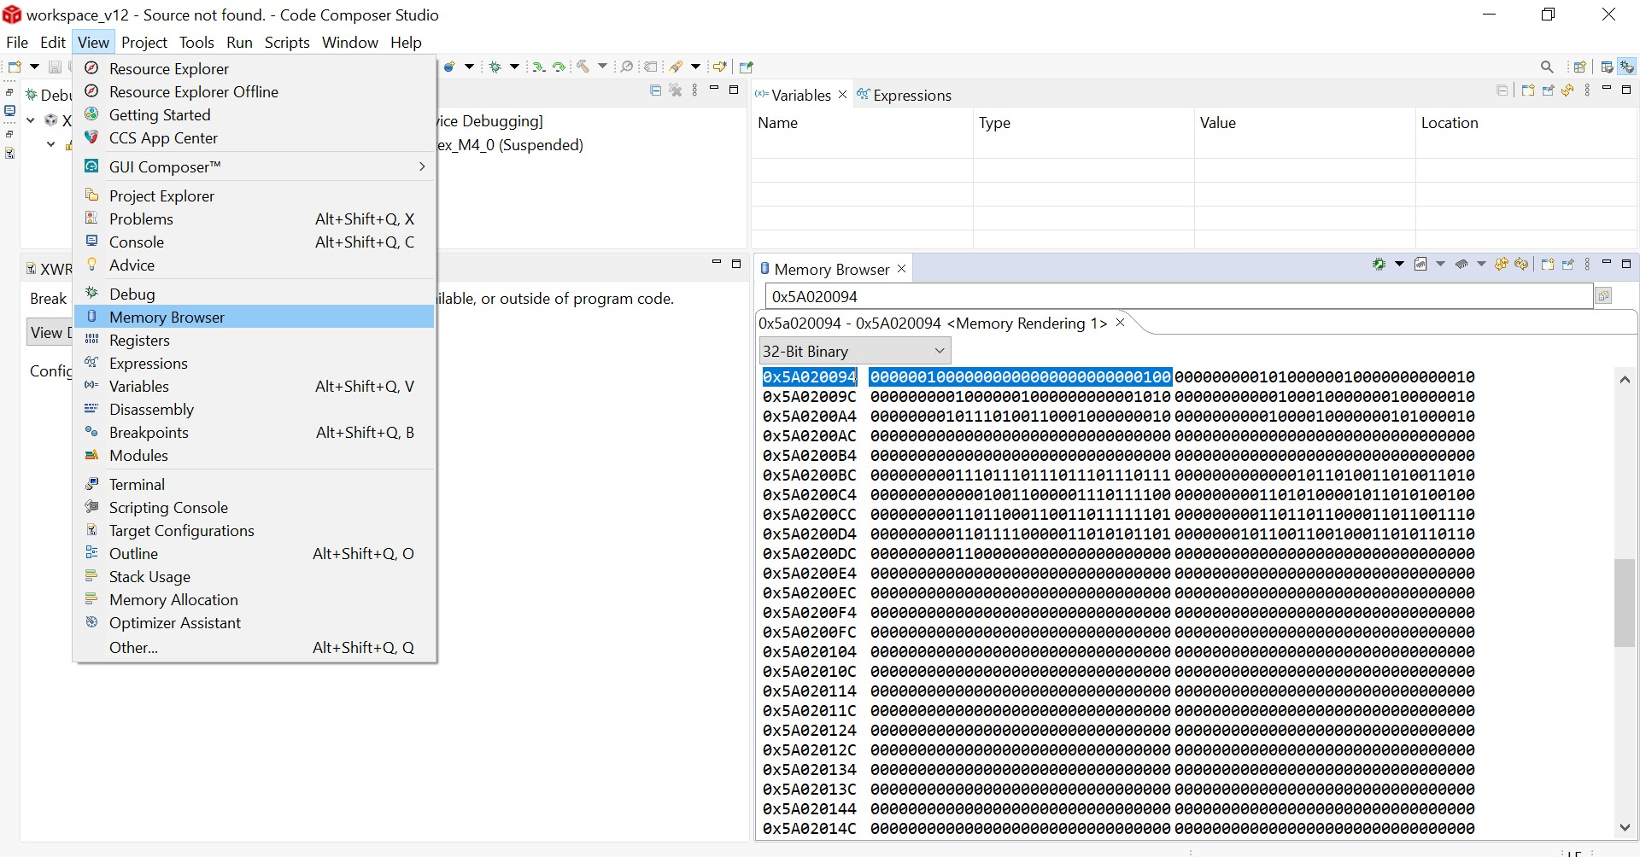
Read Register Address through Memory Browser
In CCS go to View Tab in the and open the Memory Browser.
Enter the Register address to read the contents of register.

