Slide 1
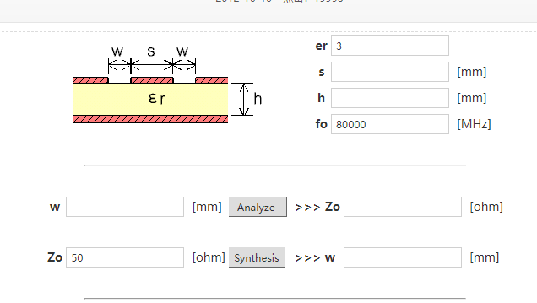
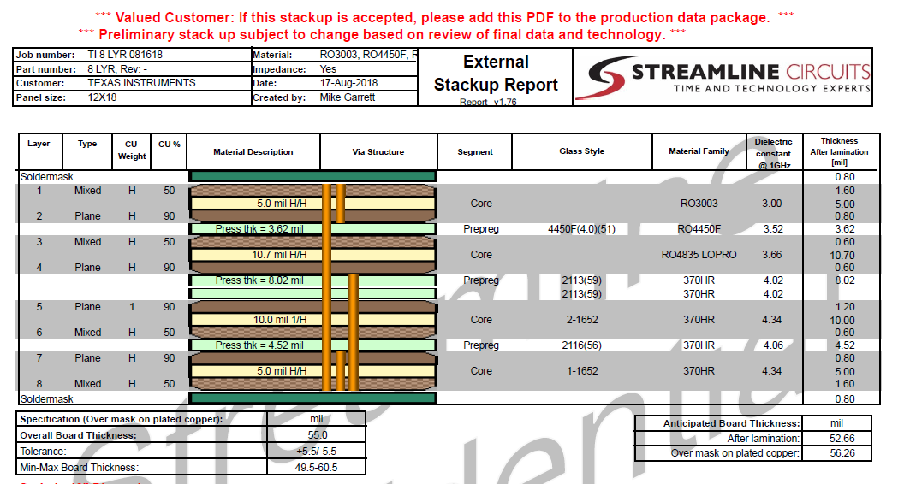
Could you help me fill in the blanks as below? I want to make sure my idea is correct? Thank you.
What value should be fill
when we using stack as picture?

Slide 2
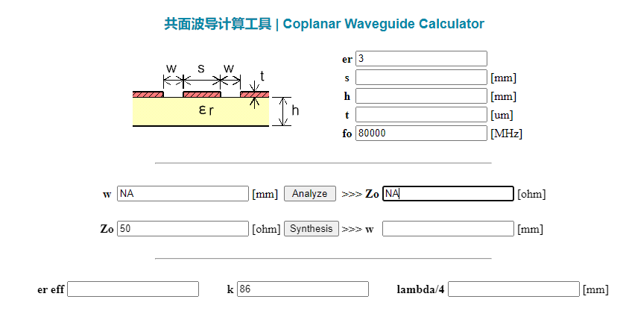
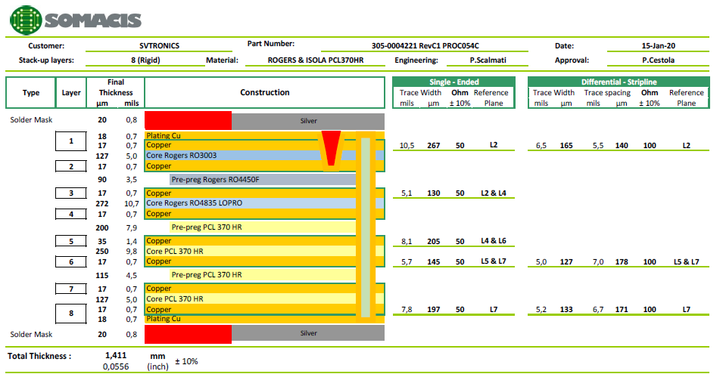
Could you help me fill in the blanks as below? I want to make sure my idea is correct? Thank you.
What value should be fill
when we using stack as picture?

