Slide 1
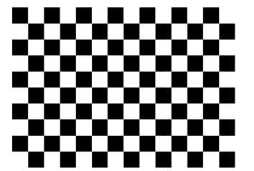
7 black squares
5 black squares

Slide 2
7 black squares
6 black squares

