Slide 1
Create CCS Debug Session Steps

Slide 2
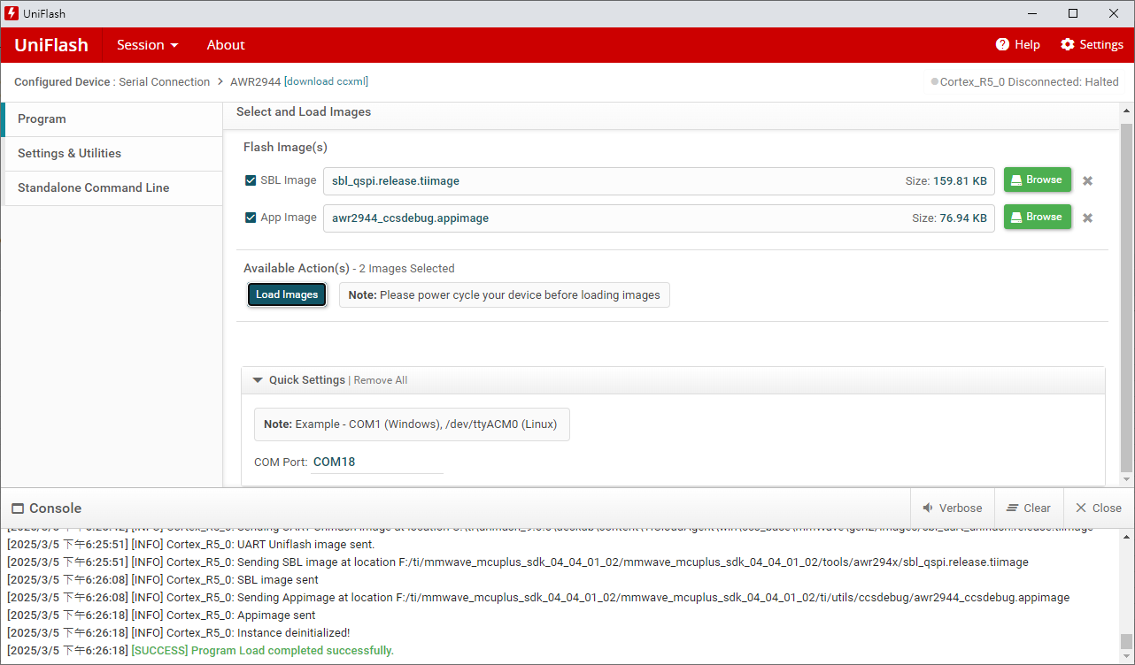
Flash CCS debug image

Slide 3
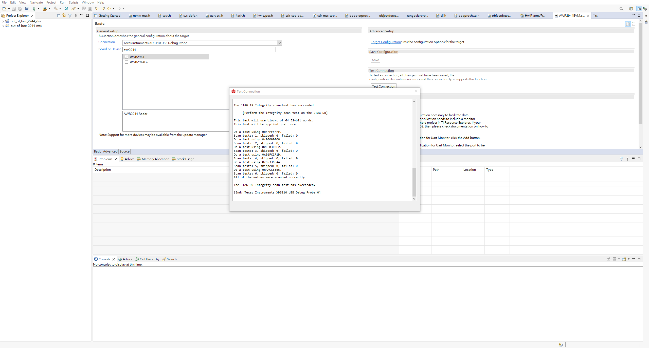
Create target configuration file for AWR2944 and run Test Connection (The result is successful)

Slide 4
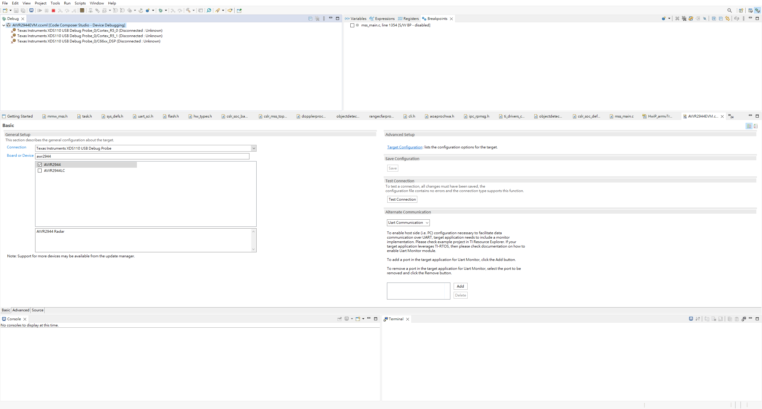
Launch the AWR2944 target configuration

Slide 5
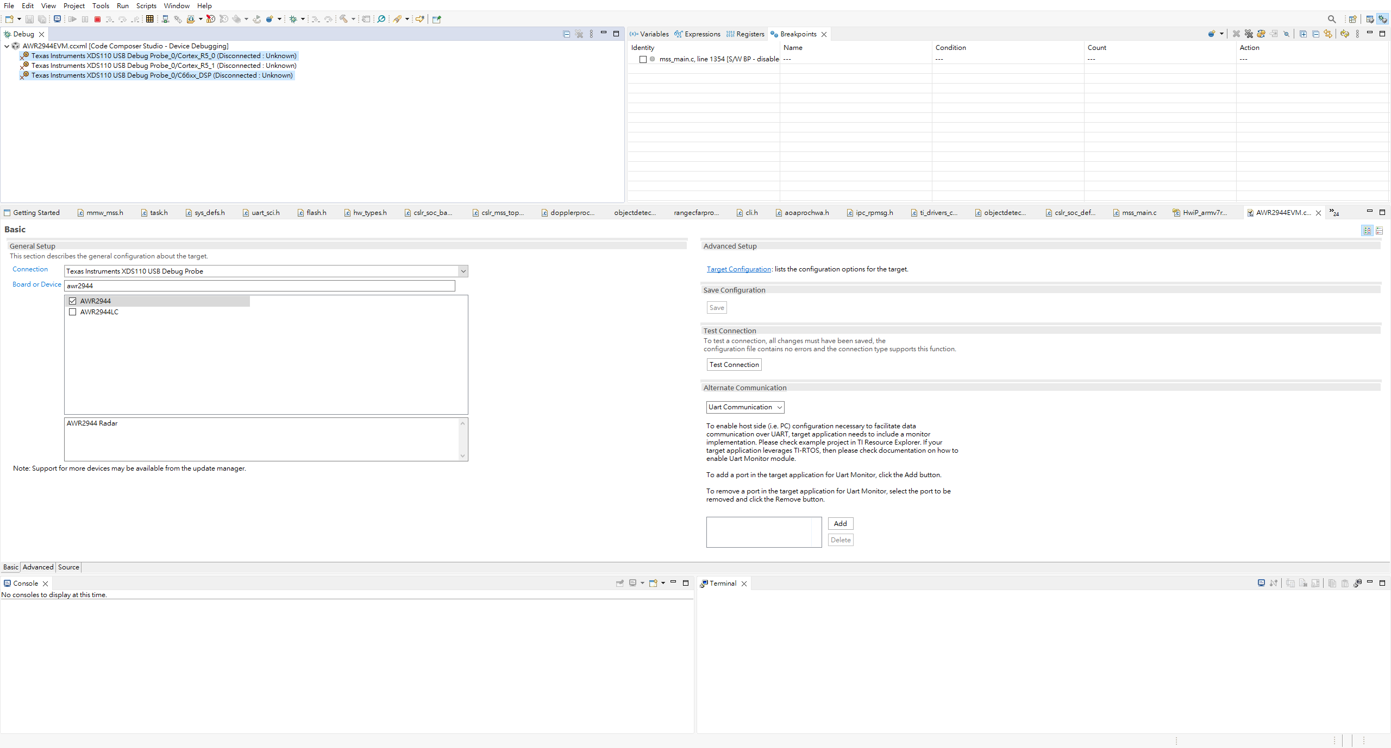
Group Cortex_R5_0 and C66xx_DSP

Slide 6
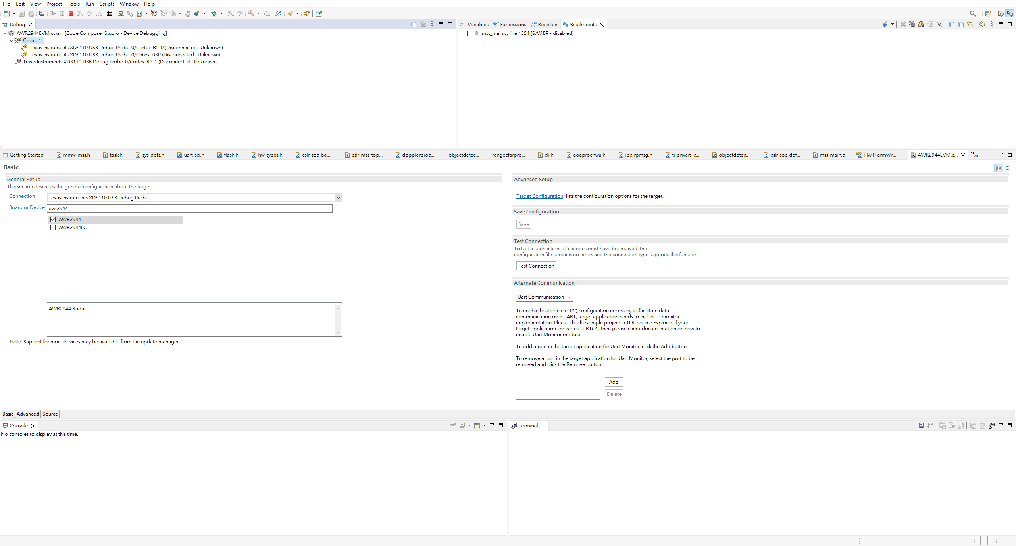
Connect target to Group 1

Slide 7
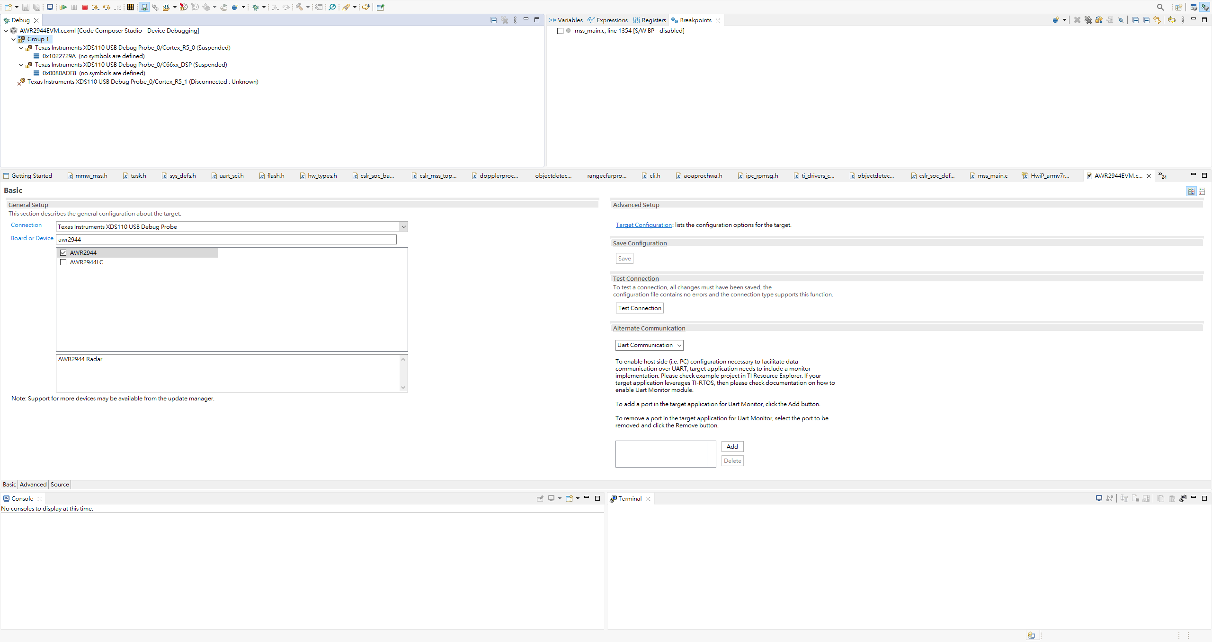
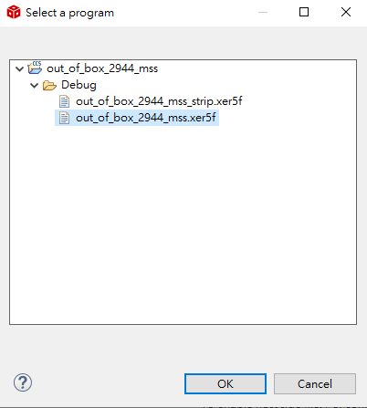
Load program from MSS project and select this file out_of_box_2944_mss.xer5f

Slide 8
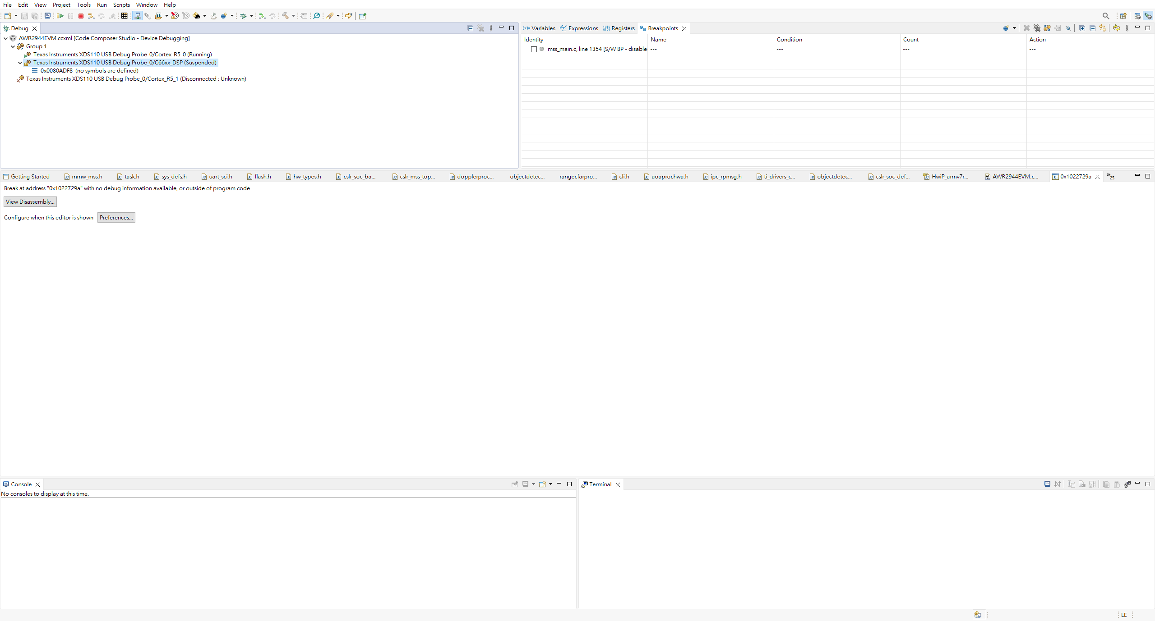
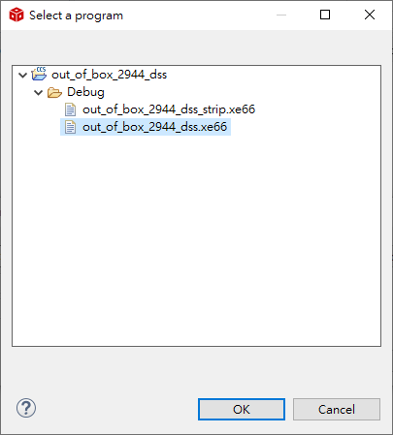
Load program from DSS project and select this file out_of_box_2944_dss.xe66

Slide 9
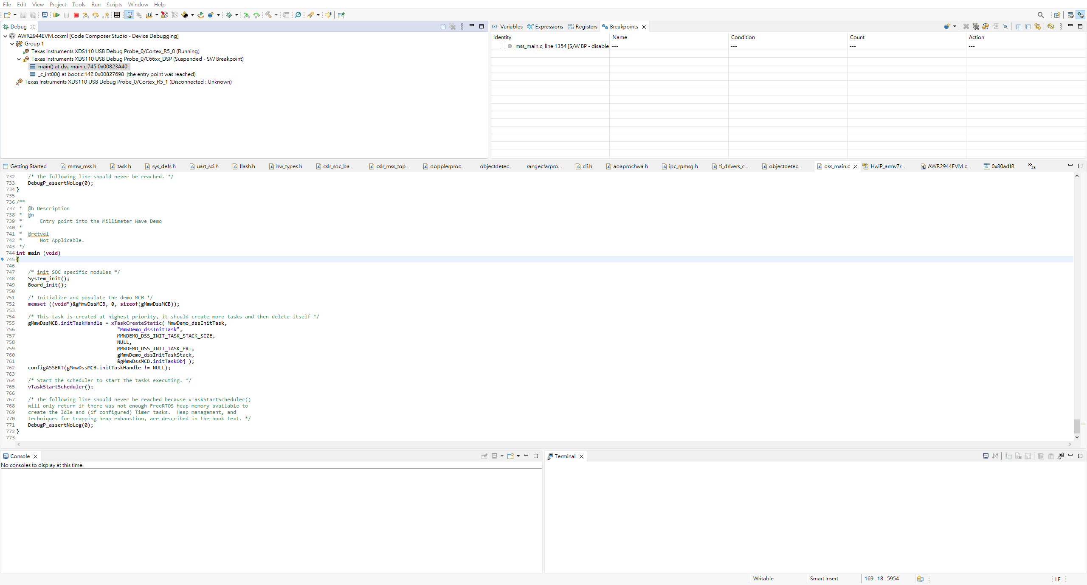
Press resume button to continue the debug session

Slide 10
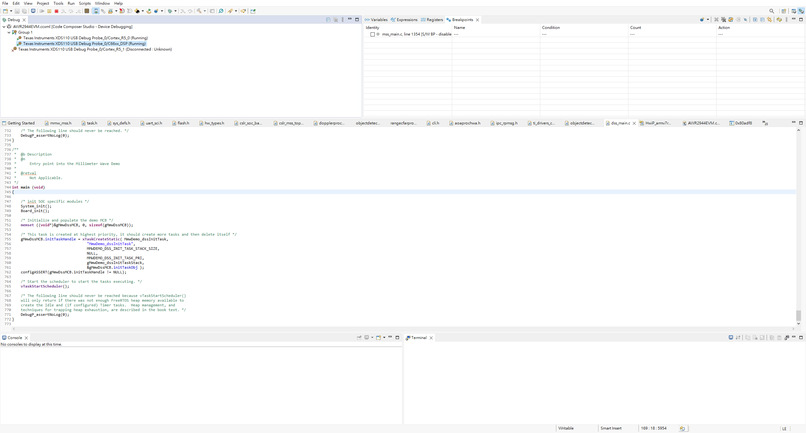
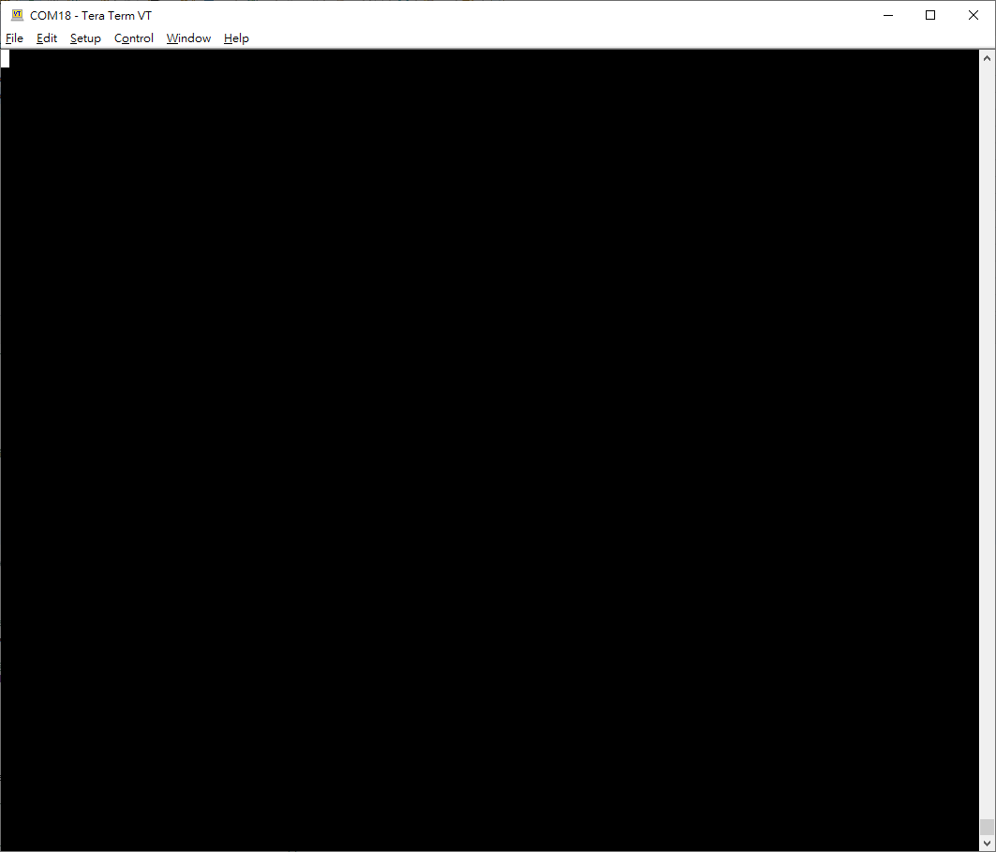
Open command UART port via teraterm, it’s no response. Can’t input any radar config.

