Slide 1
Gtrack lib rebuild issue
Version: mmwave_sdk_03_06_00_00-LTS

Slide 2
1-Add state & set value => crash

Slide 3
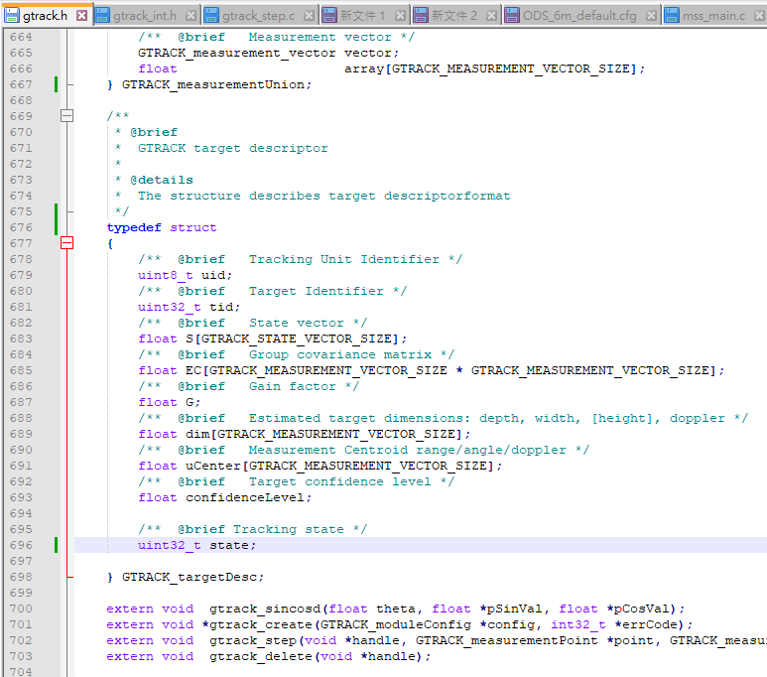
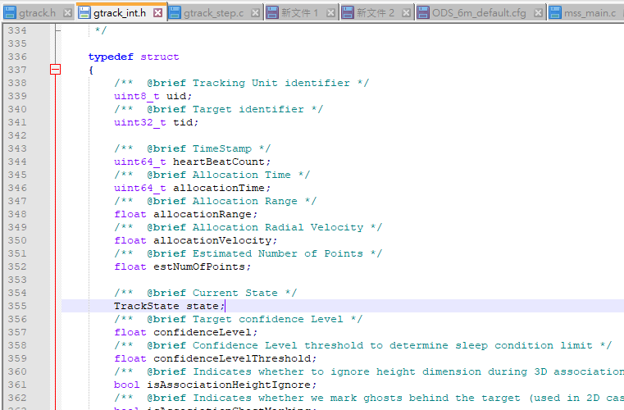
Add this for receive state

Slide 4
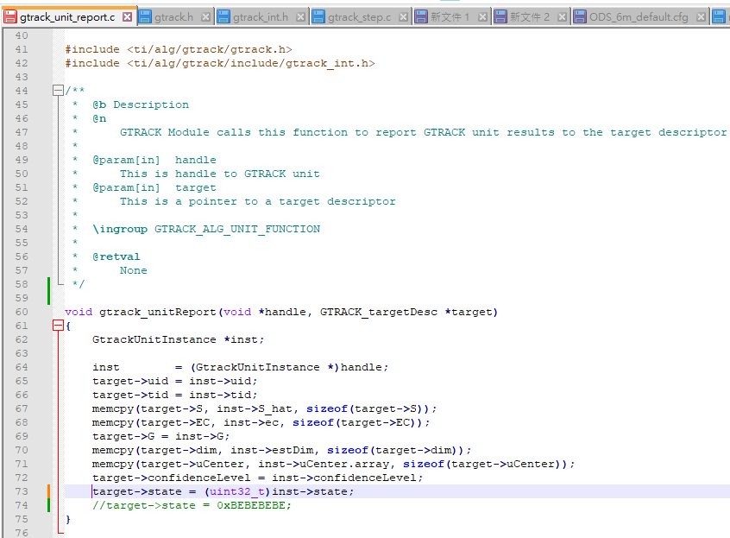

Slide 5
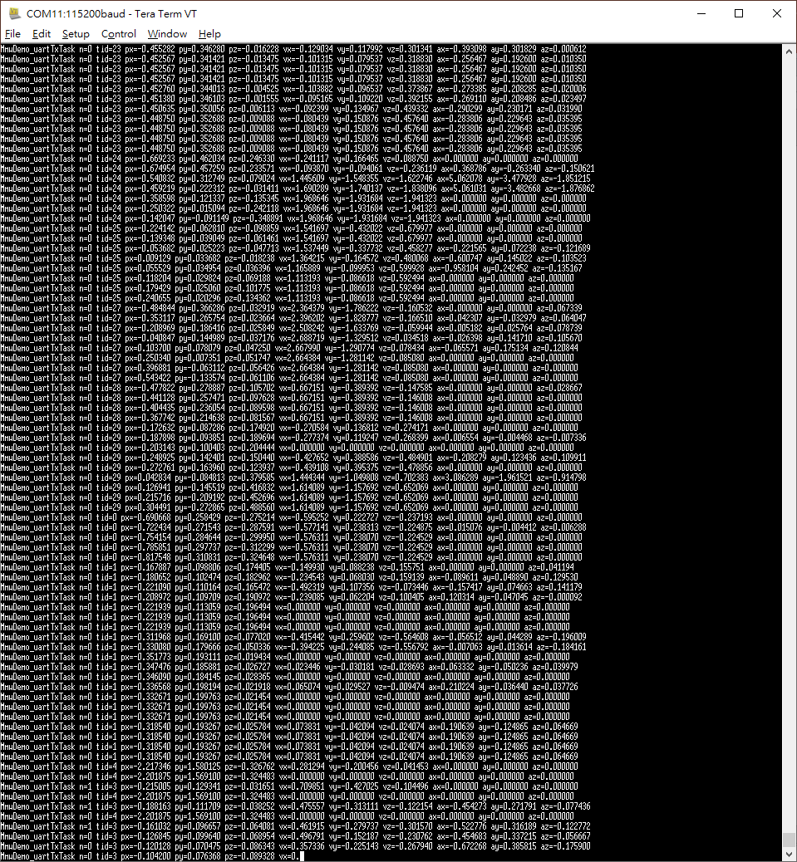
Will occurs crash

Slide 6
2- Add state but no set value => working well

Slide 7
Add this for receive state

Slide 8
