Slide 1
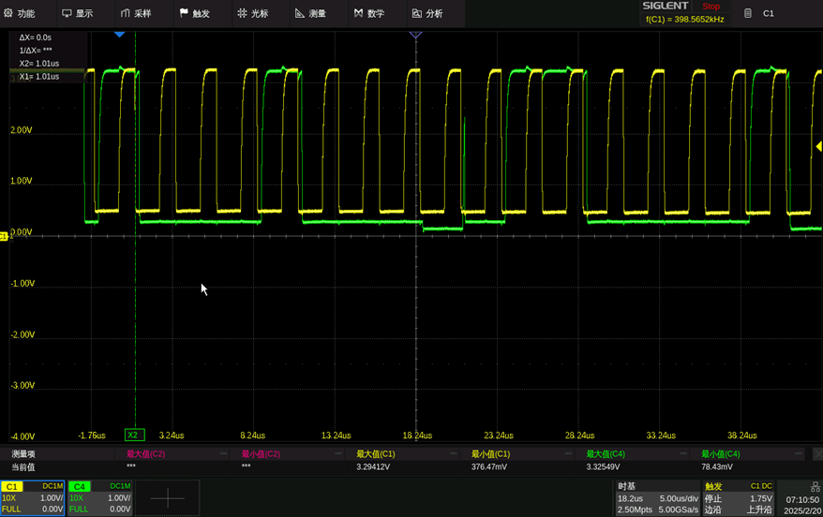
Set High Alert 80% RH 60degree address：0x611D value：0xCD33 CRC：0xFD
S
1
0
0
0
1
0
0
W
A
0
1
0
1
0
0
0
1
A
0x44 W 0x61

Slide 2
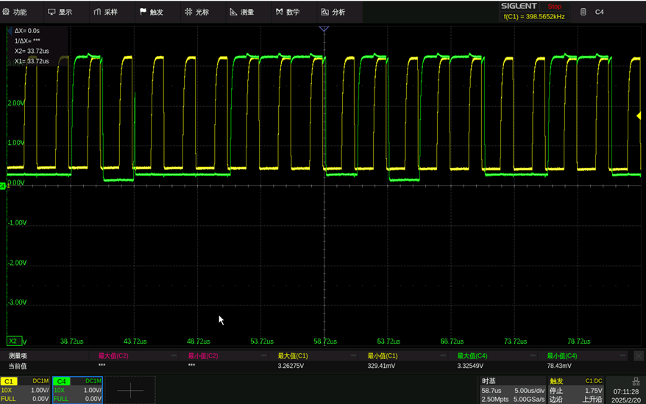
0
0
1
A
0
0
0
1
1
1
0
1
A
1
1
0
0
1
1
0
0x1D CD

Slide 3
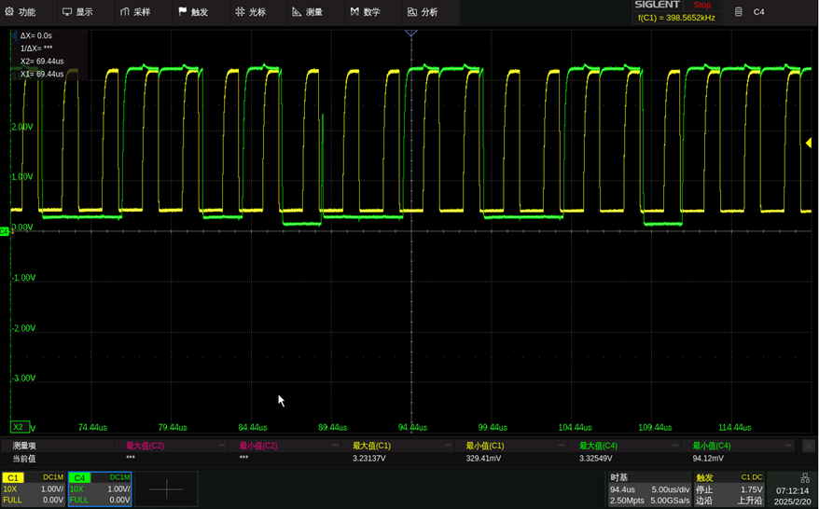
1
0
0
1
1
0
1
A
0
0
1
1
0
0
1
1
A
1
1
1
0xCD 33

Slide 4
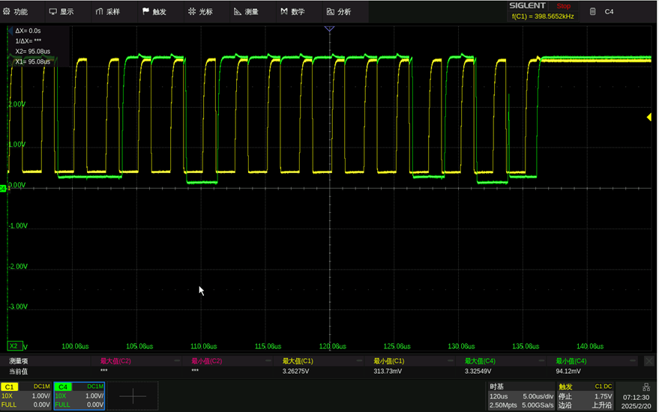
1
1
0
0
1
1
A
1
1
1
1
1
1
0
1
A
Stop
0x33 FD

Slide 5
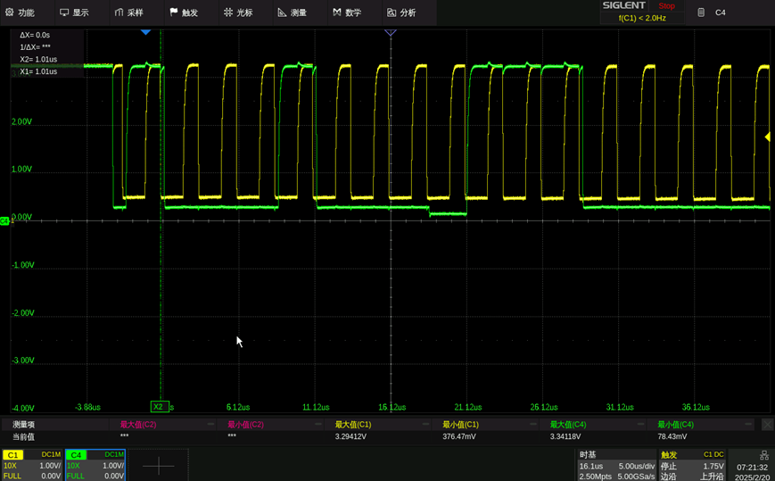
Set Configure Heater Current Full Power address：0x306E value：0x3FFF CRC：0x06
S
1
0
0
0
1
0
0
W
A
1
1
1
0
0
0
0
0
0x44W 0xE0

Slide 6
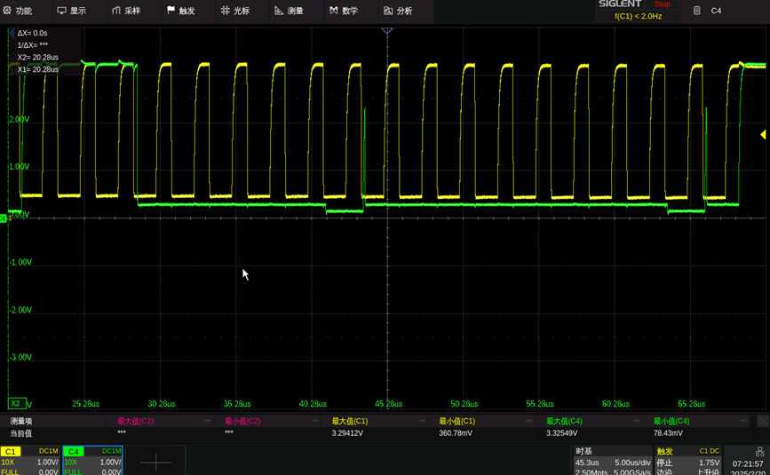
1
1
1
0
0
0
0
0
A
0
0
0
0
0
0
0
0
A
Stop
0xE0 00

Slide 7
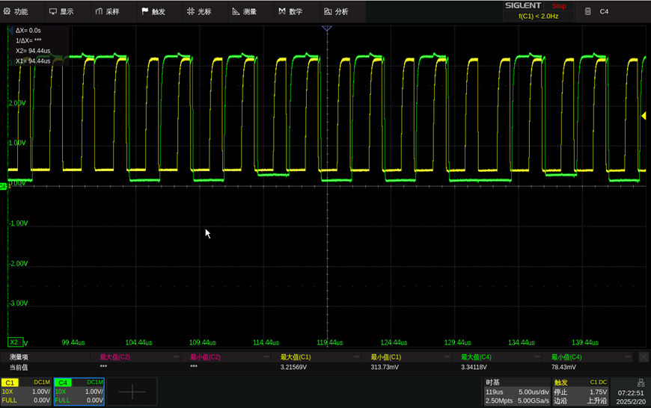
0
1
1
1
0
1
0
1
A
1
0
1
0
1
0
0
1
A
1
0
0x75 A9

Slide 8
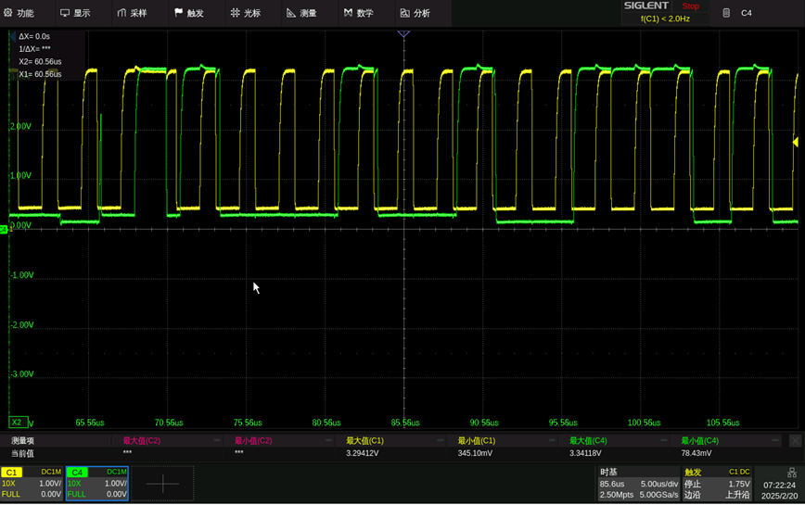
0
A
0
Stop/Start
1
0
0
0
1
0
0
R
0
0
1
1
1
1
0x44R

Slide 9
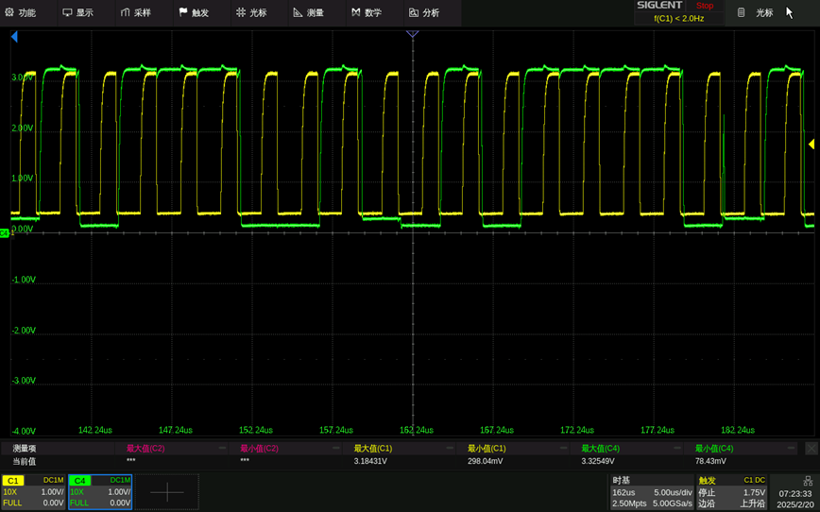
A
1
0
1
1
1
0
0
1
A
0
1
0
1
1
1
1
0
A
1
0xB9 5E

Slide 10
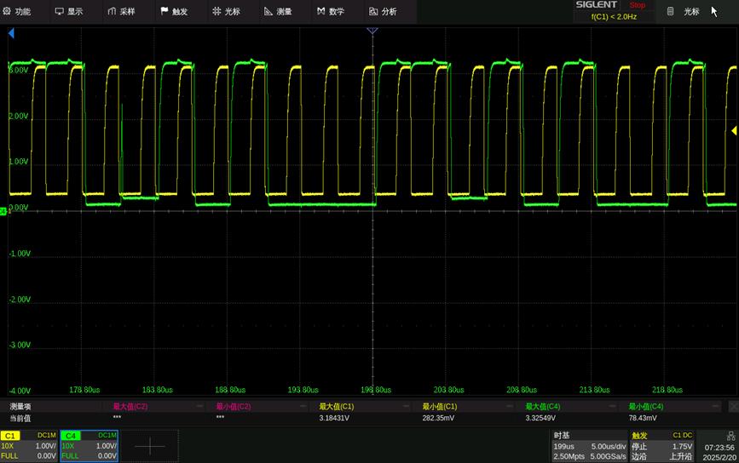
1
1
0
A
1
0
1
0
0
0
1
1
A
1
0
1
0
0
1
0
0xA3 A4

Slide 11
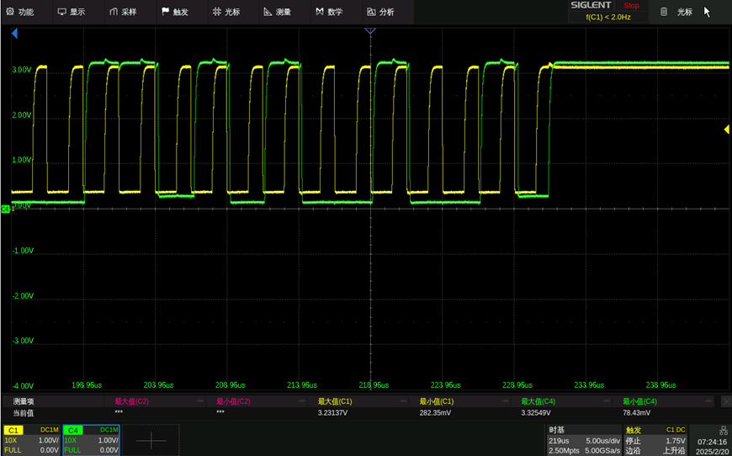
0
0
1
1
A
1
0
1
0
0
1
0
0
NA
Stop
0xA4

