Slide 1
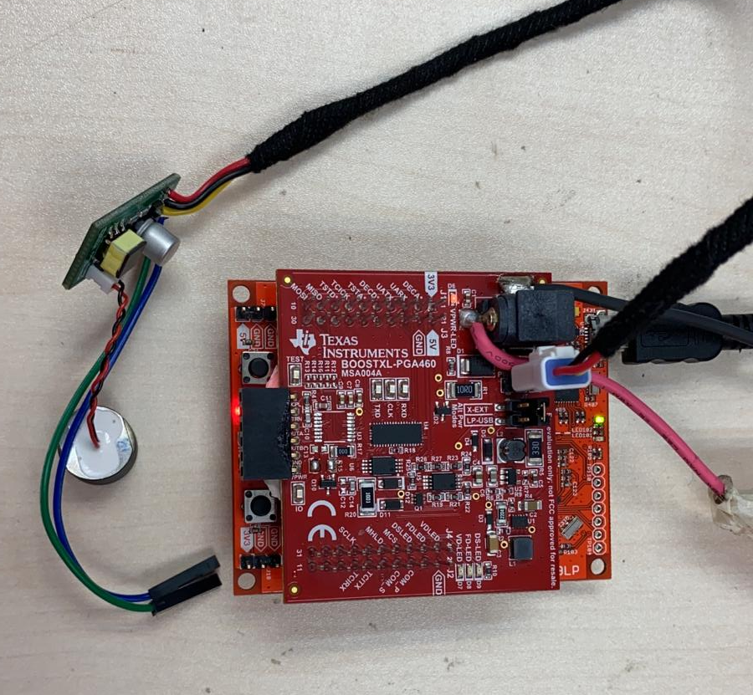
IO-Pin Interface Toggle - Experiment setup
Removed onboard pga460 to ensure communicate with external pga460
PGA460
Development board

Slide 2
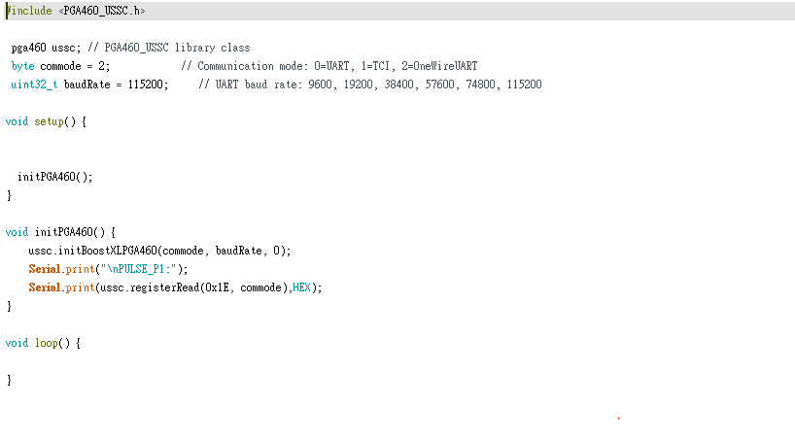
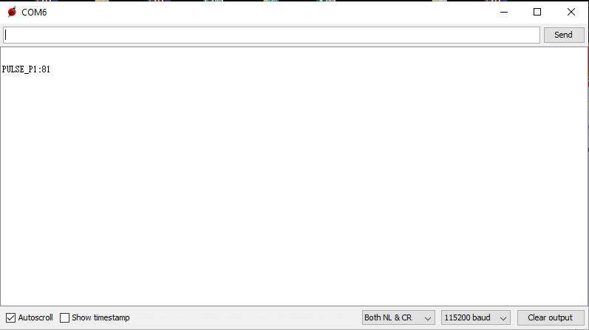
IO-Pin Interface Toggle – Read register in OWU mode
Read 0x1E register through custom program to confirm the IO_IF_SEL bit is set to 1 and using serial print function
to print out the result
Energia custom coding
Result in Energia serial monitor

Slide 3
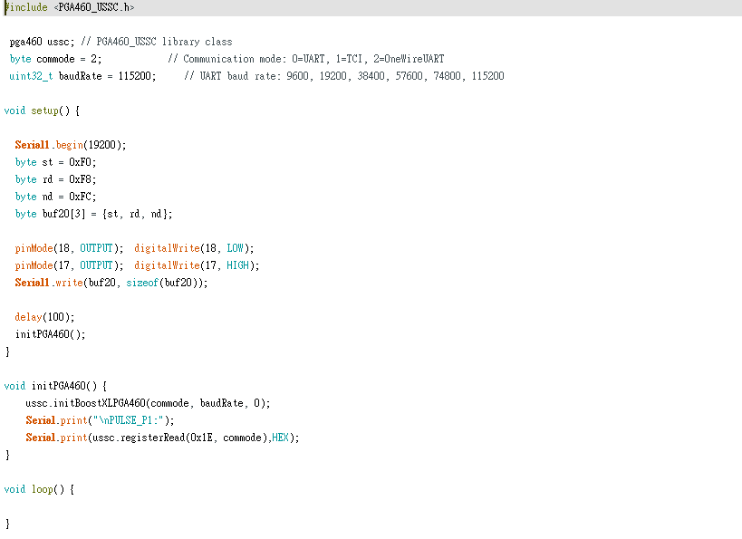
IO-Pin Interface Toggle – OWU to TCI by sending 0xF0F8FC (Coding)
The coding for send 0xF0F8FC using Serial1 (pin 4) is shown below.

Slide 4
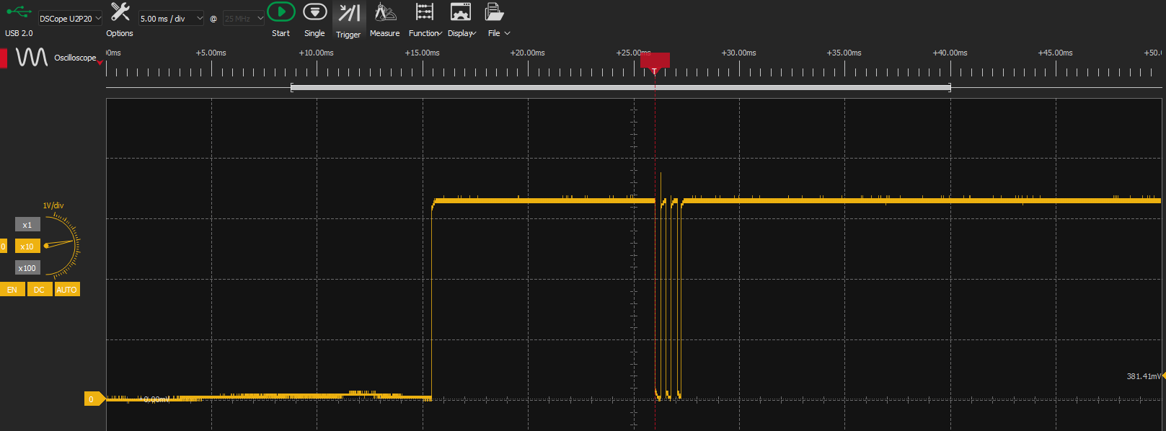
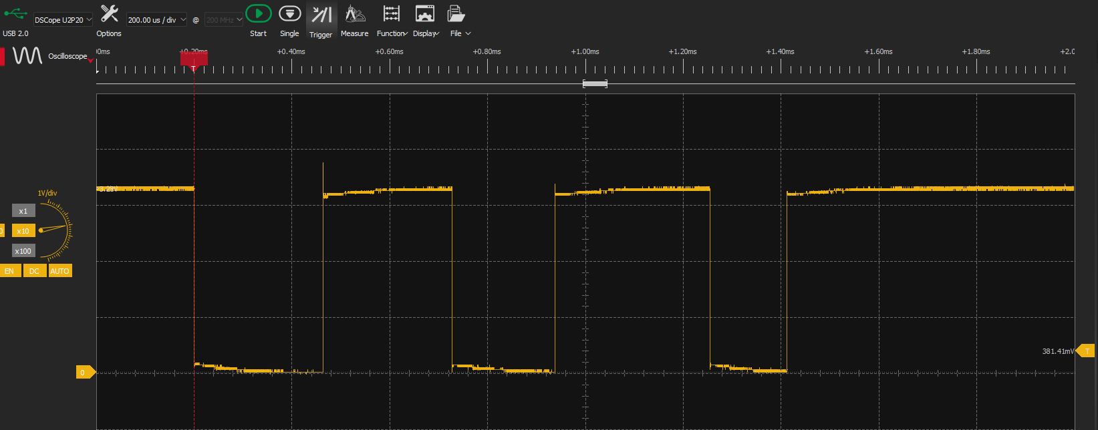
IO-Pin Interface Toggle – OWU to TCI by sending 0xF0F8FC (Waveform)
Checked with Serial1 (pin 4) signal output oscilloscope (Send 0xF0F8FC), the waveform is shown below.
262us
318us
262us
209us
157us

Slide 5
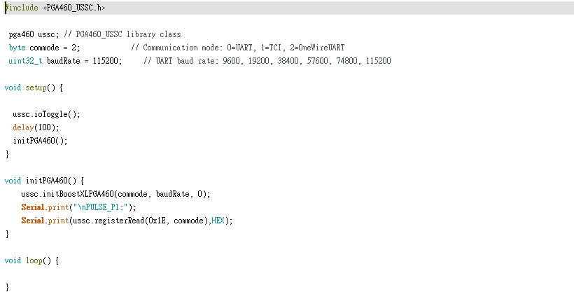
IO-Pin Interface Toggle – OWU to TCI by sending Time-Based pattern(Coding)
The coding for send time-based pattern using pin 4 is shown below.

Slide 6
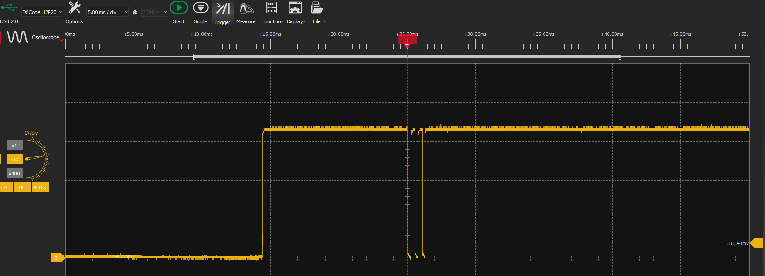
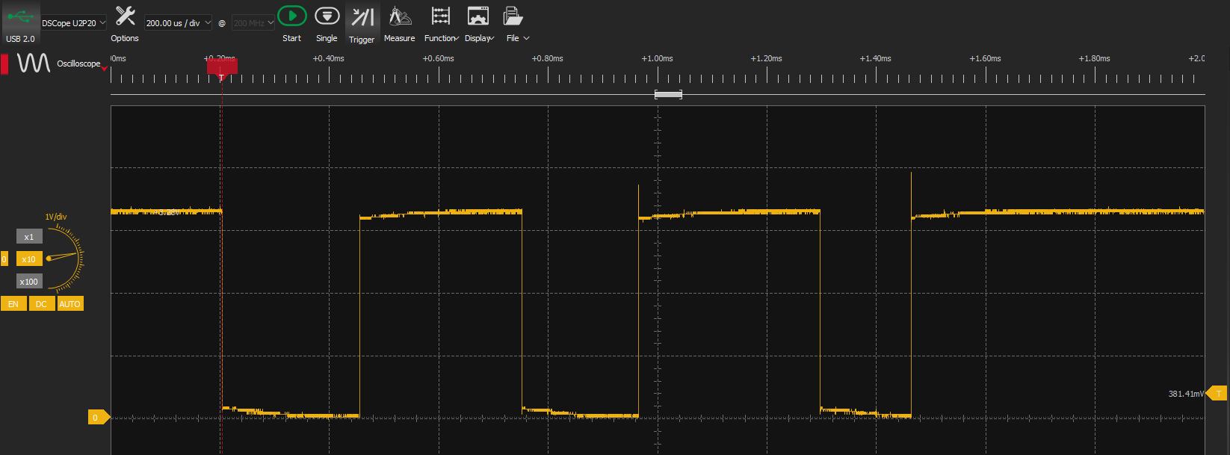
IO-Pin Interface Toggle – OWU to TCI by sending Time-Based pattern (Waveform)
Checked with pin 4 signal output using oscilloscope (Send time-based pattern), the waveform is shown below.
299us
331us
252us
211us
166us

Slide 7
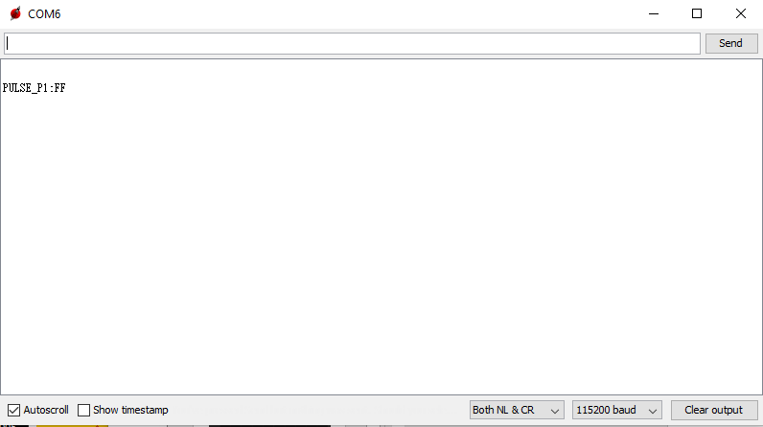
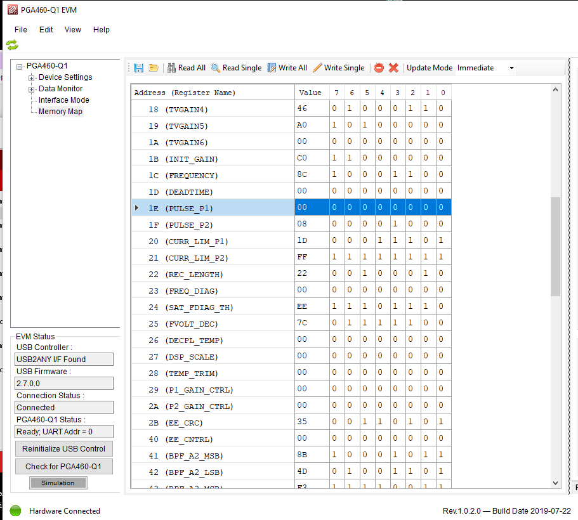
IO-Pin Interface Toggle – OWU to TCI (Result)
Checked the IO_IF_SEL bit with GUI and serial monitor (Custom program) and the result is shown below
The result is show FF, the pga460 IO_IF_SEL bit should already change to 0
Use GUI to double check to IO_IF_SEL bit, it can the bit from 1 to 0 by sending 0XF0F8FC and time-based pattern

