Slide 1
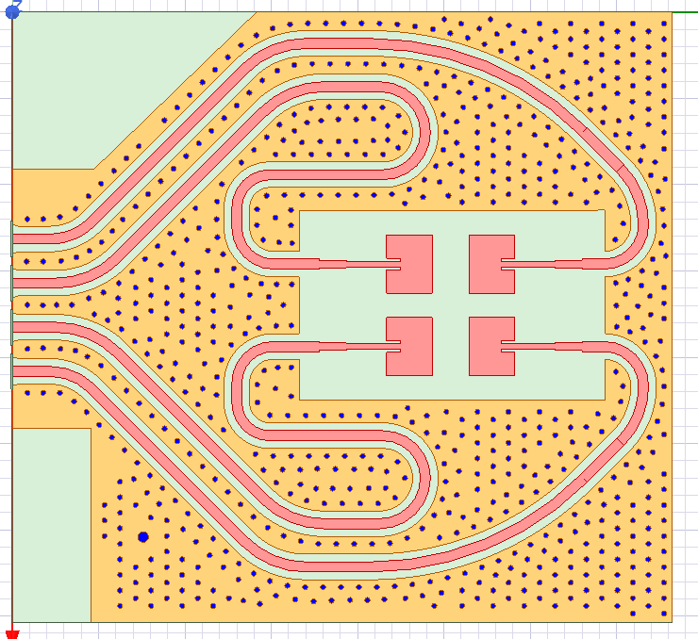
IWR6843 ODS RX antenna array: Top view of the antenna

Slide 2
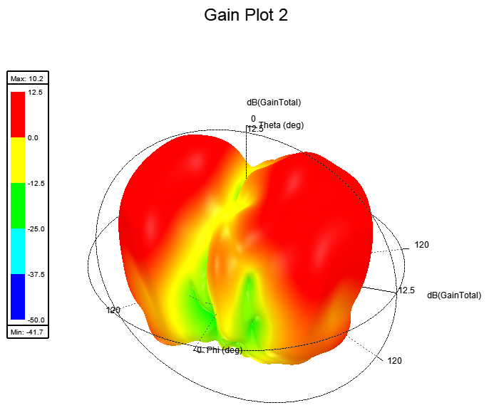
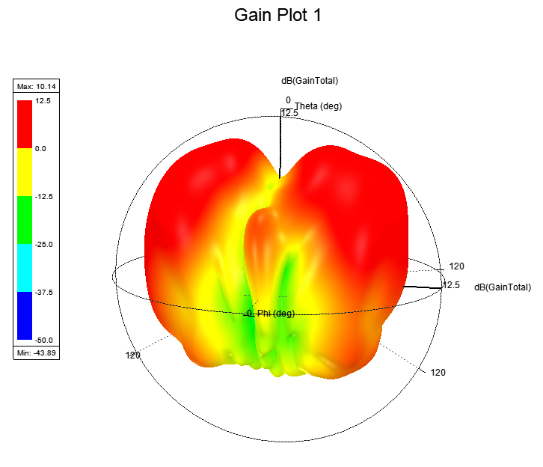
3D polar plot of Gain @ 60GHz: Gain 10.1dBi
3D polar plot of Gain @ 61GHz: Gain 10.2dBi

Slide 3
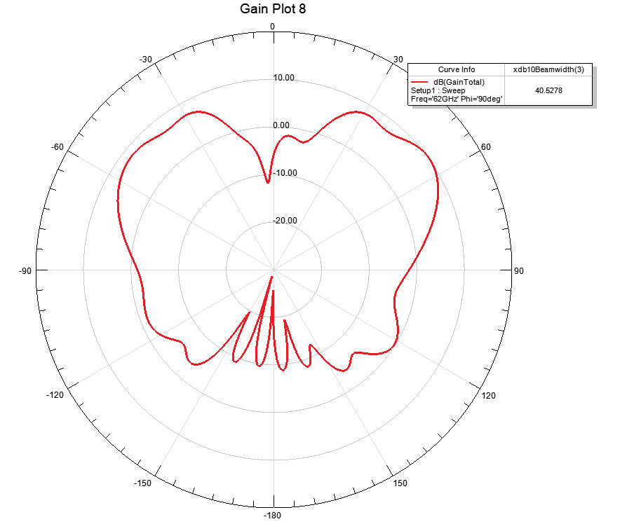
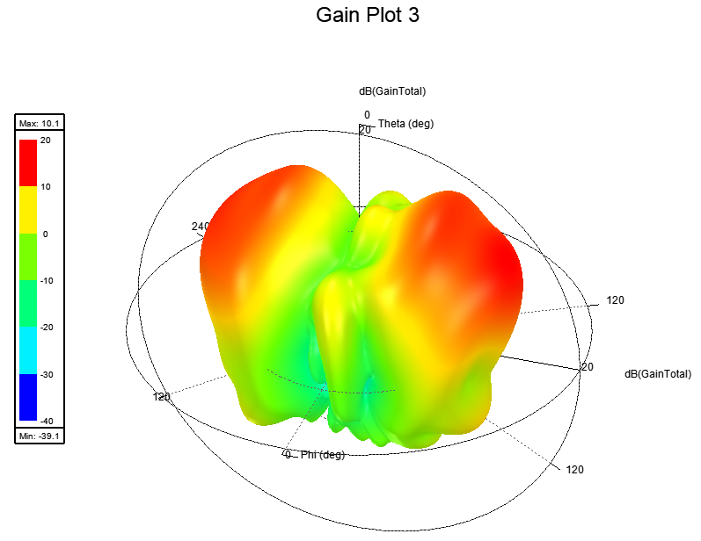
3D polar plot of Gain @ 62GHz: Gain 10.1dBi
2D Radiation plot of azimuth plane @ 62GHz:HPBW- 40 degree

Slide 4
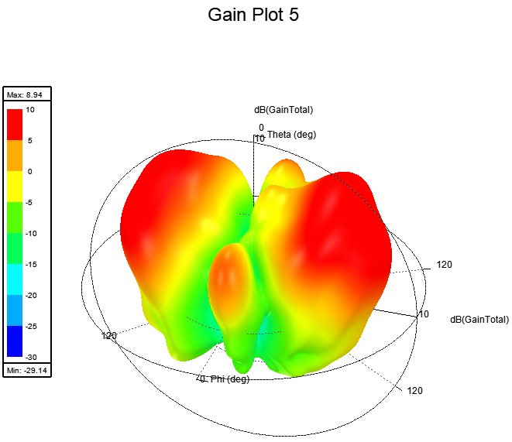
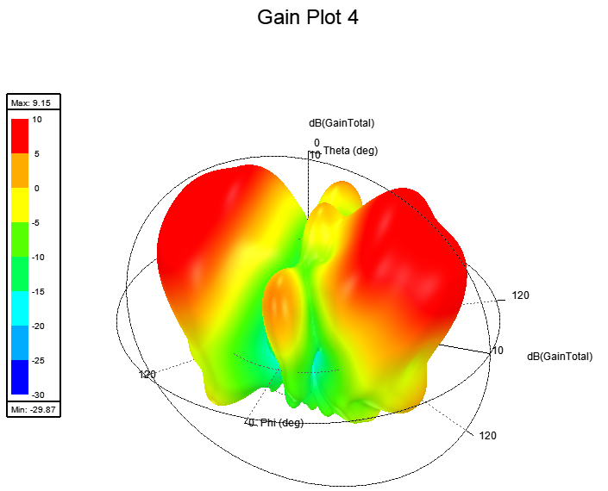
3D polar plot of Gain @ 63GHz: Gain 9.15dBi
3D polar plot of Gain @ 64GHz: Gain 9dBi

Slide 5
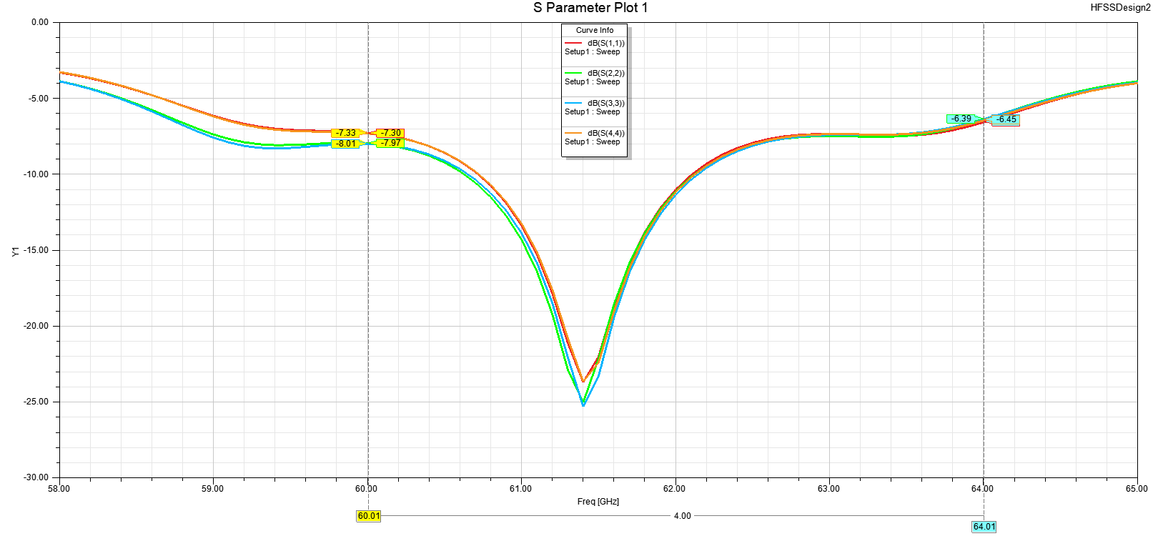
S parameter plot of all the 4 RX antennae

