Slide 1
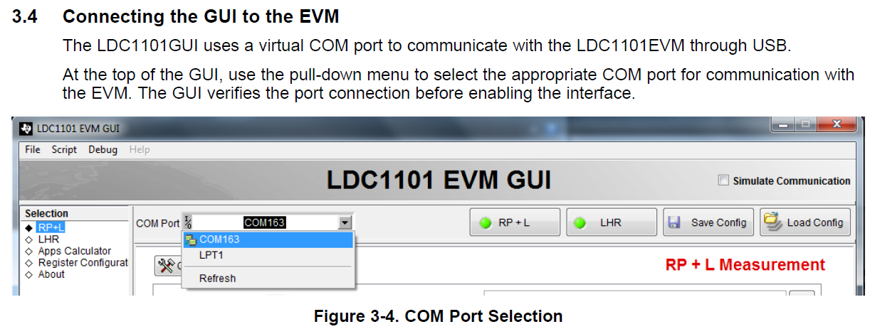
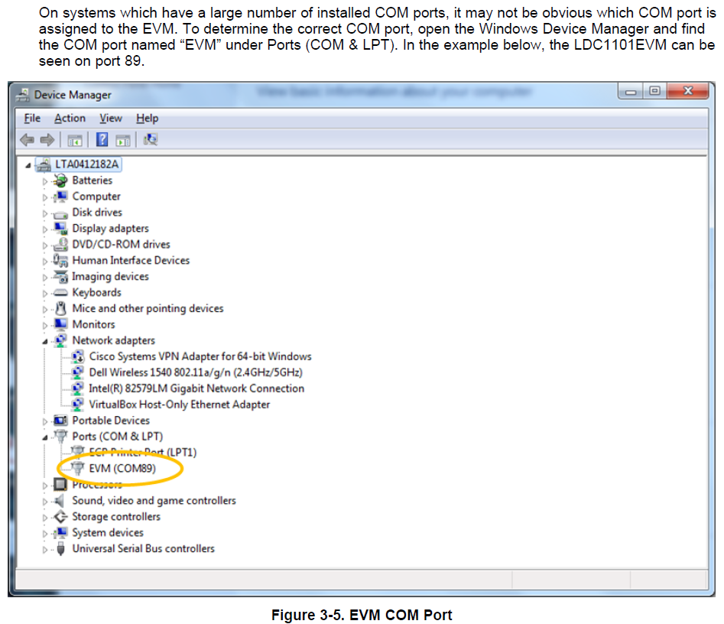
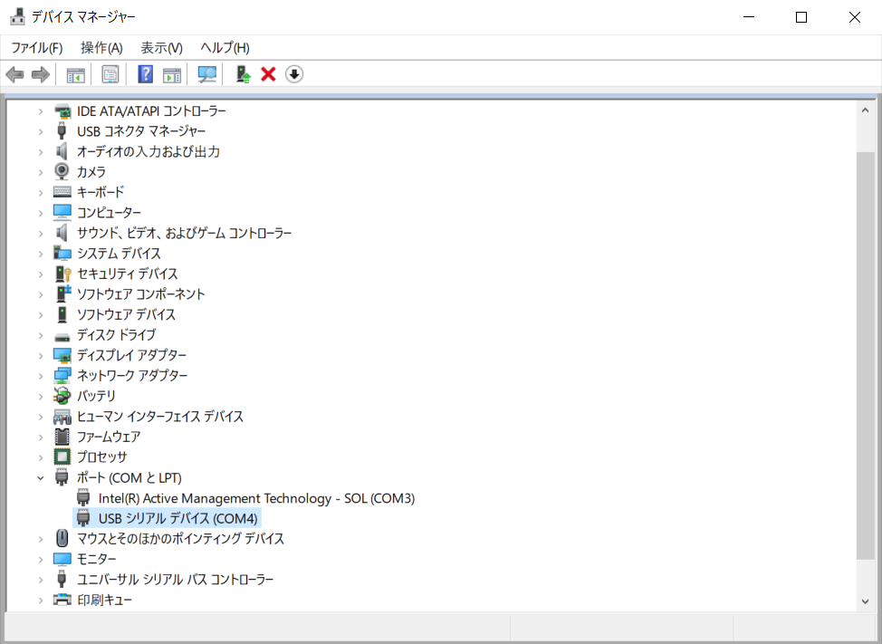
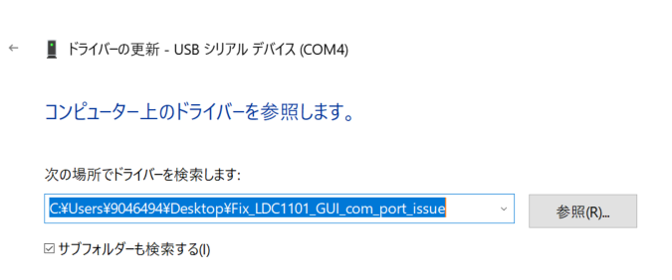
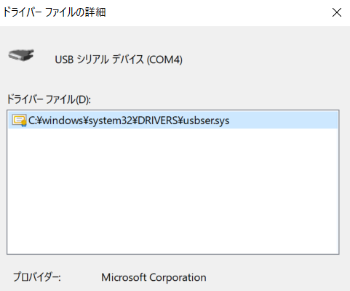
<LDC1101 EVM>USB driver cannot be installed properly * using a Windows 10 Pro PC
User's Guide
Practical results
COM Port pulldown XV (15?) Only. XV cannot be selected
No COM ports associated with the EVM
Not connected
Note: Windows settings
What you tried
It was featured in the Q&a collection on TI.com
"2541.Fix_LDC1101_GUI_com_port_issue .zip"
Download the
Update the driver manually
"Fix_LDC1101_GUI_com_port_issue"
Selected to perform an update, but it did not improve.
(While maintaining the condition described above)
USB port
EVM not shown (indicated as USB serial device)

