Slide 1
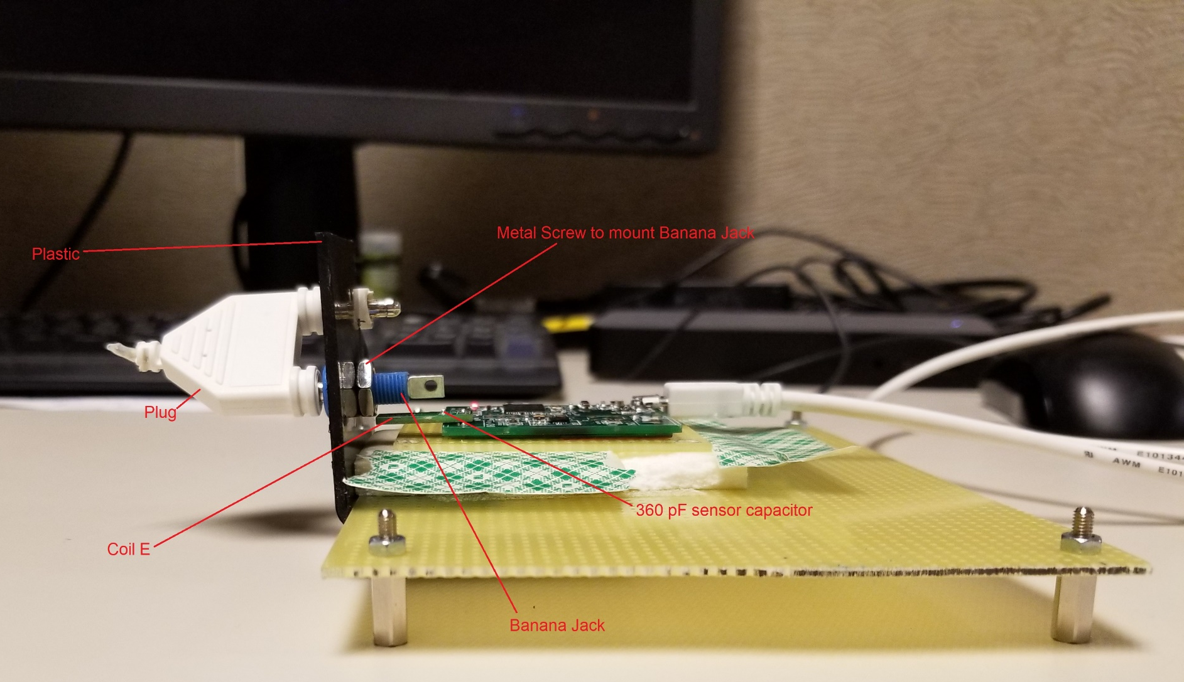
Test Fixture
LDC1612EVM
Sensor: Coil E
Sense Capacitor : 360pF
11Dec2018
Banana Jack Digikey part number J155-ND

Slide 2
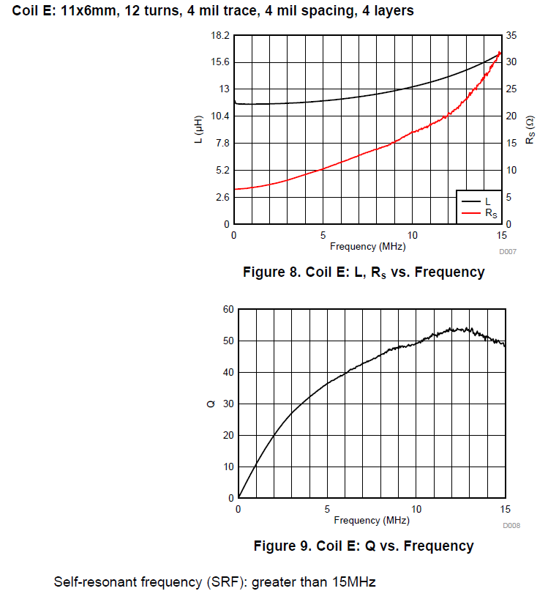
Sensor: Coil E

Slide 3
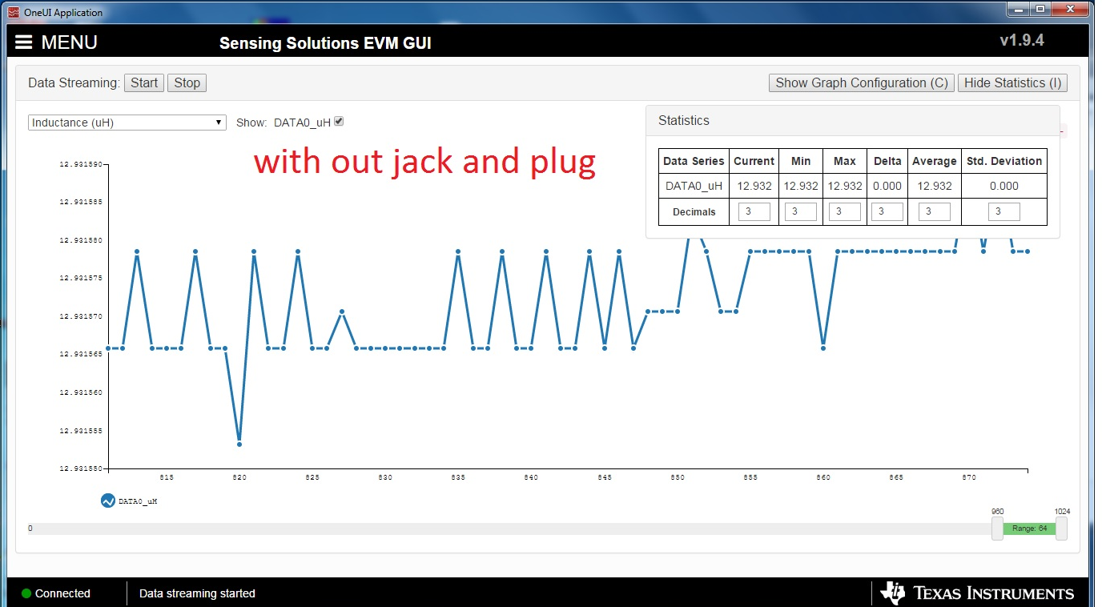
Test Result

Slide 4
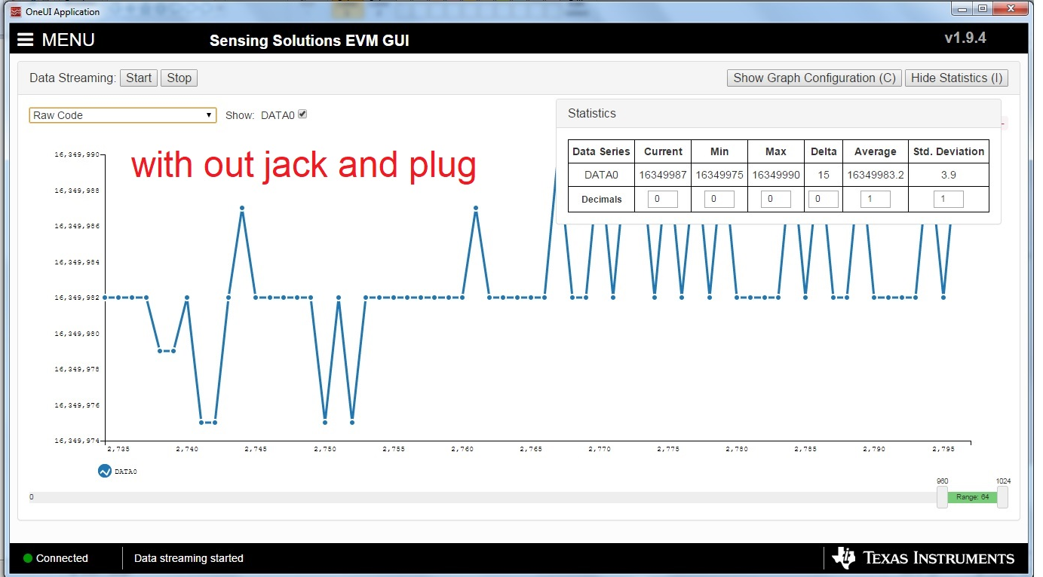
Test Result

Slide 5
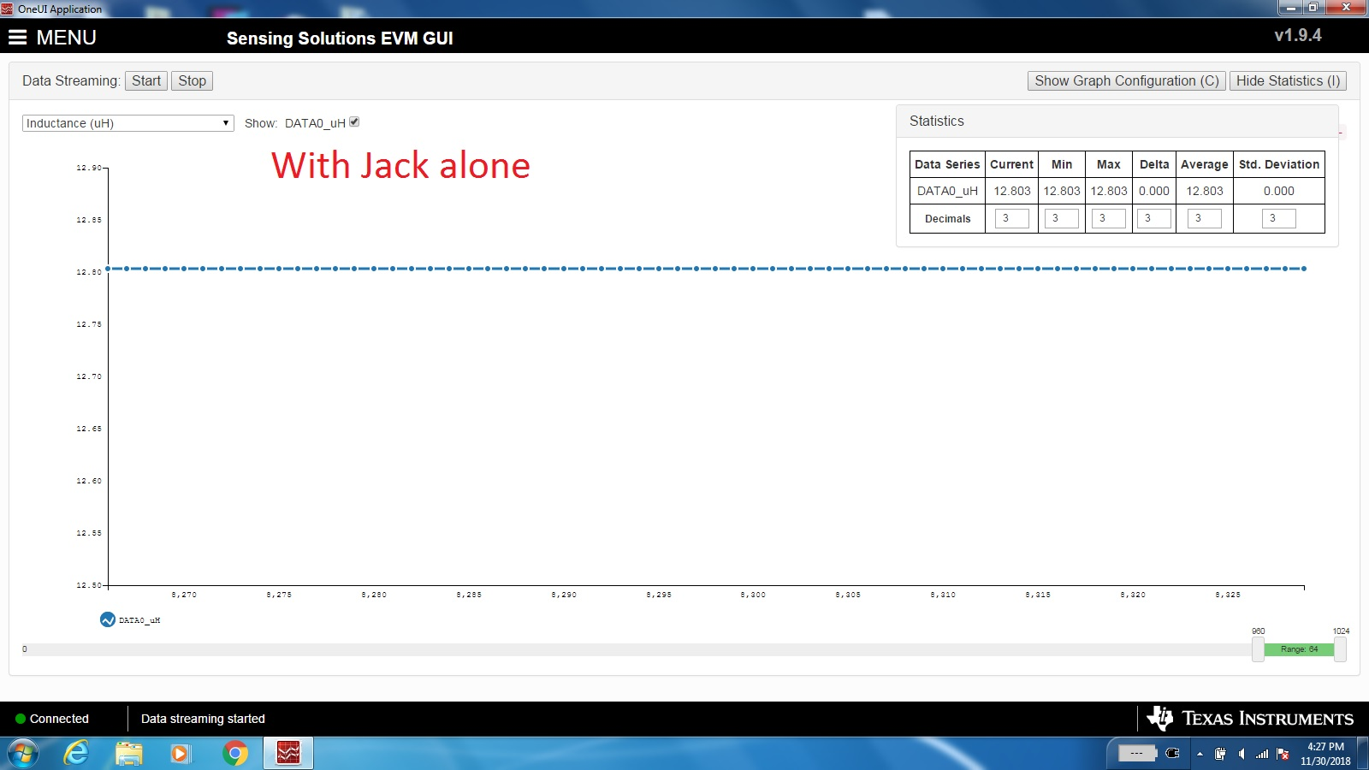
Test Result

Slide 6
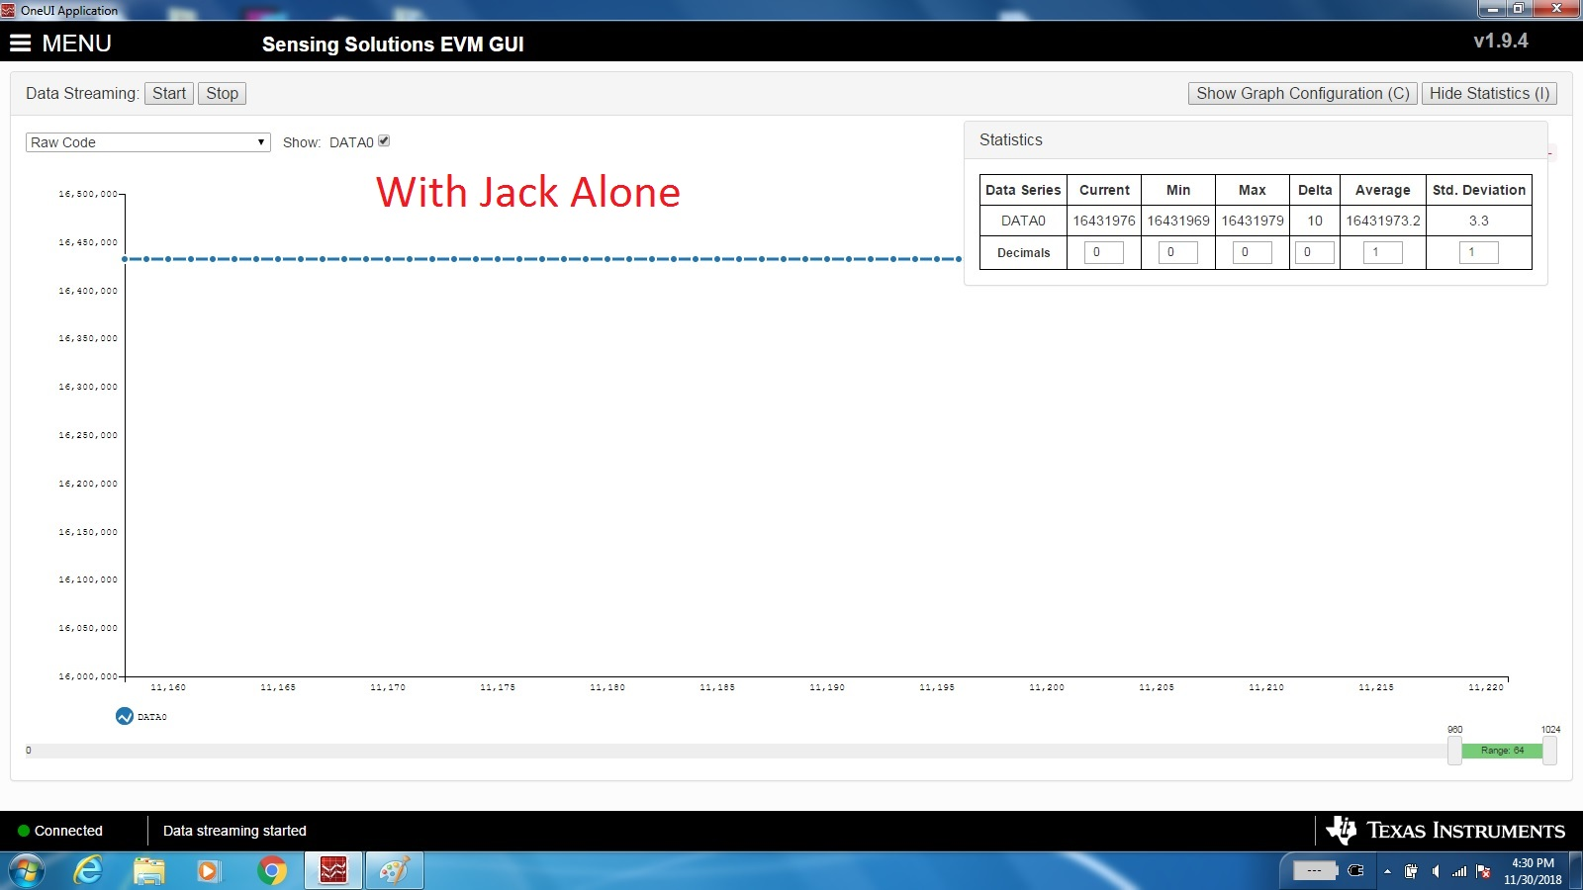
Test Result

Slide 7
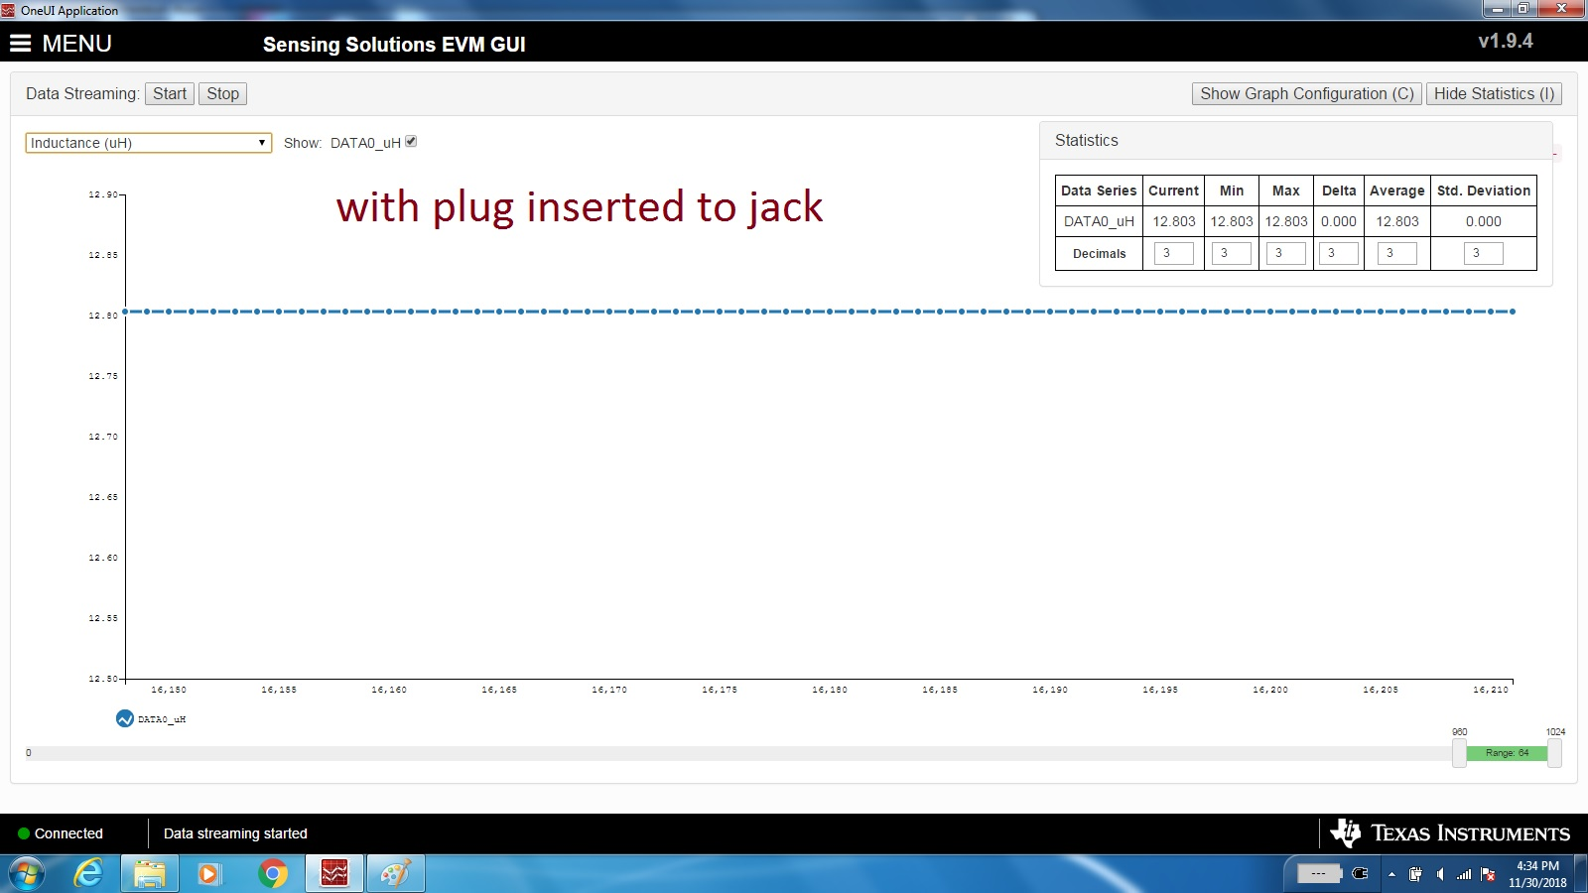
Test Result

Slide 8
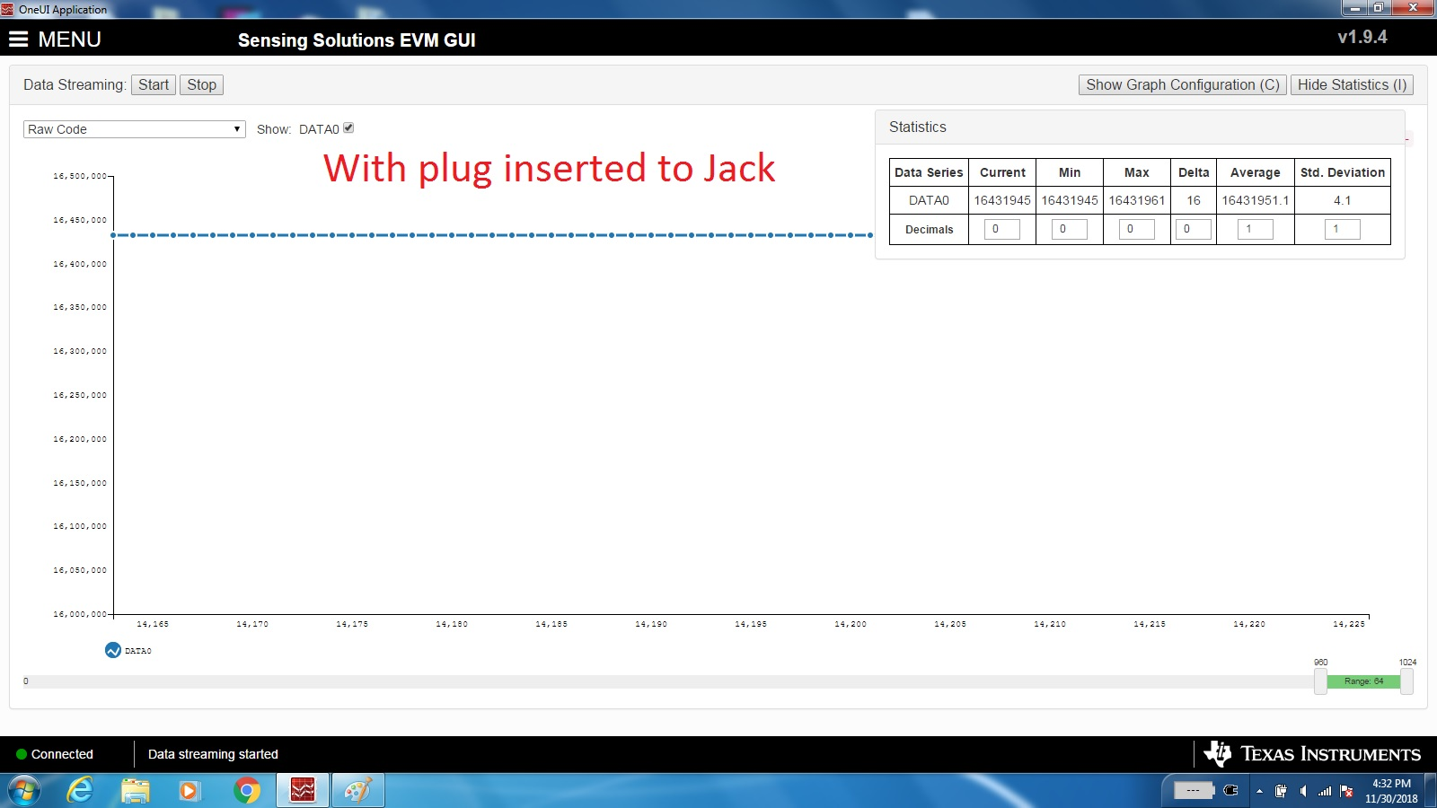
Test Result

