Slide 1
LM95221 Output Issue

Slide 2
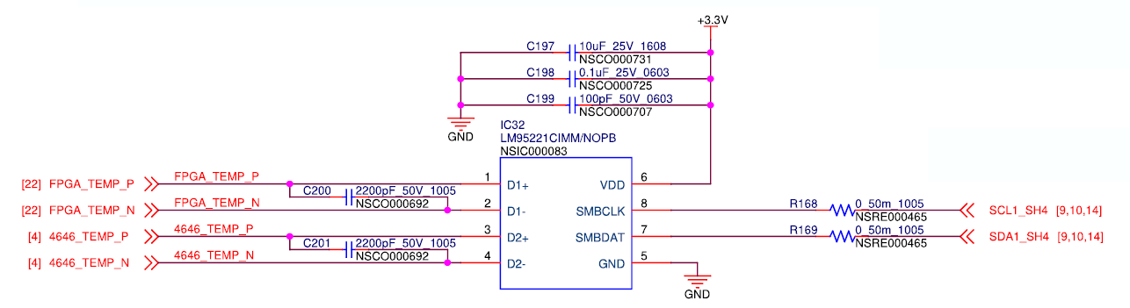
Overview
We use the LM95221 in our product.
We connect the TEMP2+ and TEMP2– terminals of the Analog Devices LTM4646 switching regulator to the LM95221 to monitor the temperature.

Slide 3
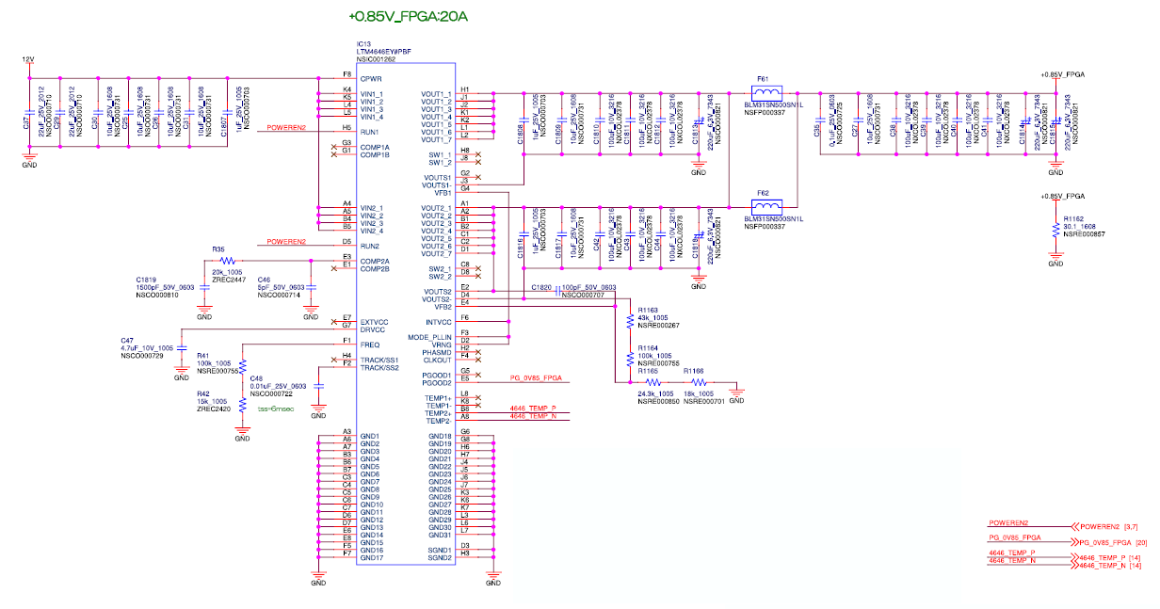
LTM4646

Slide 4
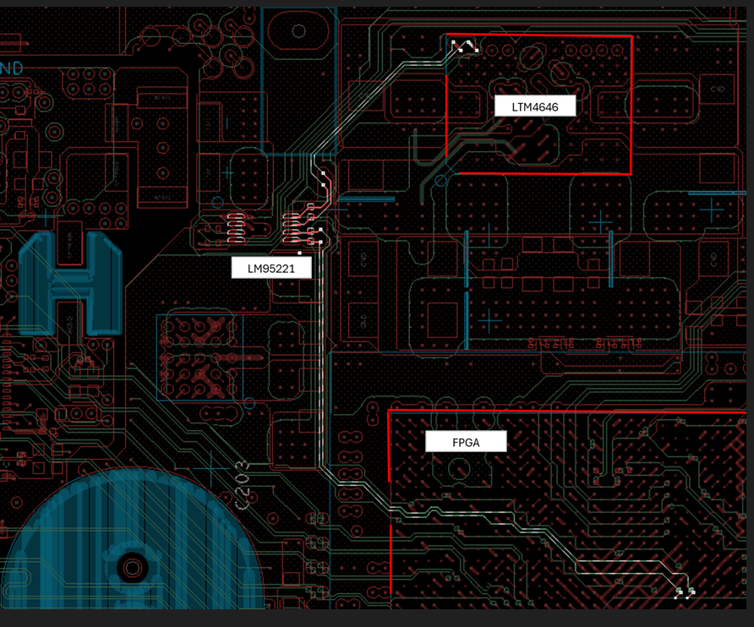
Layout

Slide 5
Description
- The Temp2+ and Temp2- pins of the LTM4646 are connected to the D2+ and D2- pins of one LM95221. Please refer to the circuit diagram.
- Switching noise (*1) from the LTM4646 is observed, but the LM95221 on boards that passed the test provides relatively stable data (*2).
- However, the output pin noise on boards that failed the test was very loud (*3).
- Since at least one LM95221 is stable, we believe there is no direct effect of switching noise.
(If switching noise were a direct effect, the output (temperature data) would be unstable regardless of the individual unit.)
When the unstable LM95221 was removed and re-installed, the waveform was stable (the test passed) (*4).
- This is a mass-production board.
- The LM95221 and LTM4646 are connected via traces on the same board.

Slide 6
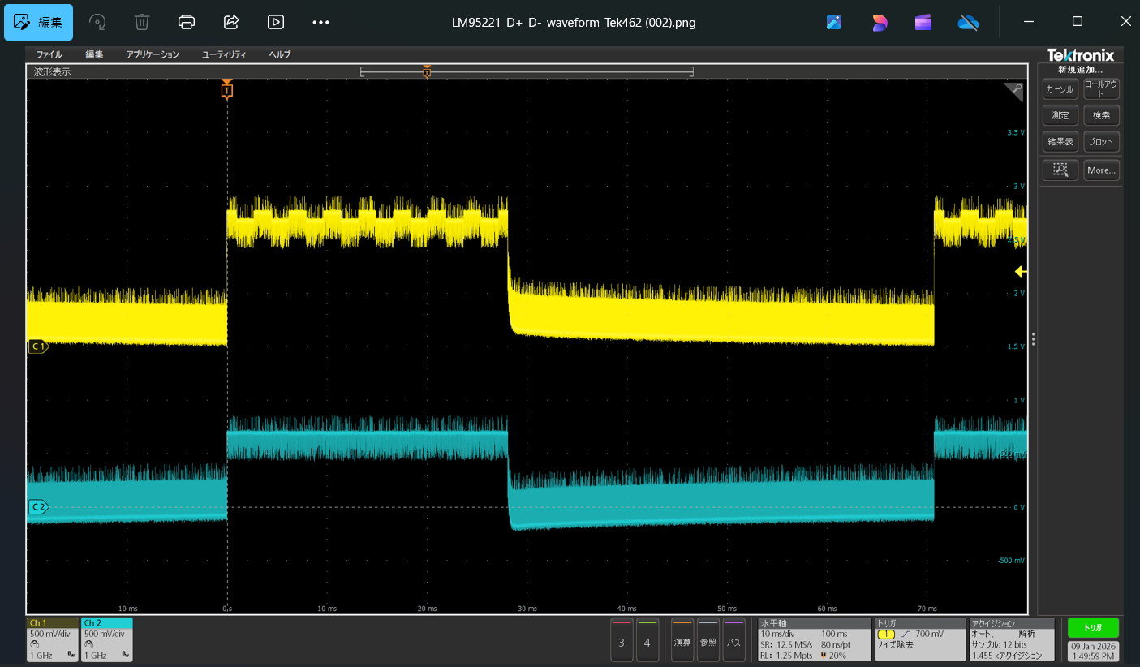
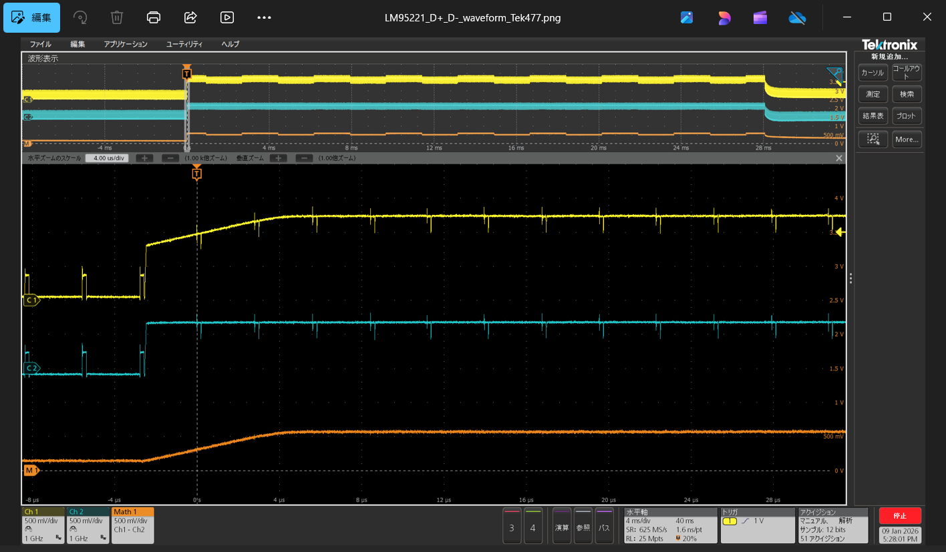
*1) LTM4646 Switching waveform
Zoom

Slide 7
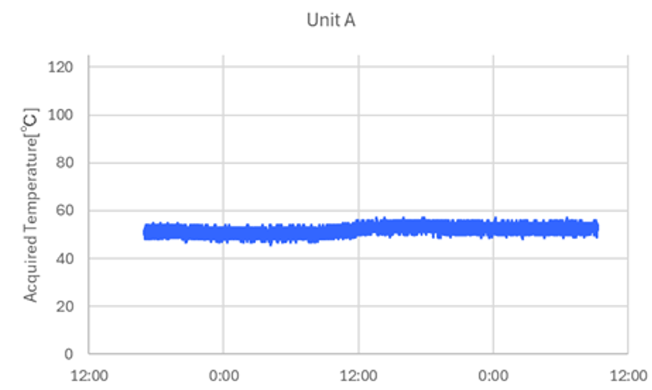
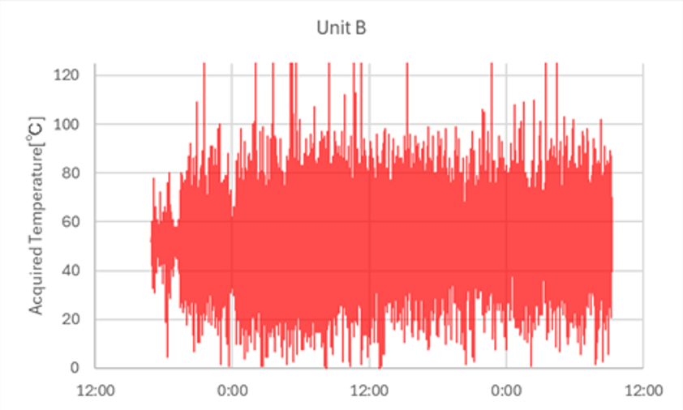
*2), *3) Temperature data
*2) Pass Data
*3) Failure Data

Slide 8
Question
1. Why is the temperature reading from Unit B unstable?
2. What is the possible cause of the difference from Unit A?
3. Why does the temperature data stabilize when the LM95221 is removed from Unit B and then reinserted?

