Slide 1
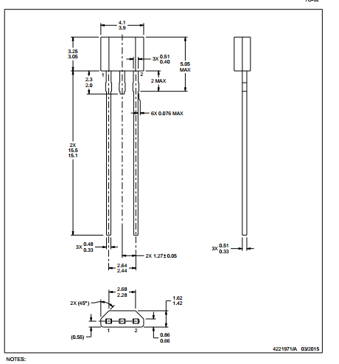
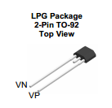
Pin assignment
DataSheet 27page
DataSheet 3page

Slide 2
