Slide 1
Bus Bar designs with FEMM
Simulating bus bar using FEMM and LUA scripts to estimate Magnetic field on a Bus Bar
Javier Contreras
Scott Vestal
February 2017

Slide 2
Installing FEMM
FEMM can be downloaded from the official website. http://www.femm.info/wiki/HomePage.

Slide 3
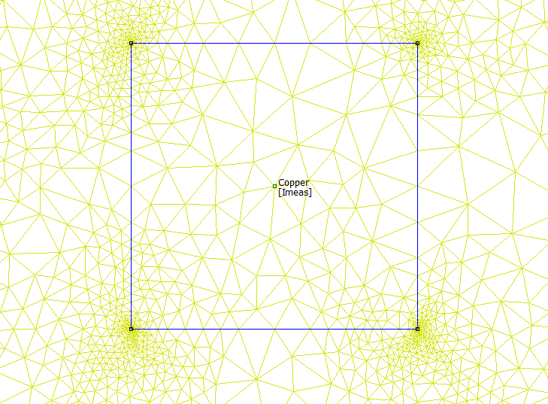
Finite Element Method Magnetics (FEMM) Basics
FEMM uses a Finite Element method to solve electromagnetics problems.
Nodes connected by line segments and arcs to define boundary conditions as well as regions containing different materials and current distributions.
FEMM then generates a mesh within this problem’s geometry, which it uses to solve for the magnetic field distribution within the boundaries.

Slide 4
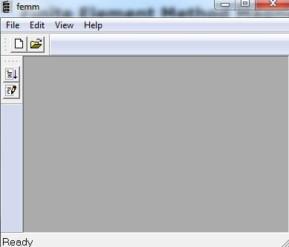
Run Script From FEMM
Click “Open a Lua Script”
Navigate to location of the scipt “Build_Magnetic_Core.lua” and select it.
Follow the next slides for description of the input parameters.

Slide 5
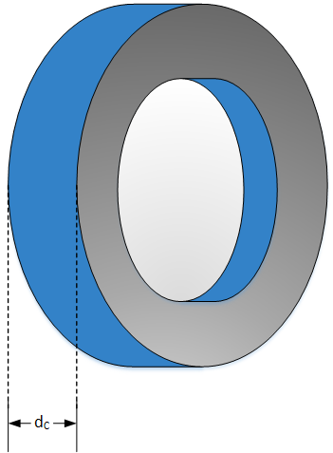
Input Parameters for Script
File Name – This is the name of the file created and saved. It will be save in the folder that contains the script.
Note: file name must include .fem extension
Core_Depth (d_{c}) This is how much depth in the simulation there is. This is the axis that is not shown in FEMM since this is only a 2D drawing.

Slide 6
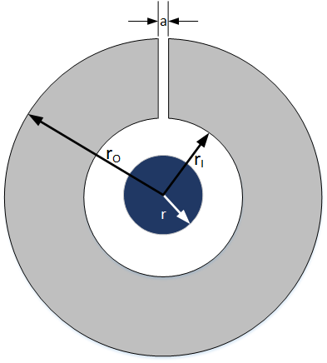
Input Parameters for Script Cont.
Core Inside Radius (r_{i})
Core Outer Radius (r_{o})
Air Gap (a)

Slide 7
Input Parameters for Script Cont.
Primary Radius (r)
Core Permeability
14000 (Iron)
83000 (Mu Metal)

Slide 8
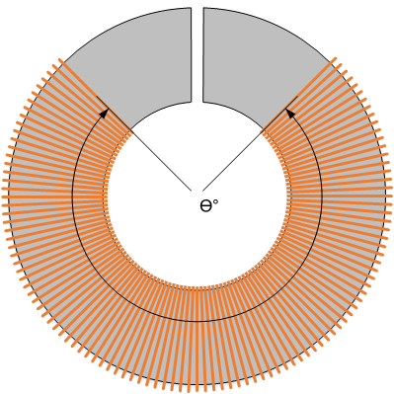
Input Parameters for Script Cont.
Number of Turns- Secondary Coil number of windings.
Winding Angle (Ɵ°)

Slide 9
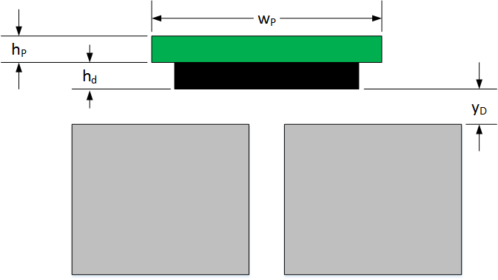
Input Parameters for Script Cont.
PCB Height (h_{P})
PCB Width (w_{P})
Distance from Core (y_{D})
DRV421 Height (h_{D}) is a constant

Slide 10
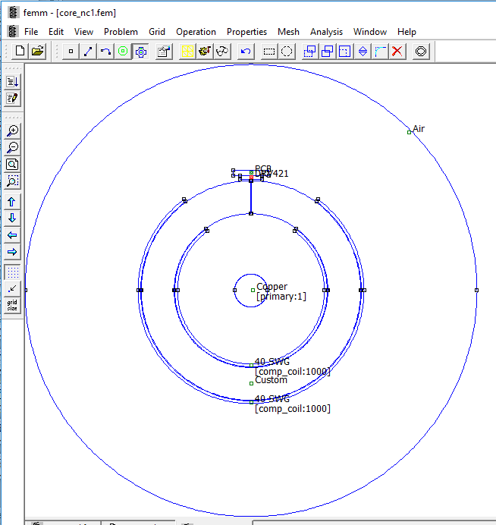
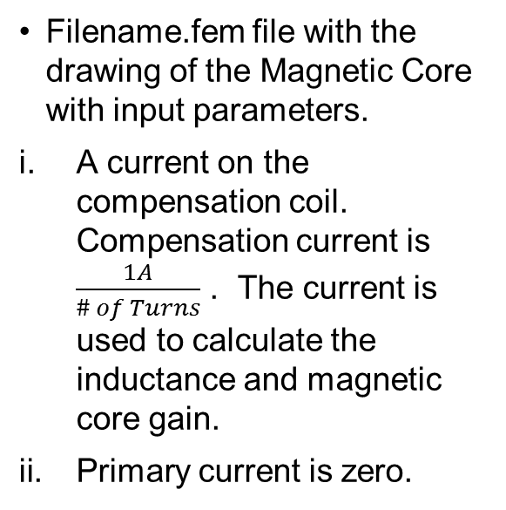
Script outputs
Filename.fem file with the drawing of the Magnetic Core with input parameters.
A current on the compensation coil. Compensation current is $\frac{1A}{\# of Turns}$ . The current is used to calculate the inductance and magnetic core gain.
Primary current is zero.

Slide 11
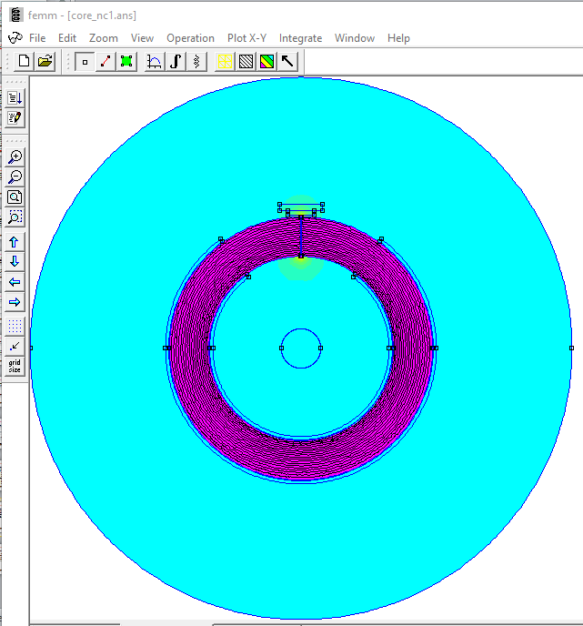
Script outputs Cont.
Filename.ans (answer) file that shows the magnetic field on and surrounding the magnetic core with current on the compensation coil as described in previous slide.

Slide 12
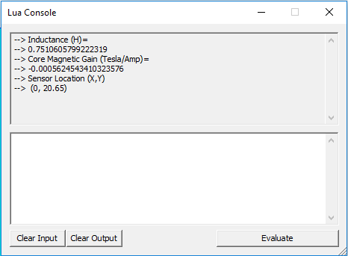
Script outputs Cont.
Lua Outputs.
Inductance(H)
Core Magnetic Gain (Tesla/Amp)
Sensor Location (X,Y) 0.4 mm from top of DRV421

