Slide 1
PGA300EVM OWI Fix

Slide 2
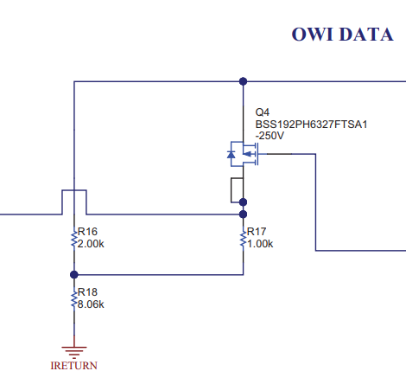
PGA300EVM Modification
EVM modified to increase amplitude of OWI signals
R16 changed from 2kΩ to 5kΩ
R18 changed from 8kΩ to 10kΩ
This increases the pk-pk voltage swing from 4V-5V to 3.3V-5V to ensure the OWI thresholds are met at the PGA300
5kΩ
10kΩ

Slide 3
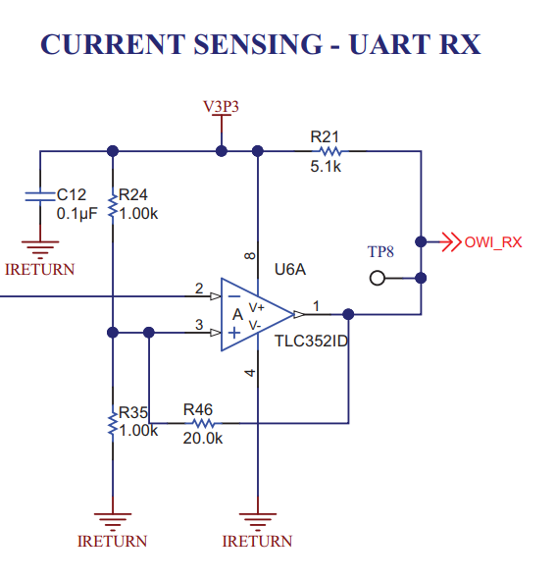
PGA300EVM Modification
Current sensing OWI RX circuitry modified:
R24 changed from 1kΩ to 730Ω
Voltage threshold of OWI RX comparator was increased from 1.65V to 1.9V
This eliminates output transitions due to spurious current changes at high temperature
730Ω

