Slide 1
PGA460 – difference dumping profile in UART and OWU mode.
Used the same EEPOM parameter setting in GUI interference and base on UART mode to optimize the Ultrasonic profile and can get positive result.
However, while change the communication mode from UART to OWU(one wire UART). It’s find the dumping profile be shifted. It is confirm all parameter are the same except the register address “1E” change from “0x08” to 0x88” for changing from UART to OWU mode.
Items | #T13(GUI_UART) | #T13(GUI_OWU) | #T14(GUI_UART) | #T14(GUI_OWU)
Decay time @ 1.28ms (<50V) | 31 | 134 | 6 | 26
Echo amplitude (>125V) | 136 | 135 | 125 | 120
Noise Floor (<25V) | 22 | 12 | 13 | 13

Slide 2
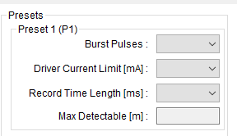
Items | #T13(GUI_OWU_RTL=8.192ms) | #T13(GUI_OWU_RTL=4.096ms)
Decay time @ 1.28ms (<50V) | 134 | 50
Echo amplitude (>125V) | 135 | 139
Noise Floor (<25V) | 12 | N/A
Used above T13 sample to compare the dump data profile with difference “Record Time Length”. It could see the shape of dumping profile is difference at beginning and the profile be shifted.

