Slide 1
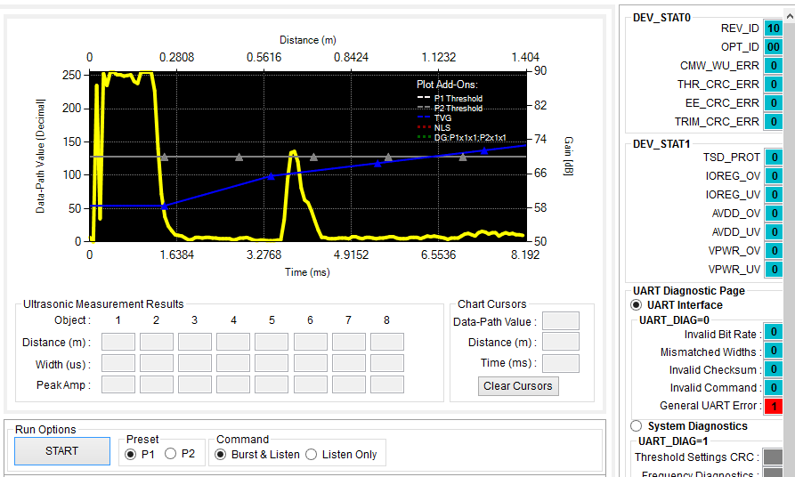
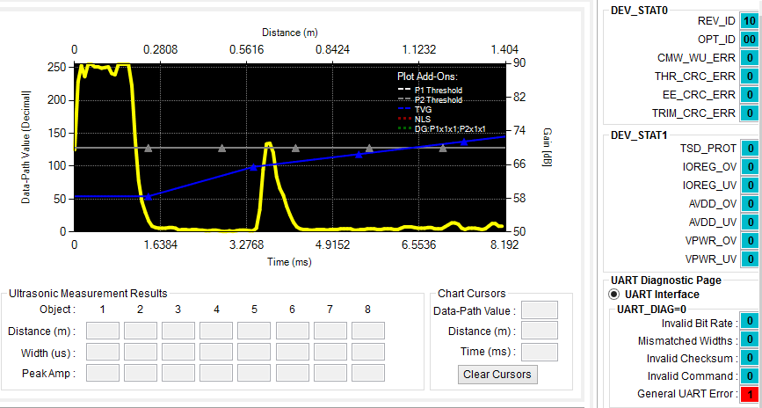
Test#10 data dump result in OWU
Difference data dump profile in UART and OWU mode. Anything the same except change the connection from UART to OWU.
There have abnormal burst signal cause to data dump profile be shifted
Test#10 data dump result in UART

Slide 2
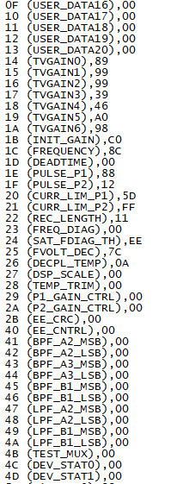
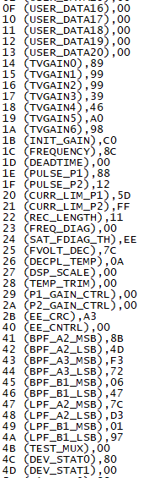
Difference data dump profile in UART and OWU mode. Anything the same except change the connection from UART to OWU.
Test#10 data dump result in OWU
Test#10 data dump result in UART

