Slide 1
Report MMWAV-CAS

Slide 2
Objectives
MMWAV-CAS is evaluated against the IWR6843 in identical measurement scenarios to investigate performance issues of the MMWAV-CAS which were detected in earlier measurements.
The comparison measurements are performed with a sliding platform where a corner reflector with rib length of 5cm was used as a standard target at ranges of 0.2m and 0.6m. Those distances are relevant for our application. The experimental setup is shown in next slide.

Slide 3
Experimental setup
The radar sensors are placed on a sliding platform, where the motion is steady, with uniform speed in the horizontal direction and none in the vertical.
The distance between the sensor and the target is referenced when the sensor is directly in front of the target.
Chirp parameters are set equal for the IWR6843 and MMWAV-CAS radar are provided in the table on the next slide
MMWAV-CAS initiated and operated with modified lua scripts, where modifications are only done for the chirp and frame configuration.
IWR is set to send 5000 frames while MMWAV-CAS 4000 frames with 3ms frame time.
Corner reflector
Distance to target
Direction of motion
Top view experimental setup
Sensor

Slide 4
Chirp and frame parameters
Parameter | Value
Samples per sweep | 128
Sampling frequency | 2MHz
ADC start time | 3us
Idle time | 30us
Sweep slope | 57 MHz/us
Sweep end time | 70us
Frame time | 3ms
Chirps per frame | *For the IWR6843 - 1 *For the MMWAV-CAS -12, each Tx sends one chirp per frame)

Slide 5
Results
The results are presented in the figures in the next slide.
The images present the range profiles as a function of time. On the horizontal axis is time, respectively the horizonal position of the sensor as a function of time, as shown in figure 3.
For the MMWAV-CAS sensor the results are shown for chip 4 (slave 3), receiver 0 and transmitter 2 (zero based indexing), because they are closest to each other in physical terms and respectively the multistatic effects shall be minimal. However, similar results are observed for other Tx-Rx combinations at all chips.
Raw data is processed with a custom Python script which resembles the provided matlab processing scripts.No window function is applied but only one dimensional FFT with no oversampling.

Slide 6
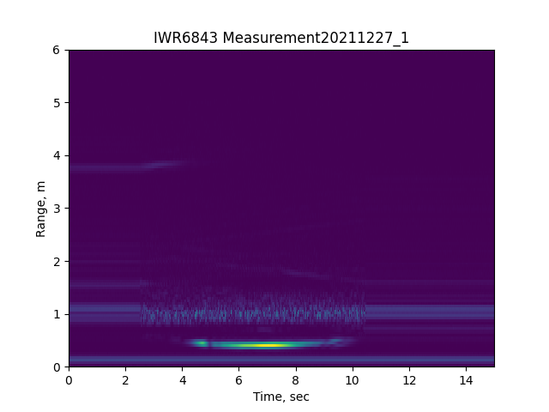
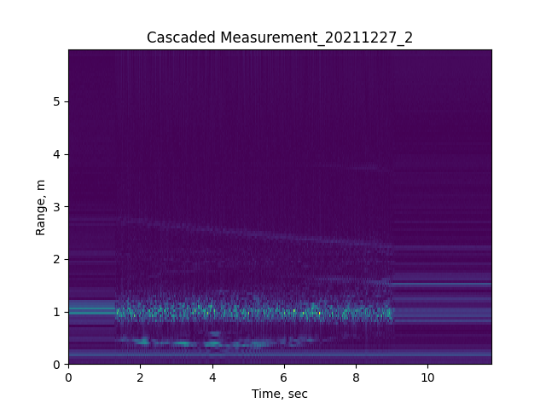
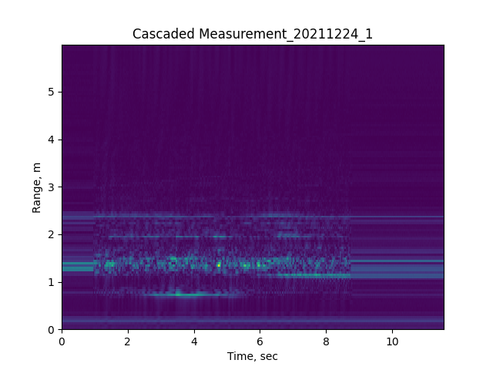
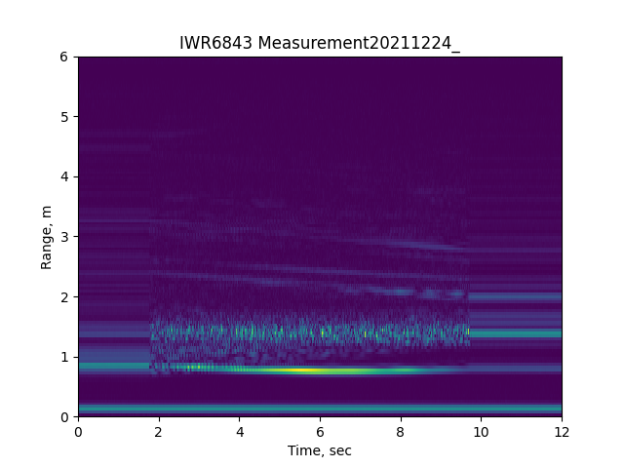
Results
RAM behind target
MMWAV-CAS, target at 20cm
IWR6843, target at 20cm
TARGET
MMWAV-CAS, target at 60cm
IWR6843, target at 60cm

Slide 7
Conclusions
Frame drops are observed for all measurements with the MMWAV-CAS. About 5% of all frames are dropped. No drops with the IWR6843
MMWAV-CAS cannot be setup such that it transmits one chirp per frame from only one transmitter
Measurement results, such as reflected power and coherency are not satisfactory and cannot be explained. For example the measurements with the IWR6843 chip provide excellent results, e.g., consistent and smooth curve as expected when sensor moves tangentially to the target. This is not the case when measuring with the MMWAV-CAS sensor. One explanation could be the spatial distance between the TX and RX elements of the MMWAV-CAS sensor but this effect should be reducing when distance is increased from 0.2m to 0.6m. However, this is not the case.
The combination of inexplicable range profile behaviour and frame drops for all measurements lead to the conclusion that errors in the front end board or the interfacing board (TIDEP-01012) must be the cause of the problem.

