Slide 1
Description of plots
This is data from a MMWCAS-RF-EVM board attached to a MMWCAS-DSP-EVM board
We purchased these as a set from the TI store
TDMA data collection with 16 Rx and 1 Tx, 256 samples per chirp
We acquired 189 chirps: 21 cycles of the 9 Tx
All 21 chirps for Tx 1 are plotted on the same chart for each Rx
Note that the Rx data is virtually the same for all 21 chirps on Rx channels 1-12
Rx 1-4 are on chip 1, 5-8 are chip 2, 9-12 are chip 3, 13-16 are chip 4
Note that the data is not synchronized in time for chip 4, Rx 13-16
Clearly, there is something wrong with chip 4
It is possible that the problem is the DSP board, but we can’t diagnose it

Slide 2
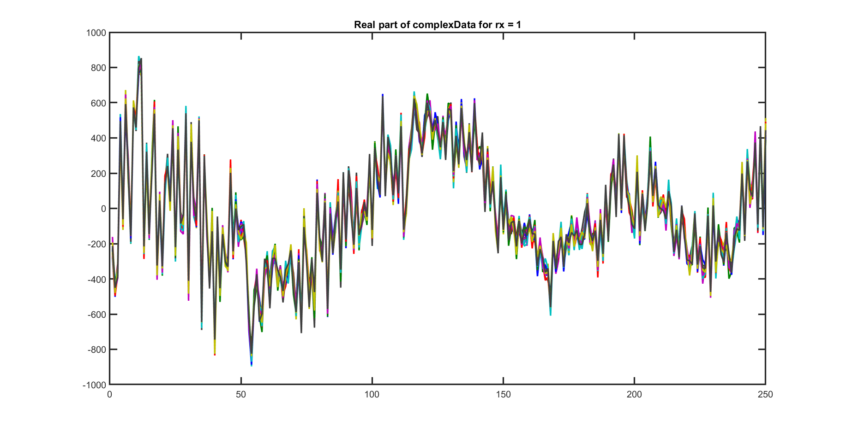

Slide 3
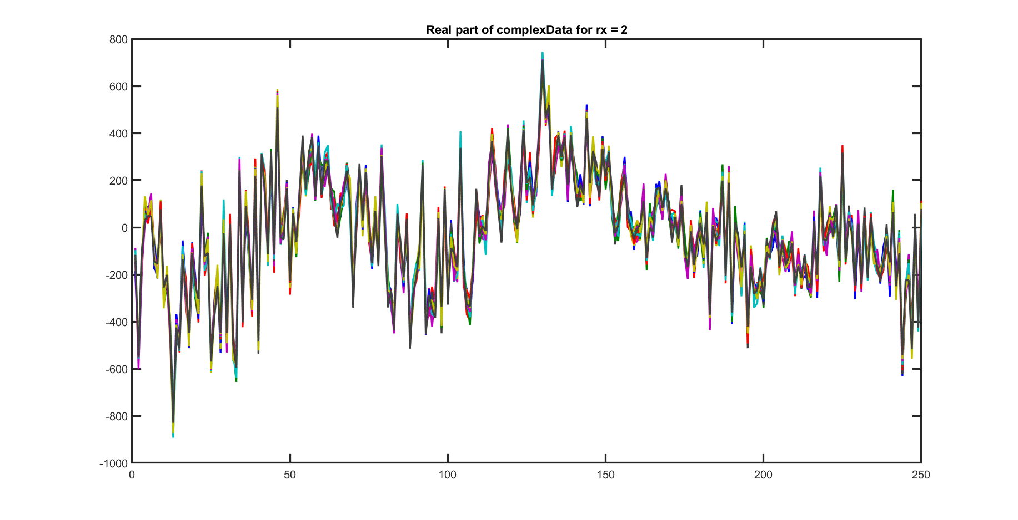

Slide 4
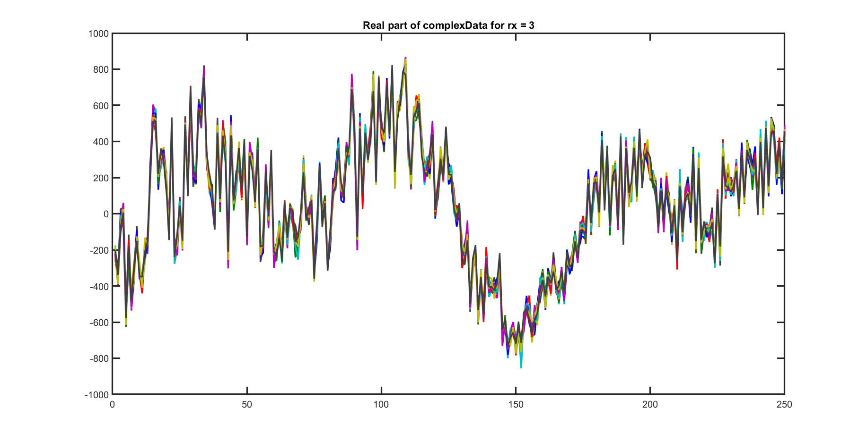

Slide 5
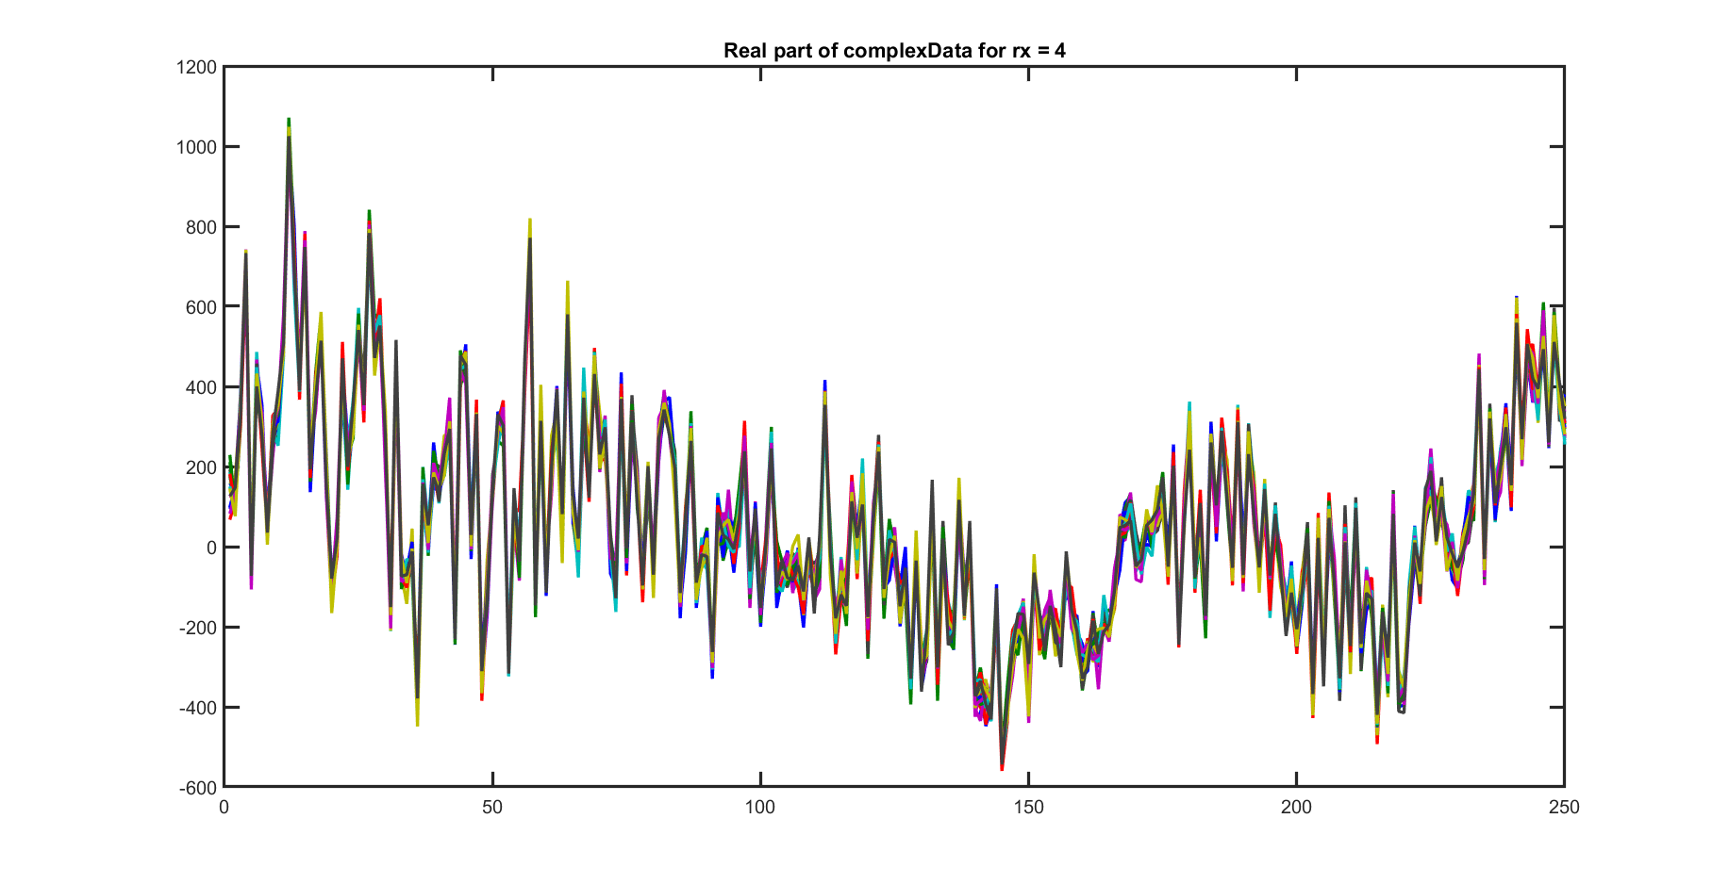

Slide 6
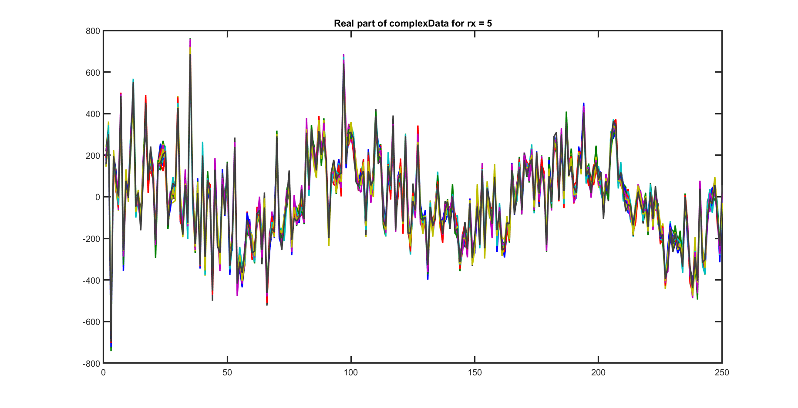

Slide 7
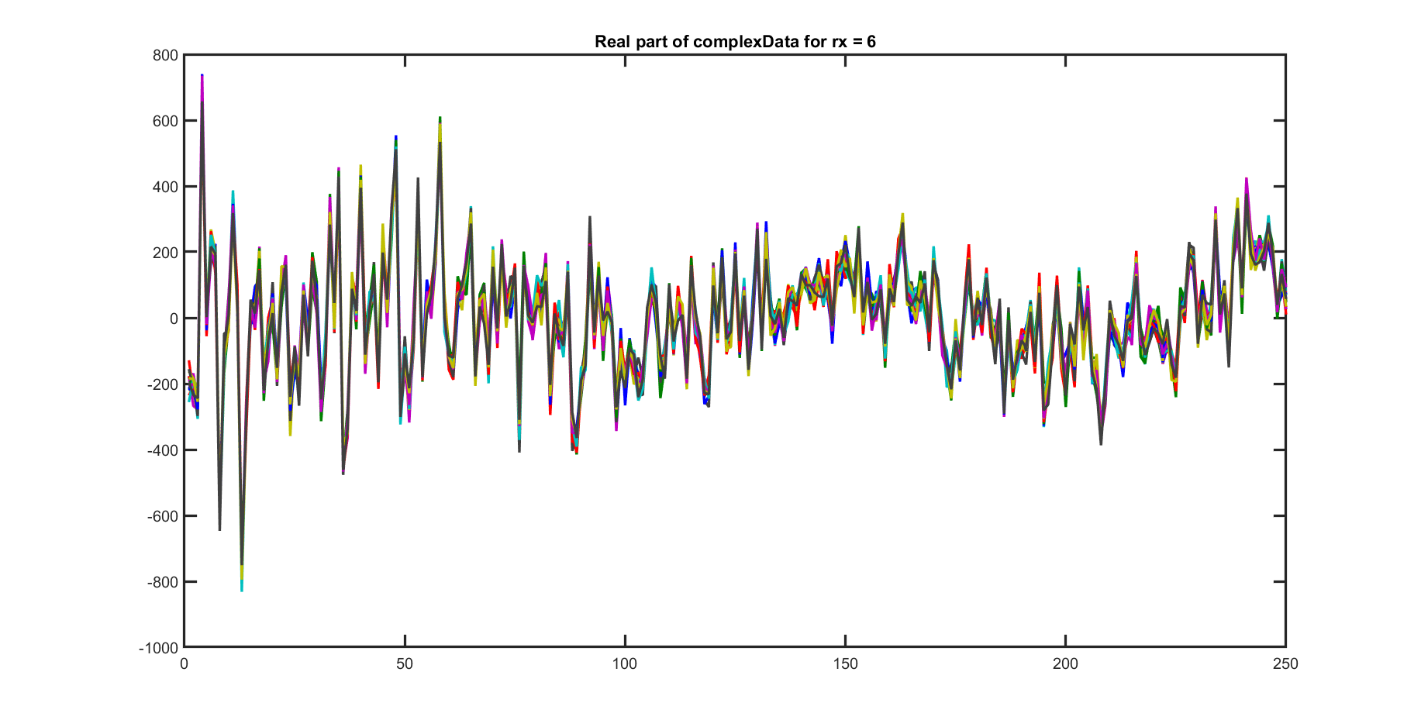

Slide 8
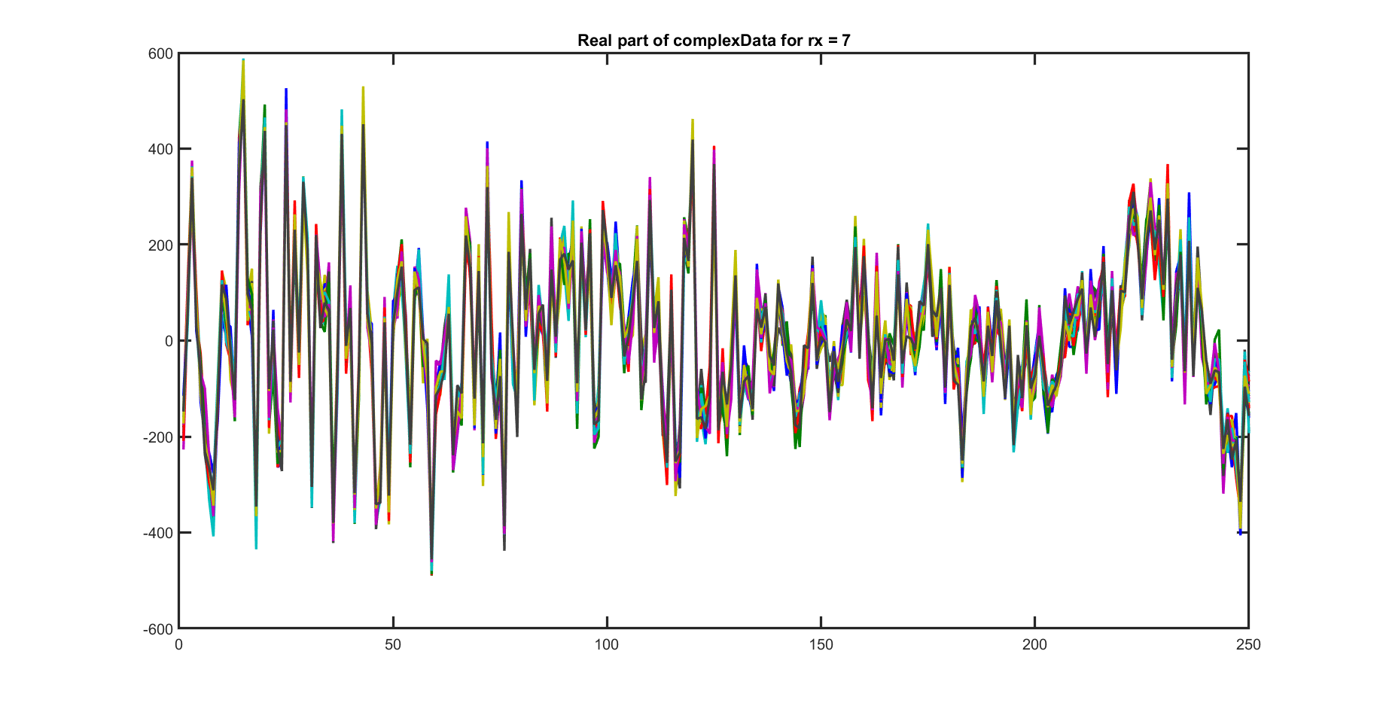

Slide 9
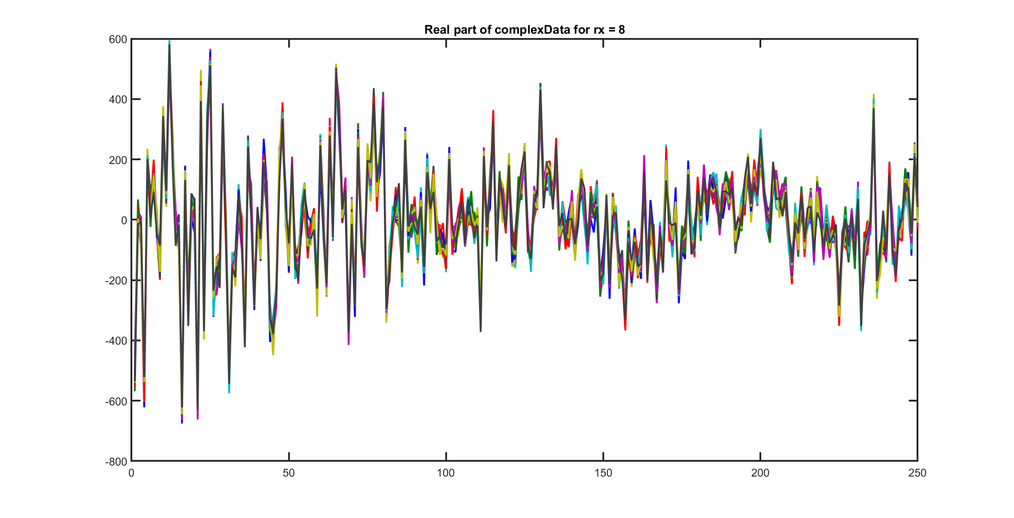

Slide 10
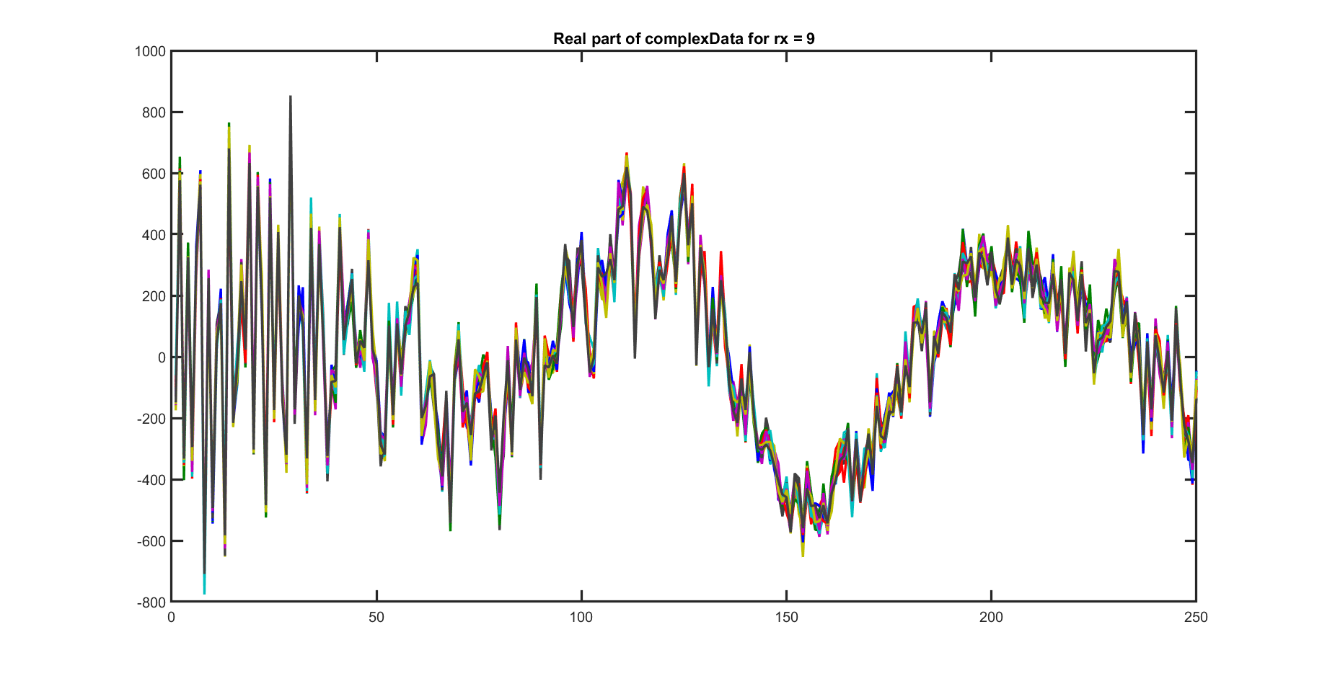

Slide 11
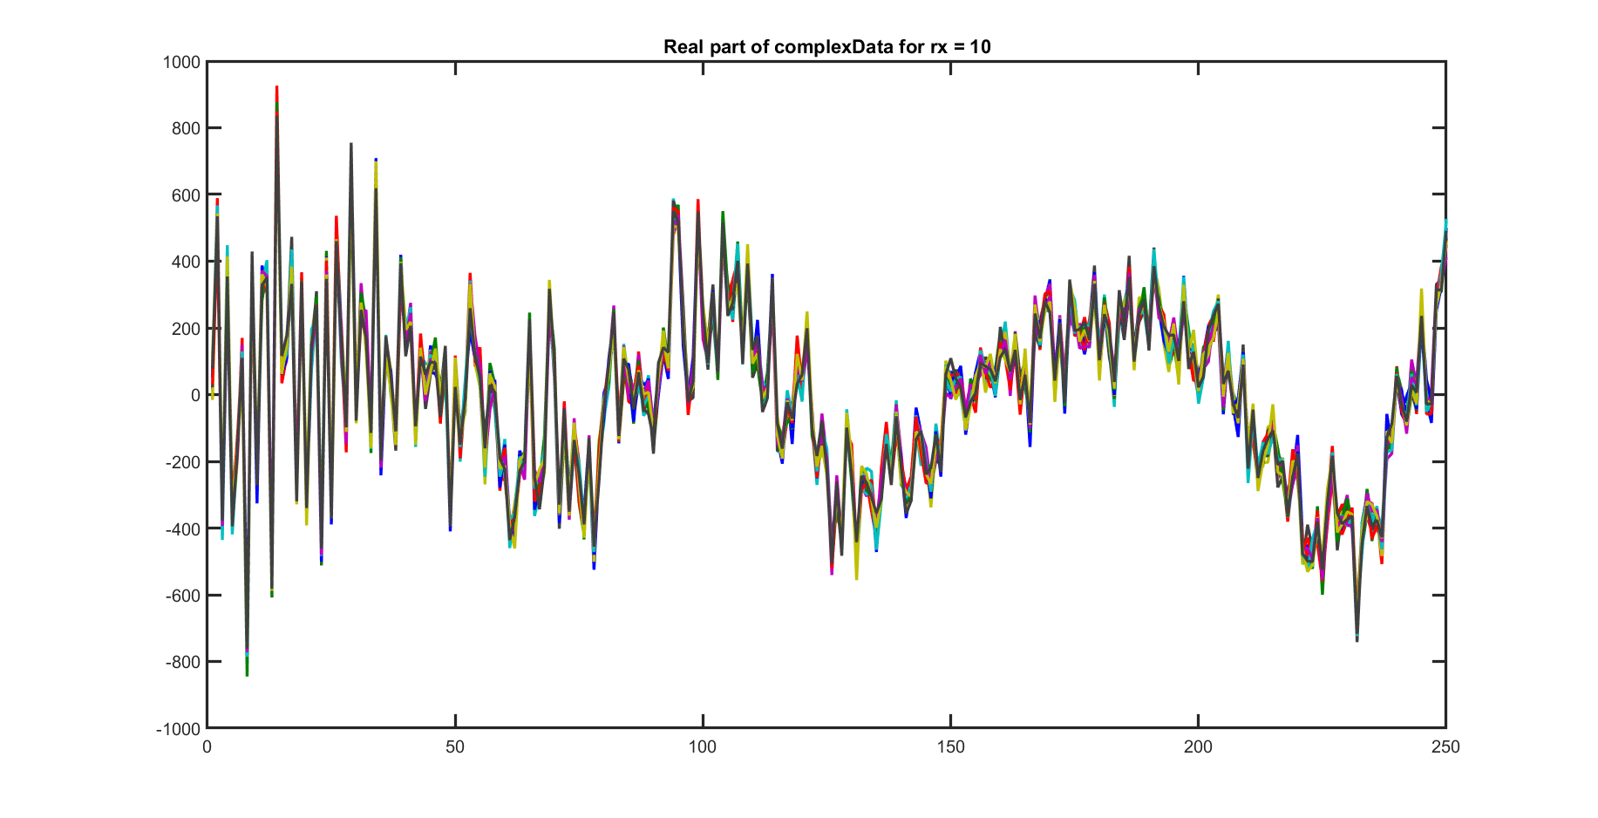

Slide 12
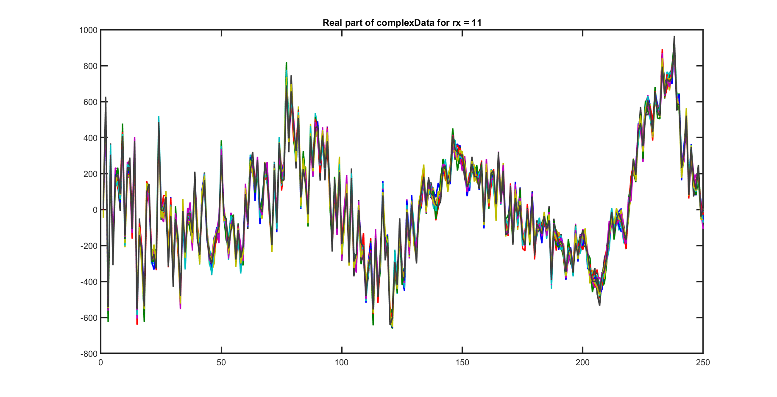

Slide 13
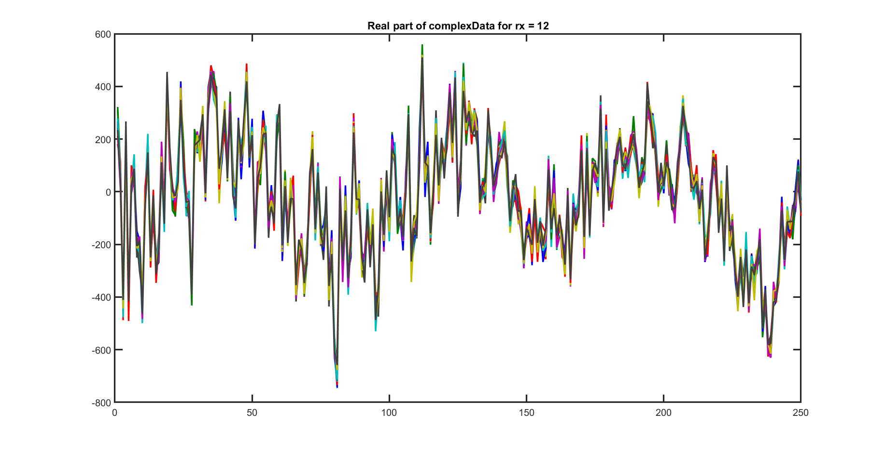

Slide 14
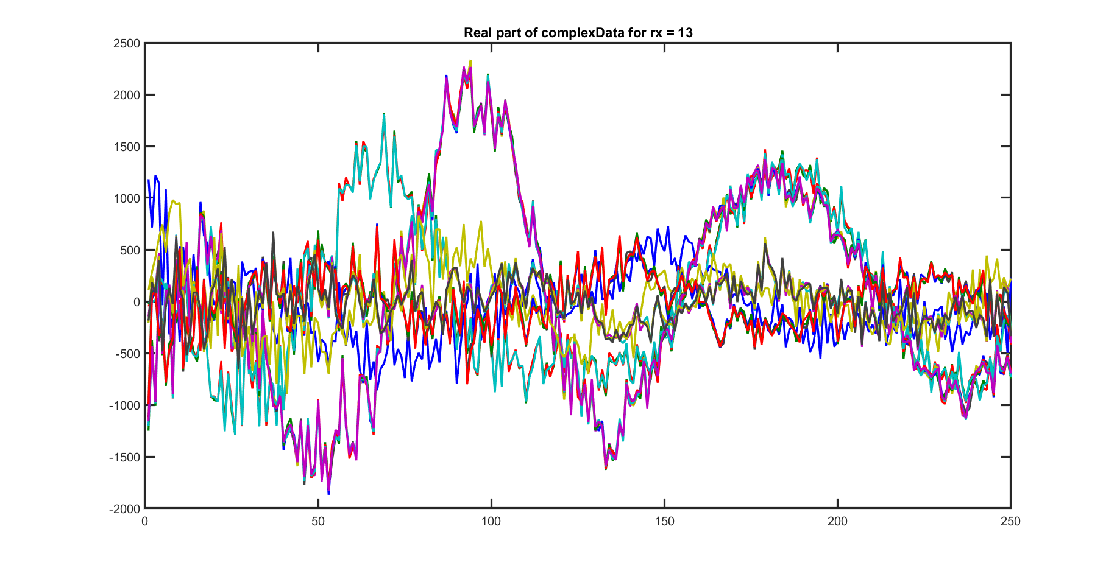

Slide 15
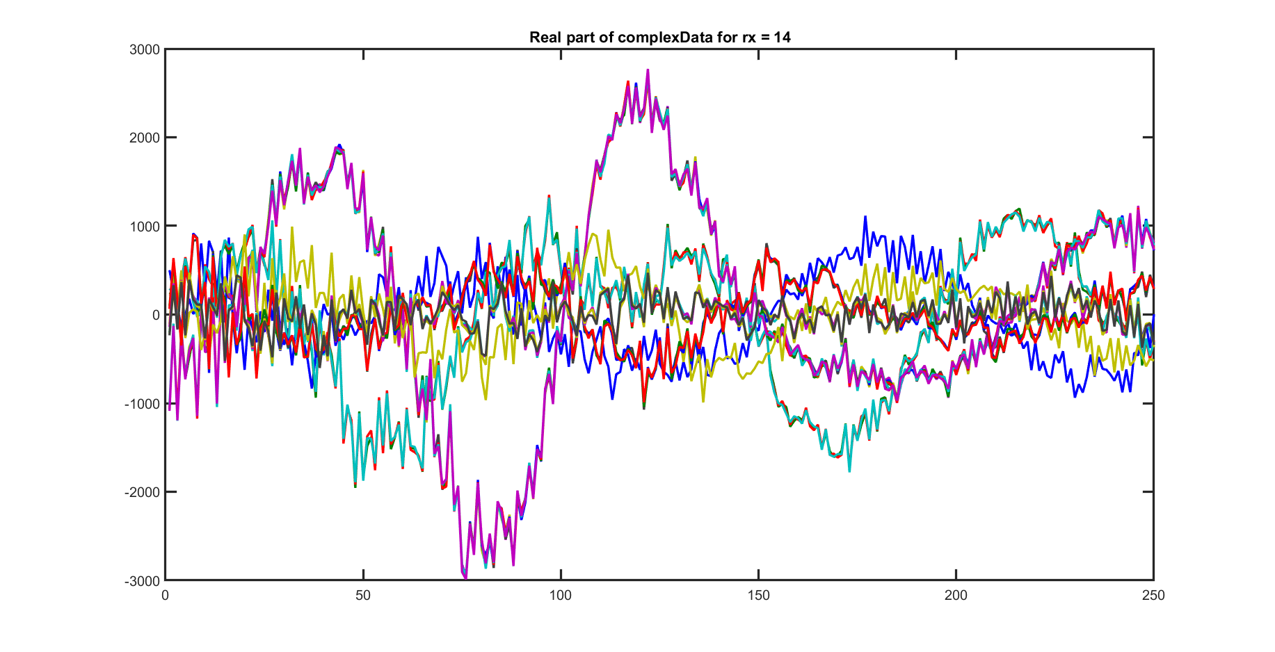

Slide 16
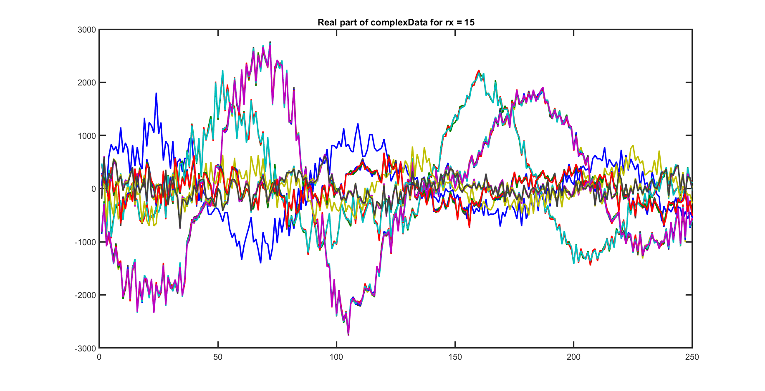

Slide 17
