Slide 1
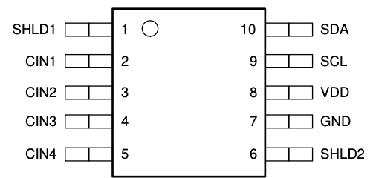
#3
Trial cable:
Detect capacitance between sensor and metal
#2
#1
S1
S2
S3
Metal

Slide 2
Hi,
We are currently using a capacitive sensor connected to an FDC1004-Q1.
The capacitive sensor is a triaxial cable, which could detect the capacitive changed,
Regarding the connection :
Inner conductor(#1) connect to CIN1, Inner shield(#2) connect to shld1, Outer shield(#3) connect to GND.
We have successfully collected data at 25C, where we can read the distance based on capacitive differences.
Howerver when measuring at 105C and 55C, 23 observed a capacitive drift issue,which casues the measurement results unstable and incorrect.
Could you help to suggest the connection method between ICand the capacitive sensor that could resolve this problem, or any other methods could compensate this drift issue?
Thanks you for your assistance.

