Slide 1
TMP431 Debug
Investigation & Findings

Slide 2
Revision History
Revision Date | Originator | Description
May 5th, 2019 | Cosmin Calinescu | Initial Draft

Slide 3
Problem Statement
We are seeing unexpected behavior on the TMP431. Assessment is based on the following document: SBOS441H –SEPTEMBER 2009–REVISED
Issue 1:
Every access to the SMBus alarm response address will set the MASK bit in register 0x3/0x9. The scenario is this: device hits one of the alarm limits, ALERT is asserted. The condition then goes away. An SMBus ARA is issued to dessert ALERT. As soon as the TMP431 receives the ARA, it internally sets MASK in the config register 0x3/0x9 thus no interrupt will ever occur from this device, until the mask is cleared.
Since there is no mention of this behavior in the above referenced document, we consider this a bug
Issue 2:
The above referenced document states:
“Clearing the Status Register bits does not clear the state of the ALERT pin; an SMBus alert response address command must be used to clear the ALERT pin.”
This statement is demonstrably false. Provided the condition that triggered the alarm has gone away, a simple read of the status register clears not only the status register bits, but deserts the ALARM signal, in direct contradiction with the quote above.

Slide 4
General setup description
TMP431 ALERT signal connected to interrupt controller
Device address at 0x4c
I2C bus run at 100 KHz or 400 Hz, bus speed make no difference. Scope traces in this presentation taken at 100 KHz
ALERT signal measurement taken at device (before interrupt controller).

Slide 5
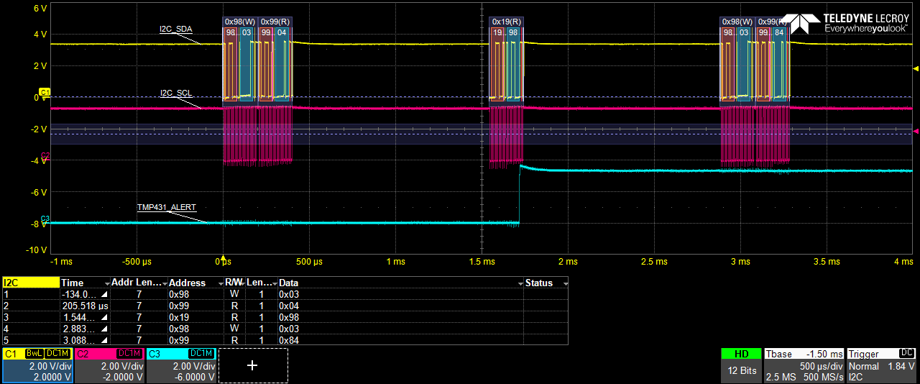
Issue 1
Every access to the SMBus ARA sets the MASK bit in register 0x3/0x9.
1. Setup:
- set registers 0xb,0xd,0x19,0x20 to 0xFF (high value for high alarm and therm thresholds).
- set registers 0xc,0xe to 0x0 (low value for low alarm thresholds).
- set config register 0x9 to 0x4 – alarm mode and extended temp range
2. Create and clear alarm:
Set register 0xb to 0x55 (this is below temp read in register 0), set register 0xb back to 0xff. At this point an alarm condition exists.
set registers 0xb,0xd,0x19,x20 to FF (high value for alarm and therm thresholds).
3. Show issue:
First transaction in picture: read register 0x3 to show current value – register 0x3=0x4
Second transaction in picture: ARA on address 0xC
Third transaction in picture: read register 0x3 to show current value - register 0x3 = 0x84 – MASK was bit set by device automatically.
Note: after ARA, the ALERT signal is de-asserted. This is not because of the ARA as it should, but because of the MASK bit. If the mask bit is cleared (write 0x9 with 0x4), the ALERT signal is back to asserted until a read to the status register 0x2 is issued (see Issue 2)

Slide 6
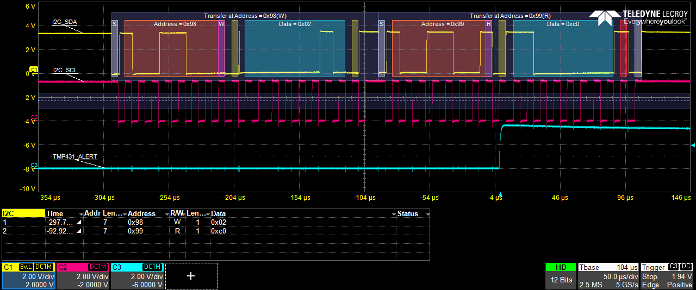
Issue 2
Read to status register clears the ALARM pin status, contrary to documentation
1. Setup:
- set registers 0xb,0xd,0x19,x20 to 0xFF (high value for high alarm and therm thresholds).
- set registers 0xc,0xe to 0x0 (low value for low alarm thresholds).
- set config register 0x9 to 0x4 – alarm mode and extended temp range
2. Create and clear alarm:
Set register 0xb to 0x55 (this is below temp read in register 0), set register 0xb back to 0xff. At this point an alarm condition exists.
3. Show issue:
Read status register 0x2
At this point the ALERT pin has cleared.

Slide 7
The End
www.curtisswrightds.com

