Slide 1
TMP431 Debug
Investigation & Findings, version 2

Slide 2
Revision History
Revision Date | Originator | Description
May 5th, 2019 | Cosmin Calinescu | Initial Draft
May 8th | Cosmin Calinescu | Version 2: Added Issue 3 – real time misbehavior

Slide 3
Problem Statement
We are seeing unexpected behavior on the TMP431. Assessment is based on the following document: SBOS441H –SEPTEMBER 2009–REVISED
Issue 1:
Every access to the SMBus alarm response address will set the MASK bit in register 0x3/0x9. The scenario is this: device hits one of the alarm limits, ALERT is asserted. The condition then goes away. An SMBus ARA is issued to dessert ALERT. As soon as the TMP431 receives the ARA, it internally sets MASK in the config register 0x3/0x9 thus no interrupt will ever occur from this device, until the mask is cleared.
Since there is no mention of this behavior in the above referenced document, we consider this a bug
Issue 2:
The above referenced document states:
“Clearing the Status Register bits does not clear the state of the ALERT pin; an SMBus alert response address command must be used to clear the ALERT pin.”
This statement is demonstrably false. Provided the condition that triggered the alarm has gone away, a simple read of the status register clears not only the status register bits, but deserts the ALARM signal, in direct contradiction with the quote above.
Issue 3:
Behavior on real time does not match the behavior reported in Issue 2 above and causes fake alarms. That is, a read to the status register immediately after the ALARM condition has been removed does not clear ALARM. This has a big impact on the real time behavior of the system. Details in the following pages.

Slide 4
General setup description
TMP431 ALERT signal connected to interrupt controller
Device address at 0x4c
I2C bus run at 100 KHz or 400 Hz, bus speed make no difference. Scope traces in this presentation taken at 100 KHz
ALERT signal measurement taken at device (before interrupt controller).

Slide 5
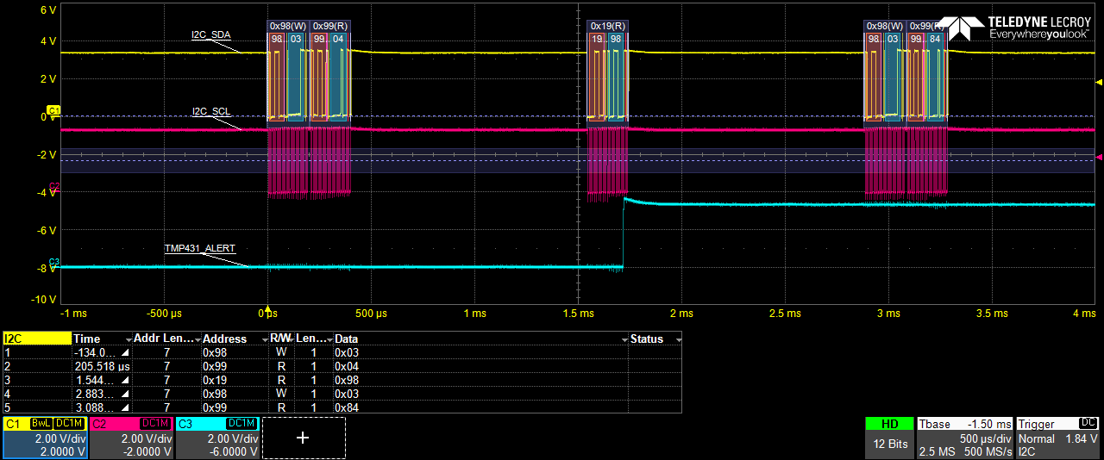
Issue 1
Every access to the SMBus ARA sets the MASK bit in register 0x3/0x9.
1. Setup:
- set registers 0xb,0xd,0x19,0x20 to 0xFF (high value for high alarm and therm thresholds).
- set registers 0xc,0xe to 0x0 (low value for low alarm thresholds).
- set config register 0x9 to 0x4 – alarm mode and extended temp range
2. Create and clear alarm:
Set register 0xb to 0x55 (this is below temp read in register 0), set register 0xb back to 0xff. At this point an alarm condition exists.
set registers 0xb,0xd,0x19,x20 to FF (high value for alarm and therm thresholds).
3. Show issue:
First transaction in picture: read register 0x3 to show current value – register 0x3=0x4
Second transaction in picture: ARA on address 0xC
Third transaction in picture: read register 0x3 to show current value - register 0x3 = 0x84 – MASK was bit set by device automatically.
Note: after ARA, the ALERT signal is de-asserted. This is not because of the ARA as it should, but because of the MASK bit. If the mask bit is cleared (write 0x9 with 0x4), the ALERT signal is back to asserted until a read to the status register 0x2 is issued (see Issue 2)

Slide 6
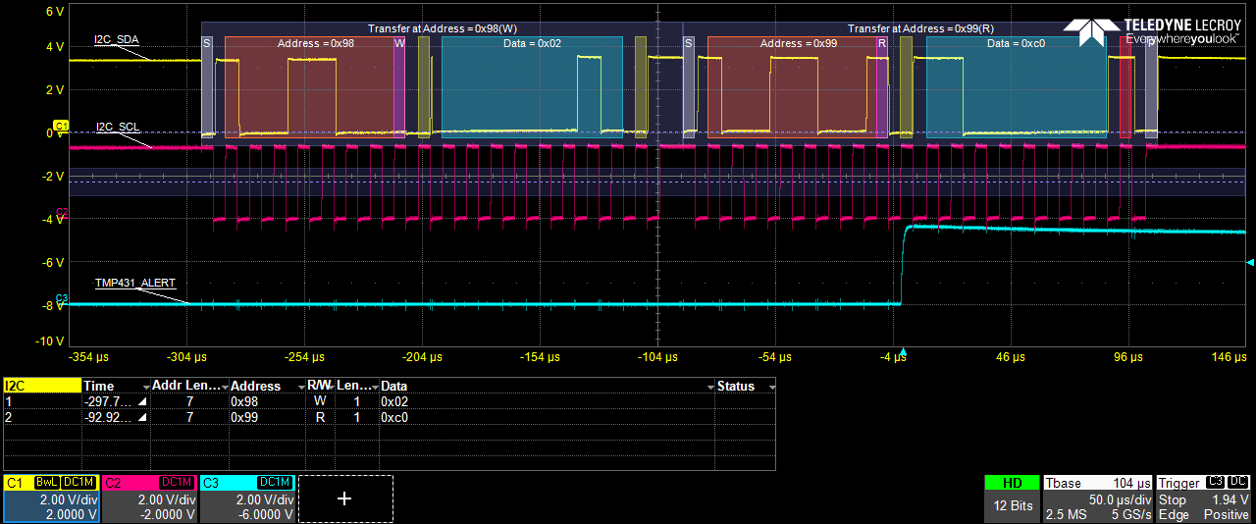
Issue 2
Read to status register clears the ALARM pin status, contrary to documentation
1. Setup:
- set registers 0xb,0xd,0x19,x20 to 0xFF (high value for high alarm and therm thresholds).
- set registers 0xc,0xe to 0x0 (low value for low alarm thresholds).
- set config register 0x9 to 0x4 – alarm mode and extended temp range
2. Create and clear alarm:
Set register 0xb to 0x55 (this is below temp read in register 0), set register 0xb back to 0xff. At this point an alarm condition exists.
3. Show issue:
Read status register 0x2
At this point the ALERT pin has cleared.

Slide 7
Issue 3
“Real time behavior not the same as Issue 2”
In Issue 2 we’ve shown that a read to the status register after the alarm condition cleared clears the ALARM signal. But Issue 2 was shown with executing commands from the command line with large amounts of time (seconds) between setting the alarm threshold register back to highest value and reading of the status register to clear ALARM. In this scenario, the same mechanism is used but the raising of the threshold and the reading of the status register happen fast as they would in real time system.
What we’re trying to achieve is a beyond basic solution as described below:
The system needs a high threshold alarm. We need to know when the high threshold was crossed – temperature going up - and when the system has cooled back down below the high threshold; interrupt notifications need to be used for these two events.
The system starts with a high thresh alarm (set register 0xb to desired temp, let’s say 0x60).
When an alarm occurs, set high threshold to very high (set register 0xb to 0xff) and low threshold to the old high threshold (set register 0xc to 0x60) and then clear ALARM by reading register 0x2 (as we have established empirically at Issue 2)
When the system cools down, a low threshold alarm will be obtained and the registers set back to the original values.
But the device misbehaves and does not clear the high threshold alarm in the status register 0x2 at step 2. This causes the system to enter an endless loop and ALARM never clears or stays set until the system cools down causing large amounts of interrupts. The next page shows scope captures to show this behavior.

Slide 8
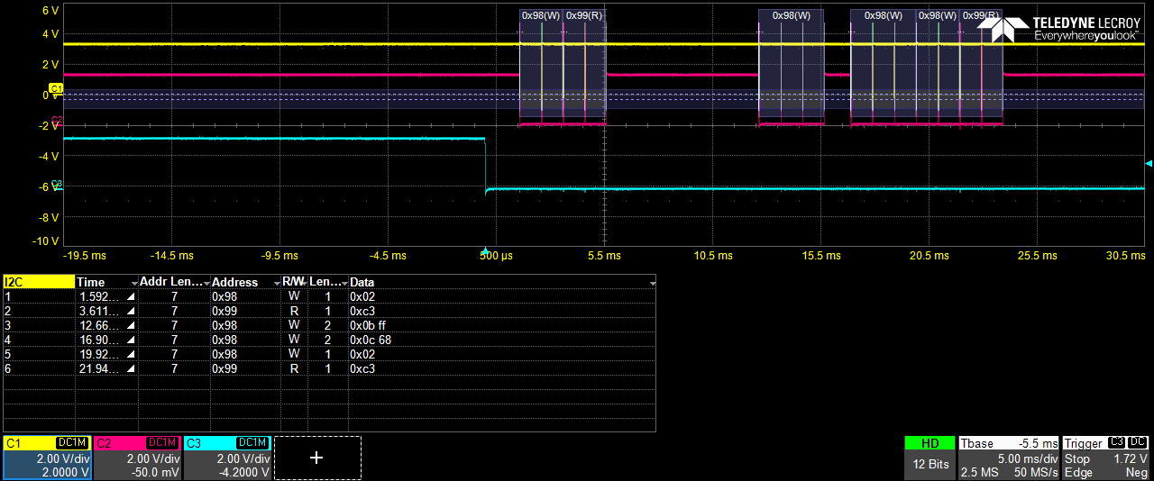
Issue 3 (cont)
1. Setup:
- set registers 0xb,0xd,0x19,x20 to 0xFF (high value for high alarm and therm thresholds).
- set registers 0xc,0xe to 0x0 (low value for low alarm thresholds).
- set config register 0x9 to 0x4 – alarm mode and extended temp range
2. Set a High temp threshold:
Set register 0xb to 0x68 (this is above temp read in register 0).
Run heat gun to push sensor above high threshold
3. Show issue:
There are 6 transactions shown in the capture below – see lower left box. Timing can be the signal traces on top. Light blue is ALRAM. This was the only screen setup that could capture all event as desired.
Notice transaction 3 where the high threshold is set to 0xff (0xb=0xff)
When transaction 5/6 (read the status register happens we expect ALARM to go high because transaction 3 would have removed the condition of the ALARM, thus acknowledging the ALARM by reading the status register (as we empirically determined at issues 2). Instead ALARM stays asserted and what follows is another high threshold crossed alarm which at this point is fake.

Slide 9
The End
www.curtisswrightds.com

