Slide 1
Trip Temp is 105 degree

Slide 2
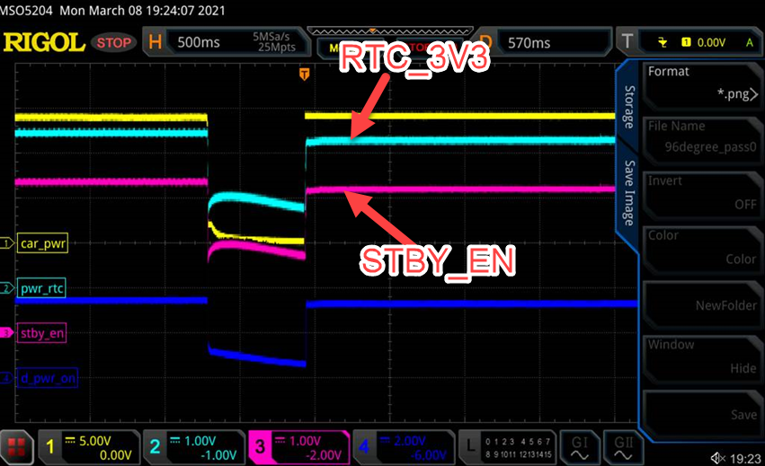
Trip Temp is 105 degree
PASS CASE
Pass (96degree @ thermal couple)

Slide 3
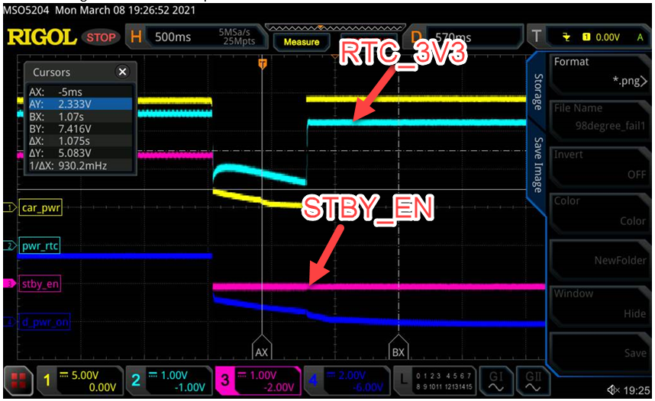
Trip Temp is 105 degree
FAIL CASE
Fail (98degree @ thermal couple)
Fail Steps:
(1)Ambient Temp 90 degree
(2)Power on device
(3)Wait 30 sec
(4)Chip surface 98 degree from boot up 30sec
(5)Power break the cable and plug in power immediately
(6)Pass case: STBY_EN is HIGH
(7)Fail case STBY_EN is LOW
(8)Happen possibility 2/10 times
Next Step.
(1)Verify 2nd device.

