Slide 1
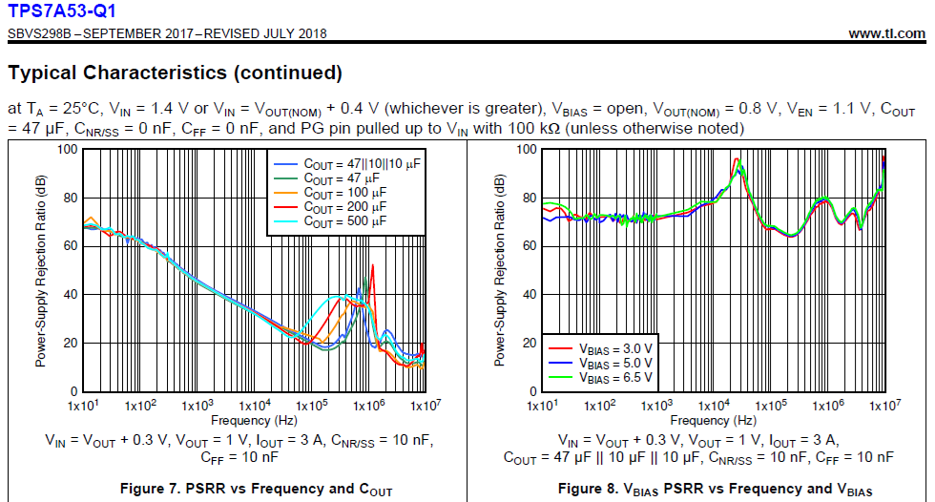
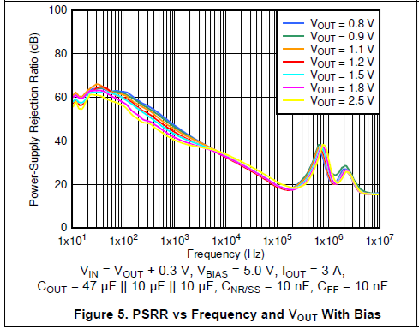
tps7a53-q1 datasheet(SBVS298B –SEPTEMBER 2017–REVISED JULY 2018)
1.3Vin 1.0Vout@3A
PSRR > 60dB

