Slide 1
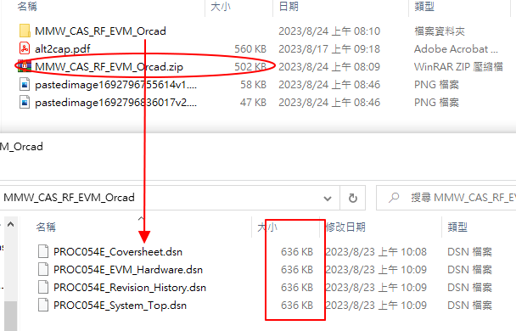
The DSN size is too small, it can’t open this file by using Orcad.
PICPICKSHAPE

Slide 2
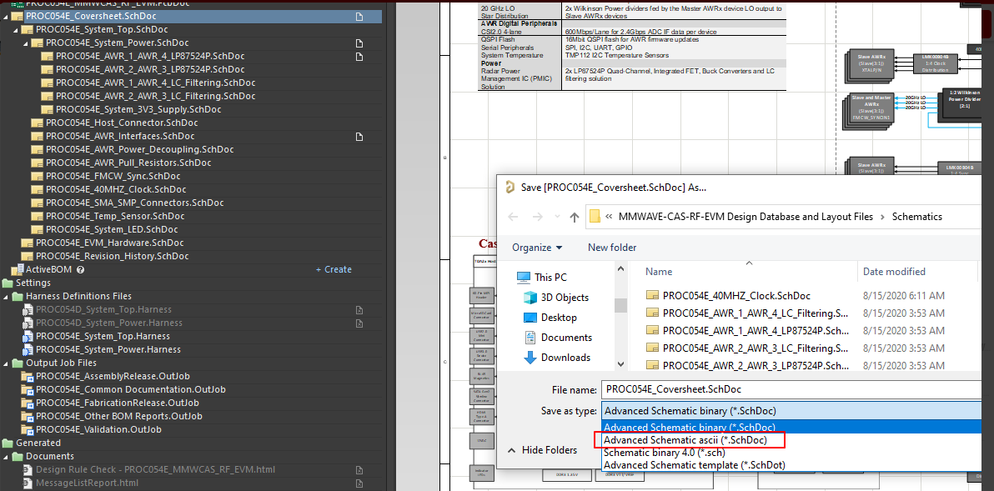
Would you help us save as Advanced Schematic ascii(*.SchDoc)?

