Slide 1
Range and Velocity accuracy in FMCW radar system

Slide 2
Accuracy
Accuracy (range/velocity) is dependent upon SNR and the corresponding resolution. The actual achieved accuracy would also depend upon the FFT size.
The formula for accuracy in general is
Accuracy = Resolution / sqrt (2 x SNR).
Range resolution (dres) depends on the RF bandwidth (B) and is given by
Rres= 𝒄/𝟐B
The velocity resolution of the radar is inversely proportional to the chirp duration time and number of chirps in the frame and is given by:
V𝐫𝐞𝐬 = 𝛌 / (𝟐Nchirp𝐓c)

Slide 3
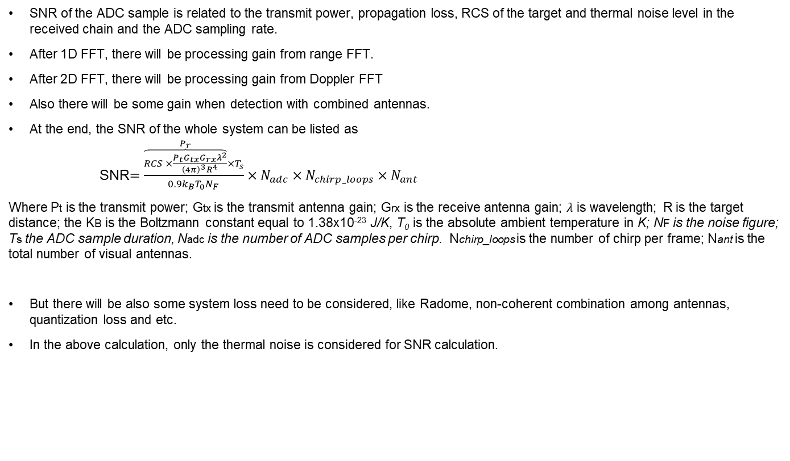
SNR calculation
SNR of the ADC sample is related to the transmit power, propagation loss, RCS of the target and thermal noise level in the received chain and the ADC sampling rate.
After 1D FFT, there will be processing gain from range FFT.
After 2D FFT, there will be processing gain from Doppler FFT
Also there will be some gain when detection with combined antennas.
At the end, the SNR of the whole system can be listed as
SNR$=\frac{\overset{P_{r}}{\overbrace{RCS ×\frac{P_{t}G_{tx}G_{rx}λ^{2}}{{\left(4π\right)}^{3}R^{4}}}}×T_{s}}{0.9k_{B}T_{0}N_{F}}×N_{adc}×N_{chirp_loops}×N_{ant}$
Where Pt is the transmit power; Gtx is the transmit antenna gain; Grx is the receive antenna gain; $λ$ is wavelength; R is the target distance; the KB is the Boltzmann constant equal to 1.38x10⁻²³ J/K, T₀ is the absolute ambient temperature in K; NF is the noise figure; Ts the ADC sample duration, Nadc is the number of ADC samples per chirp. Nchirp_loops is the number of chirp per frame; Nant is the total number of visual antennas.
But there will be also some system loss need to be considered, like Radome, non-coherent combination among antennas, quantization loss and etc.
In the above calculation, only the thermal noise is considered for SNR calculation.

