Slide 1

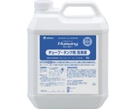
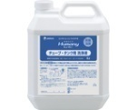
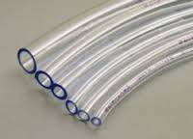
The idea of the customer
Metal
Metal
Liquid sensing
tank×2ch
tube×6ch
Total:8ch
FDC1004
SWITCH
1:8
×8ch
Metal
The customer is thinking a inexpensive solution that 8sensors are sensed by one FDC1004.
Is it possible?
At this time, what should he take care?
What type of switch do you recommend?
Metal

Slide 2
A basic idea
Metal
FDC1004
Metal
×8ch
FDC1004
Liquid sensing
tank×2ch
tube×6ch
Total:8ch
In this case, there isn’t any problem.
But they are need 8 FDC1004s.
The cost is going up.
Metal
FDC1004

