Slide 1
high voltage spike across C2 -AFE3010 in Autel
Date: Aug. 23, 2022

Slide 2
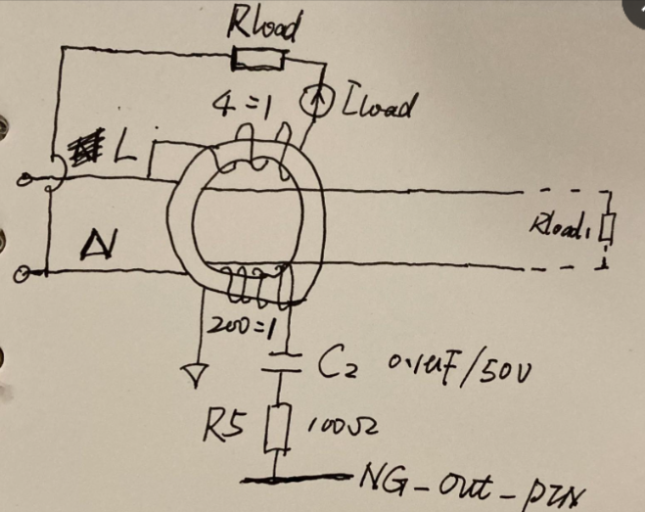
Schematic
It is based on the schematic shown in AFE3010 Datasheet.
issue
The C2 is damaged when Iload is suddenly added.
There is as high as 210Vpeak across C2. It results in C2 fail during test

Slide 3
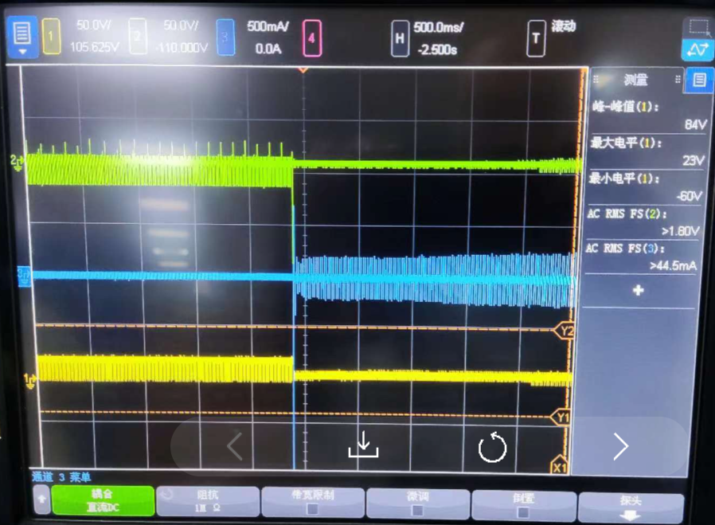
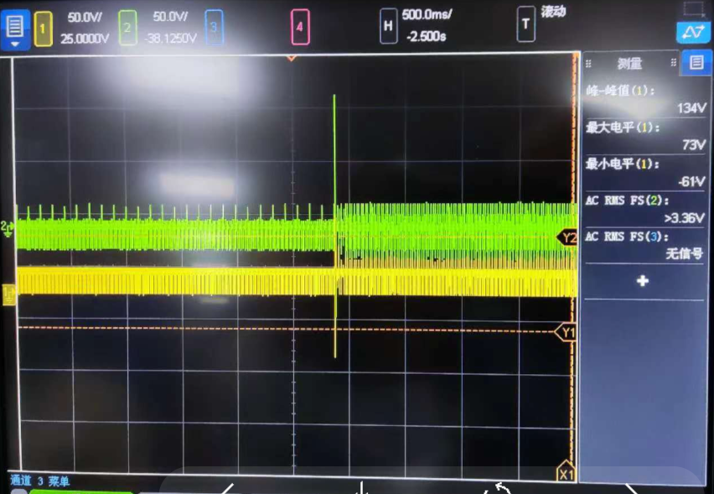
Waveforms
Questions:
It seems 20V rate C2 can’t tolerate the test in customer. Do you know what rate of C2 is usually used in other customers projects?
To pass customer test conditions, any suggestion to avoid C2 damage, adding TVS, or higher voltage rate of C2, or new CT design, or others?
Any instructions about CT design (Current transformer) for AFE3010, especially for magnetic material chosen?
Test conditions.
Vin across L-N is 220Vac is plug in at first.
Then a current , Iload, is added by connect the Zload which is not a purely resistor to simulate leakage current occur.
Test the voltage on both terminators of C2.
C2 is damaged
Zload is added to simulate leakage current, Iload_peak is abut 2A
NG_OUT
Fig. 1 Ch1 and CH2: Voltage on both terminators of C2; Ch3: Iload;
C2 is easily damaged after Zload is suddenly connected.
Fig. 21 Ch1 and CH2: Voltage on both terminators of C2. The peak voltage
Across C2 is as high as 134v+(-80V)=210V.

