Slide 1
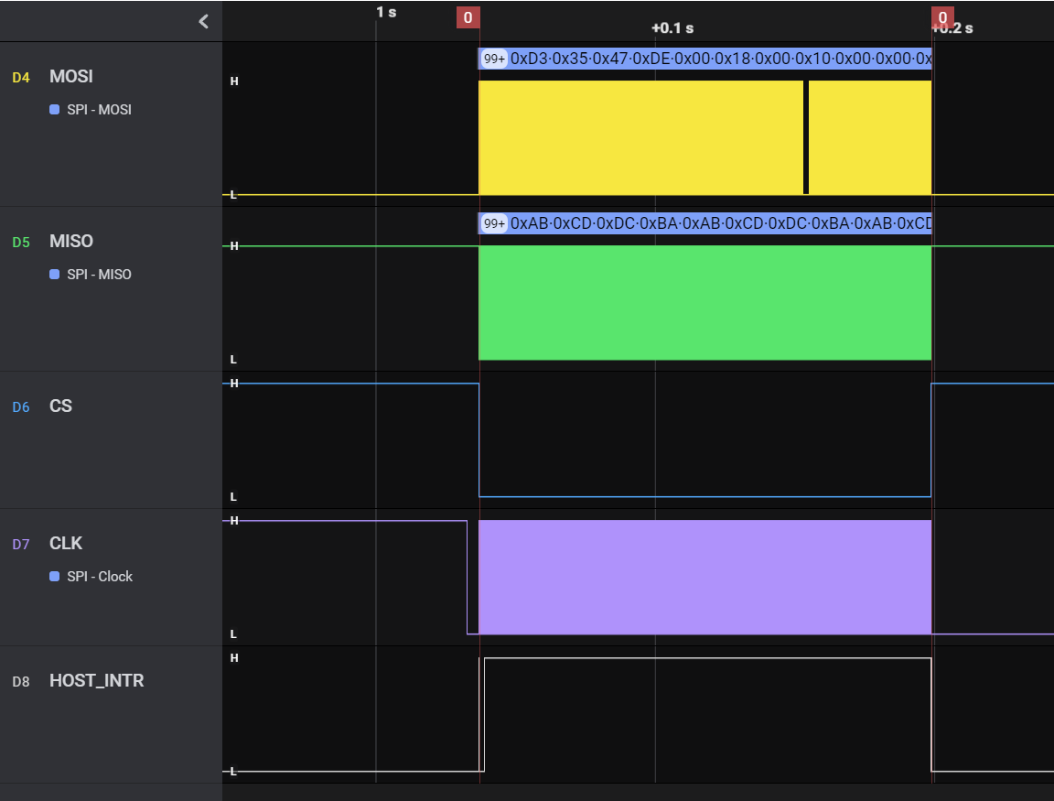
xWRL6432 SPI Boot Sequence – Complete Boot Operation
Entire SPI Boot operation is shown in this picture
It includes multiple sections like commands sent from host, image download, response from 6432

Slide 2
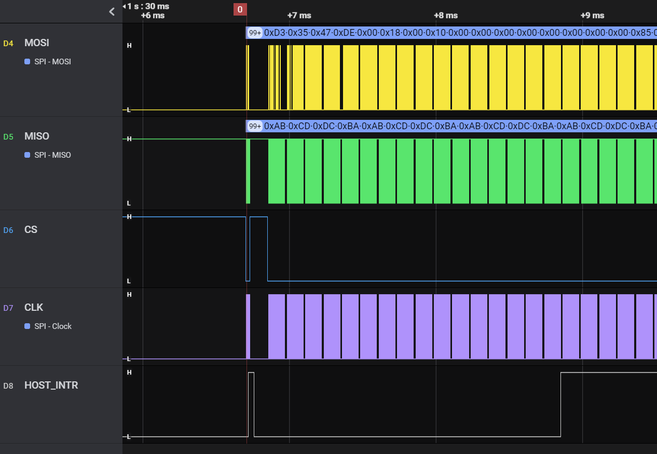

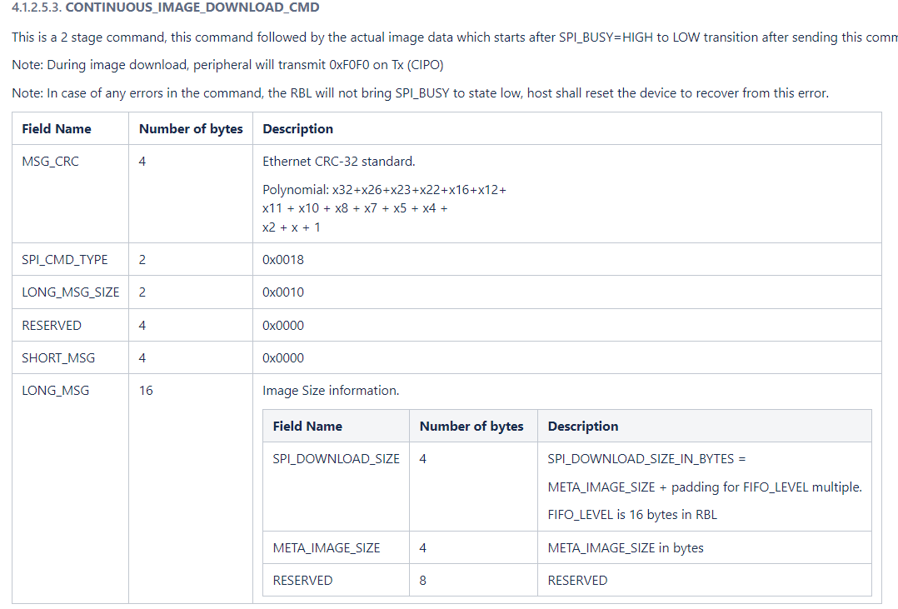
xWRL6432 SPI Boot Sequence – Initial Command
CONTINUOUS_IMAGE_DOWNLOAD_CMD sent from Host
Continuous image download command contains 32 bit CRC, Command Type, Size of the Image

Slide 3
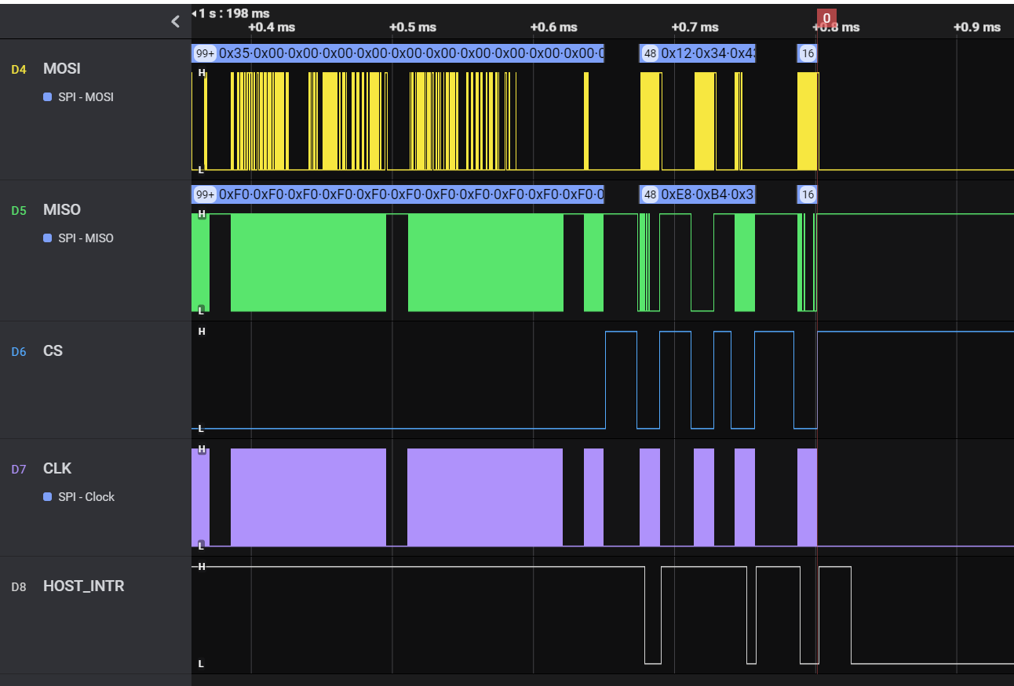
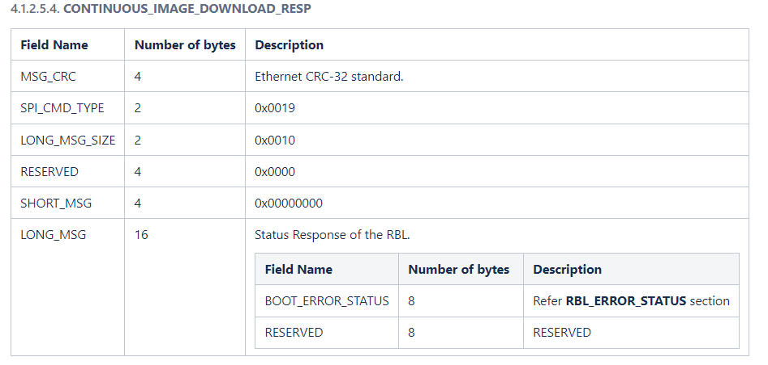
xWRL6432 SPI Boot Sequence – Continuous Image Download Response
Response from 6432 - CONTINUOUS_IMAGE_DOWNLOAD_RESP
Response from 6432 contains 32 bit CRC, Command Type and Image download status and error code

Slide 4
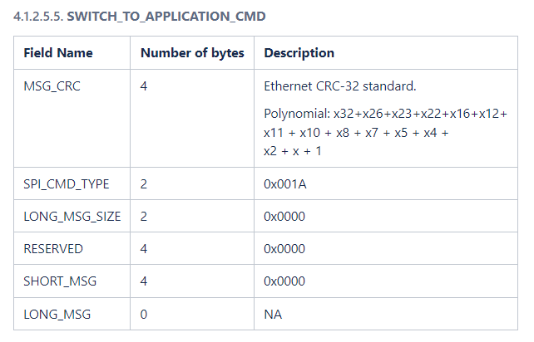
xWRL6432 SPI Boot Sequence – Switch to Application
SWITCH_TO_APPLICATION_CMD from Host
Message contains 32 bit CRC and switch to application command

Slide 5
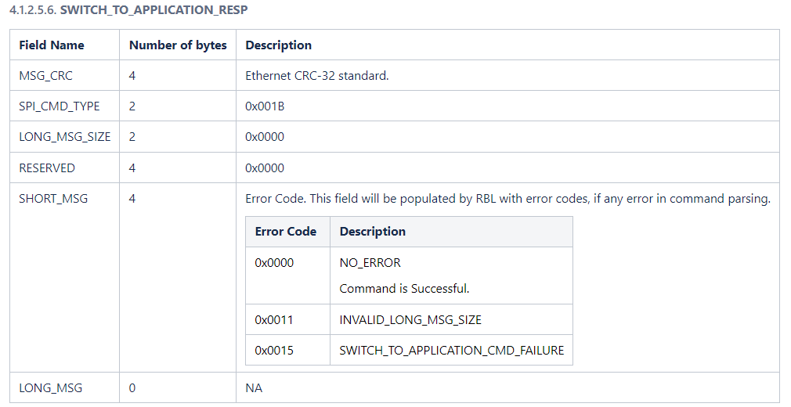
xWRL6432 SPI Boot Sequence – Switch to Application Response
SWITCH_TO_APPLICATION_RESP from 6432
Message contains 32 bit CRC, command type, and application switch status

