Slide 1
TMUXHS4212 schematic review

Slide 2
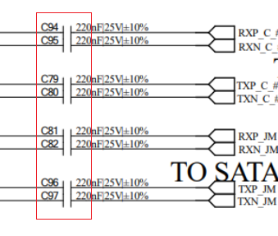
TMUXHS4212 SCH review
1: for sata, AC cap is 10nf , not 220nf

Slide 3
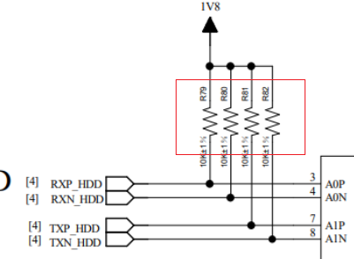
TMUXHS4212 SCH review
2: for VCC 1.8v, common mode voltage is 1.2v, so you can not biased to 1.8v.
If the sata signal common mode voltage is less than 1.2v, then you don’t need to bias it.

