Slide 1
IC Fault Review
CAN Driver IC Fault Review
2017.11.30

Slide 2
Part Name : SN65HVD233QDRQ1
Test Date : 30, Nov, 2017
CAN communication test for the IC (SN65HVD233QDRQ1)
At this time. --------------------------------------------------------------------------------
Today’s 1st. Reporting a Test 15 PCB again. That result is below... ( 9AM in the My Office. )
- Pass is 14 PCB.
- Fault is 1 PCB.
1 PCB goes to fault today. ( I didn’t do anything to the PCBs. )
I want to know why it is changing.
--------------------------------------------------------------------------------------------------

Slide 3
Part Name : SN65HVD233QDRQ1
Test Date : 29, Nov, 2017
Fault doubt reason is below…
1. When CAN communication error : I was resolved fault, connecting to other can module with jumper wire.
2. I was try to rework a new IC : even hand-soldering, Fault was remained frequently.
CAN communication test for the IC (SN65HVD233QDRQ1)
At this time. --------------------------------------------------------------------------------
1st. Reporting a Test 15 PCB. That result is below... ( 10AM in the My Office. )
- Pass is 8 PCB.
- Fault is 7 PCB.
-> Fault rate is about 24 ~ 45%
2nd Reporting a Test Fault 7 PCB. That result is below… ( 3PM in the My Office. )
- Pass is 4 PCB.
- Fault is 3 PCB.
3rd Reporting a Test Remain 3 PCB. That result is below… ( 5PM in the My Office. )
- Pass is 3 PCB.
15 PCB is a not fault now.
*** I don’t know why it was change.
--------------------------------------------------------------------------------------------------
I guess, the SMT is not fault.
The reason is other parts is all ok.

Slide 4
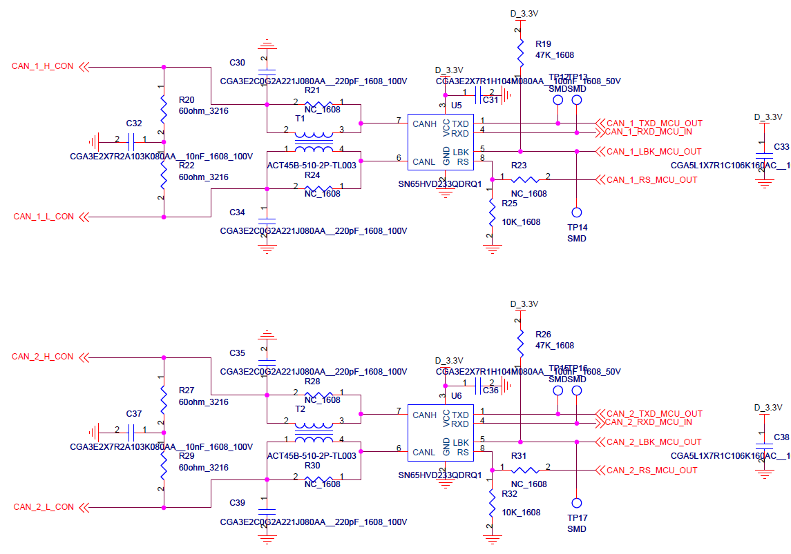
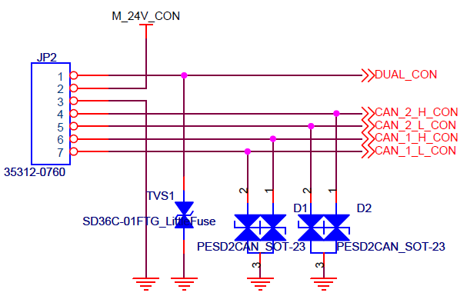
Designed Ciruit : SN65HVD233QDRQ1
LBK pin is 0V ( from MCU )
RS pin is connected 10k resistor only.
Using ESD diode for CAN-Line.

Slide 5
ANOTHER 6PCBS tEST
Additional PCBs Test

Slide 6
Another 6PCBs : SN65HVD233QDRQ1
Test Date : 29, Nov, 2017
CAN communication test for the IC (SN65HVD233QDRQ1)
At this time. --------------------------------------------------------------------------------
Reporting a Test another 6PCB. That result is below... ( 6PM in the My Office. )
- Pass is 5 PCB.
- Fault is 1 PCB.
--------------------------------------------------------------------------------------------------
Test Date : 30, Nov, 2017
CAN communication test for the IC (SN65HVD233QDRQ1)
At this time. --------------------------------------------------------------------------------
Reporting a Test another 6PCB. That result is below... ( 6PM in the My Office. )
- Pass is 5 PCB.
- Fault is 1 PCB.
This another 6PCBs Test result is not changed.
--------------------------------------------------------------------------------------------------
At here, important is IC fault appears in my case.
I had experience same situation about one month ago. ( I do careful the ESD damage when testing. )
This second time appears IC fault again.
I want to know reason. My fault or IC fault ?

