Slide 1
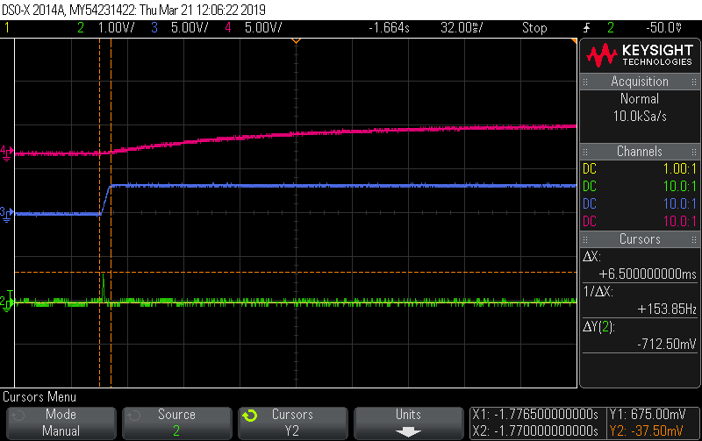
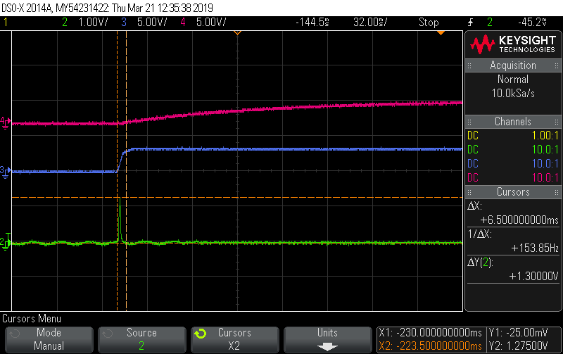
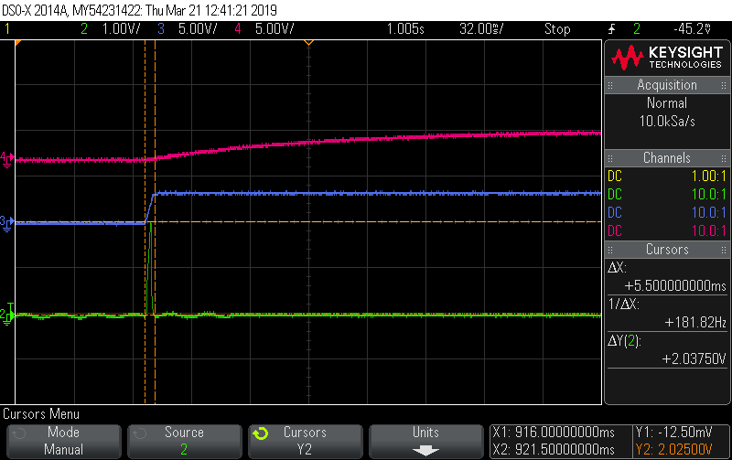
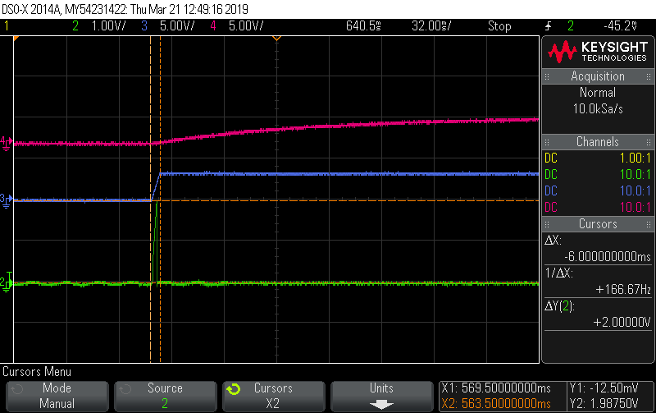
PDB
OEN/VCC
Lock
Good Board A
Good Board B
PDB
OEN/VCC
Lock
Abnormal one
Bad Board A
Bad Board B

