Slide 1
Test Procedure
Setup the boards and connect them through the desired cable length
Enable reverse loop-back on one of the boards.
Enable packet generation on another connected board.
Following parameters were monitored :
Link-status
Number of packets received
Number of packets received with errors.

Slide 2
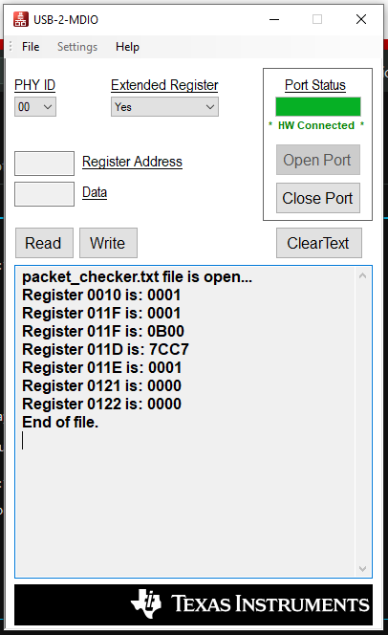
Test Results
Link is up
~1million packets
0 packets with errors
Similar number of packets were sent multiple times and 0 packet errors were observed.

Slide 3
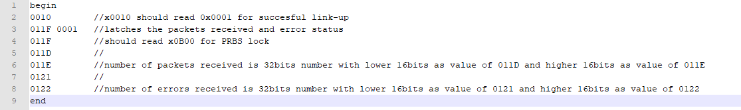

Test Scripts
Packet Checker
Packet Gen Enable
Reverse Loopback Enable

