Slide 1
How to flash MP430 Launchpad for USB2MDIO compatibility

Slide 2
Equipment list for flashing MSP430F5529
MSP430F5529 Launchpad
1 USB to Micro-USB cable (1 available USB ports on laptop/PC)
3 Female to Female wires
Uniflash
MSP430F5529 firmware text file

Slide 3
How to flash launchpad – connecting the launchpad
Please connect USB cable between MSP and laptop
Ensure jumpers are connected along middle of launchpad
GND, 5V, 3V3, RXD, TXD, SBWTDIO, SBWTCK

Slide 4
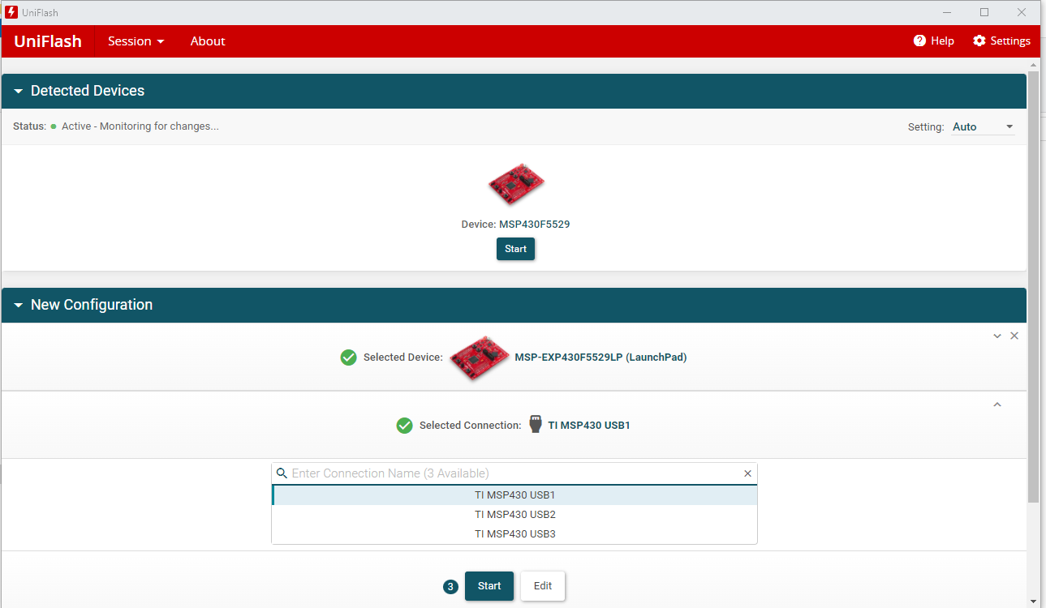
How to flash launchpad – using UniFlash
Open UniFlash
Device may be auto-detected under “Detected Devices”
If not, will need to manually configure
Search “F5529” and click “MSP-EXP430F5529LP”
Click “TI MSP430 USB1”
Click Start

Slide 5
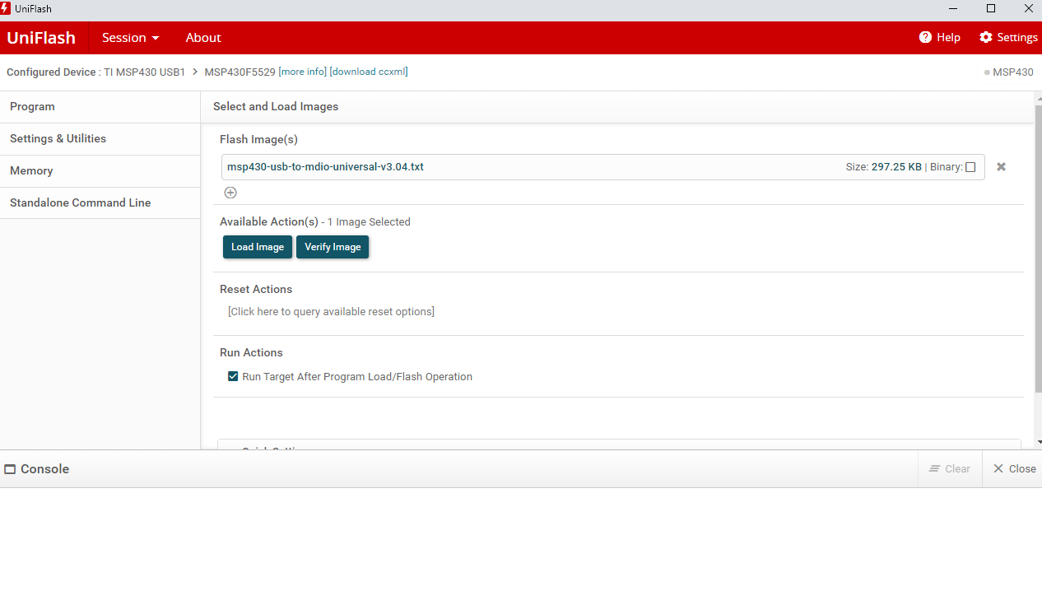
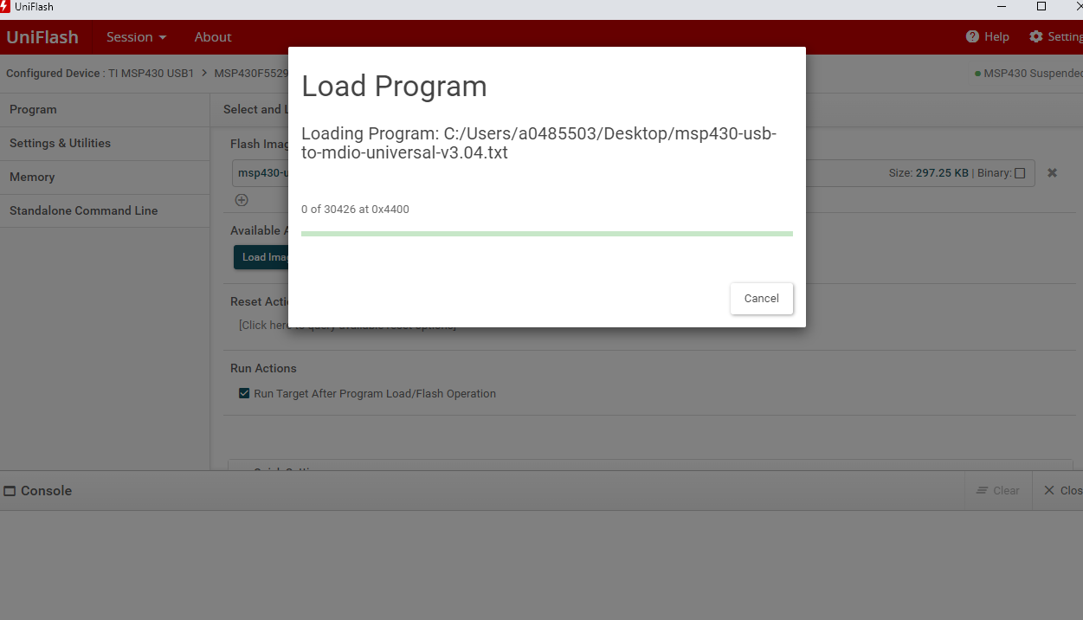
How to flash launchpad – Script loading
Upload script by clicking “Browse” and finding script in repository
In this example, I am using version 3.04 of MSP FW for USB2MDIO
Click “Load Image”
For first time MSP flashing, there may be a prompt for EZ-FET flashing. Update EZ-FET and MSP flashing will commence shortly thereafter

Slide 6
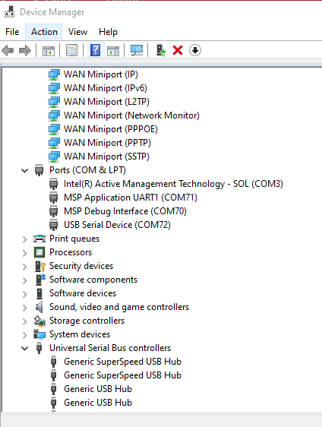
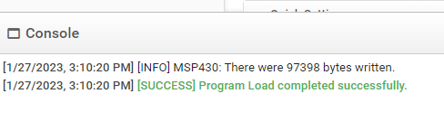
Successful Flashing
Once flashed, Console will say “[Success] Program Load completed successfully”
Device Manager will show 3 COMs under Port
MSP target device will be label as “USB Serial Device”
Here, it is COM72
Note: It has been observed that power cycling Launchpad
via disconnect/reconnect USB cable also helps if not seen
immediately

Slide 7
Using Launchpad
Now that launchpad has been flashed, it is time to connect MSP to a PHY
4.1 of MSP = MDC of PHY
4.2 of MSP = MDIO of PHY
GND will also need to be connected
IMPORTANT: Ensure connections are made, then power up PHY, then MSP. FW has logic to scan and “softlock” if PHY doesn’t initially respond
Open USB-2-MDIO and configure with “Settings”
Configure COM port to be intended COM port seen in Device Manager (Slide 6)
Baud Rate set to 9600
Configure PHY ID to be intended PHY ID
To read, enter register value as 4 digit hex value (Must be 4 digits. 0x0 = 0000) and click “Read”
To write, enter register value as 4 digit hex value and data value as 4 digit hex value and click “Write”. This will also give an immediate readback of the same register

Slide 8
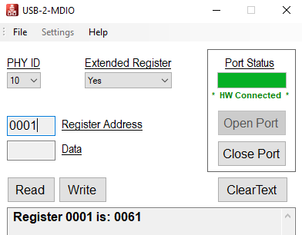
Using a flashed MSP – 813EVM-MC example
Using MSP on board of DP83TC813EVM-MC, DP83TC813 is located on PHY ID 10
Reading register 0x1 will give 0x61 for no link, 0x65 for link

