Slide 1
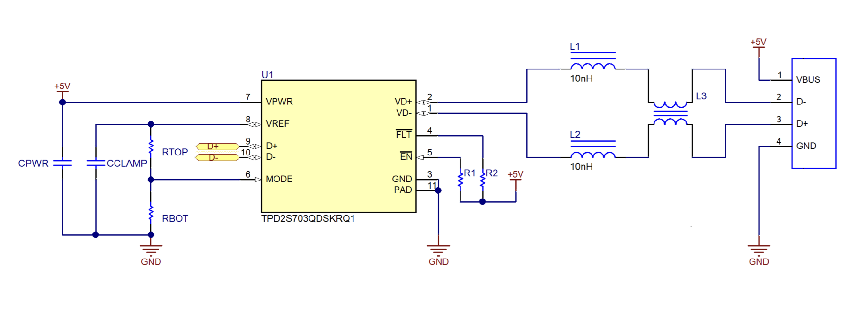
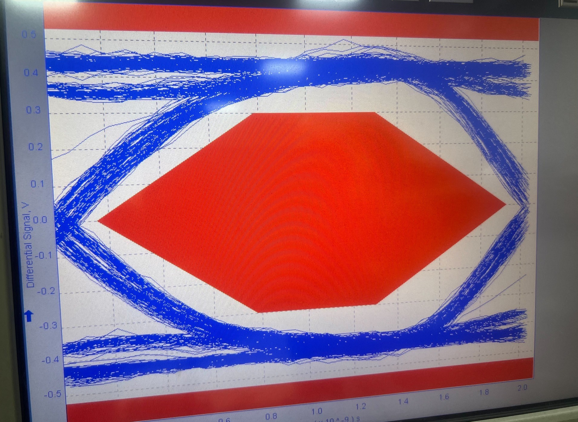
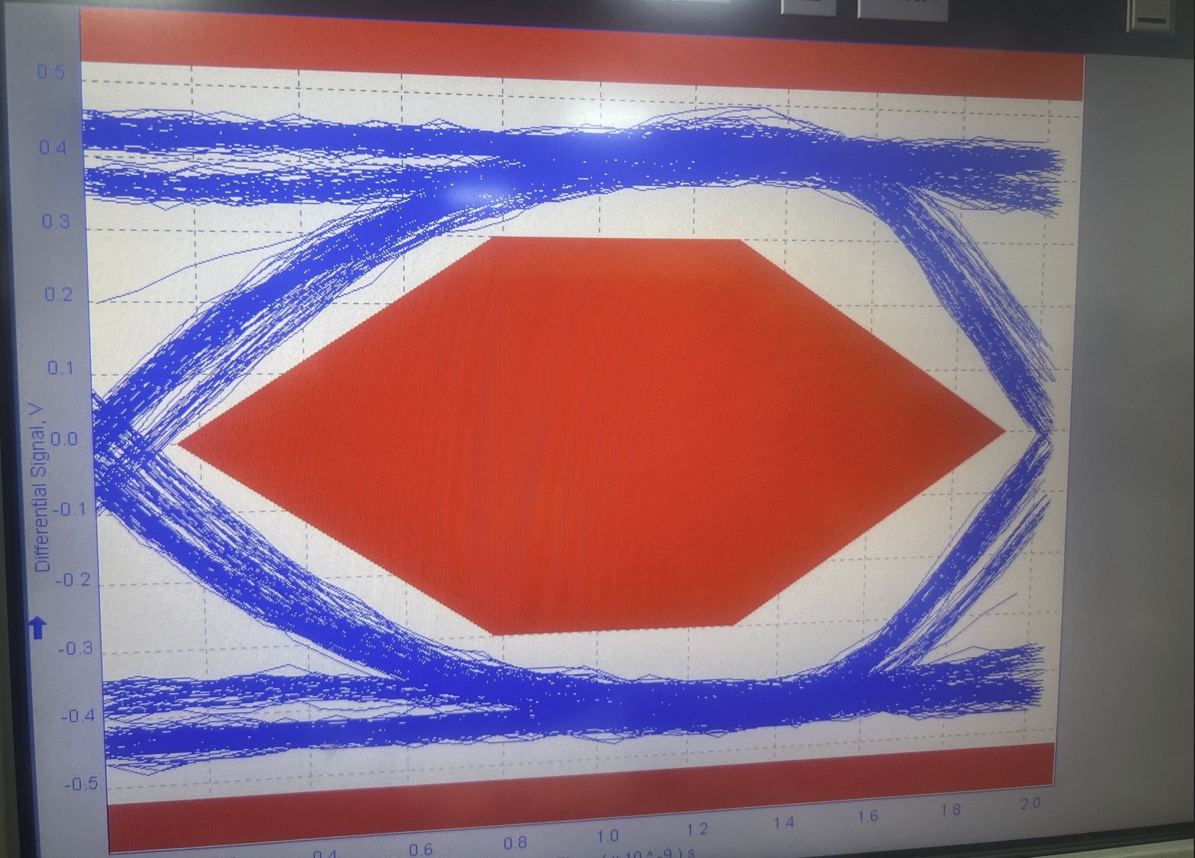
Jitter RMS would be better if change to smaller inductor
L1 and L2 move to 6.2nH
L1 and L2 move to 3.6nH

Slide 2
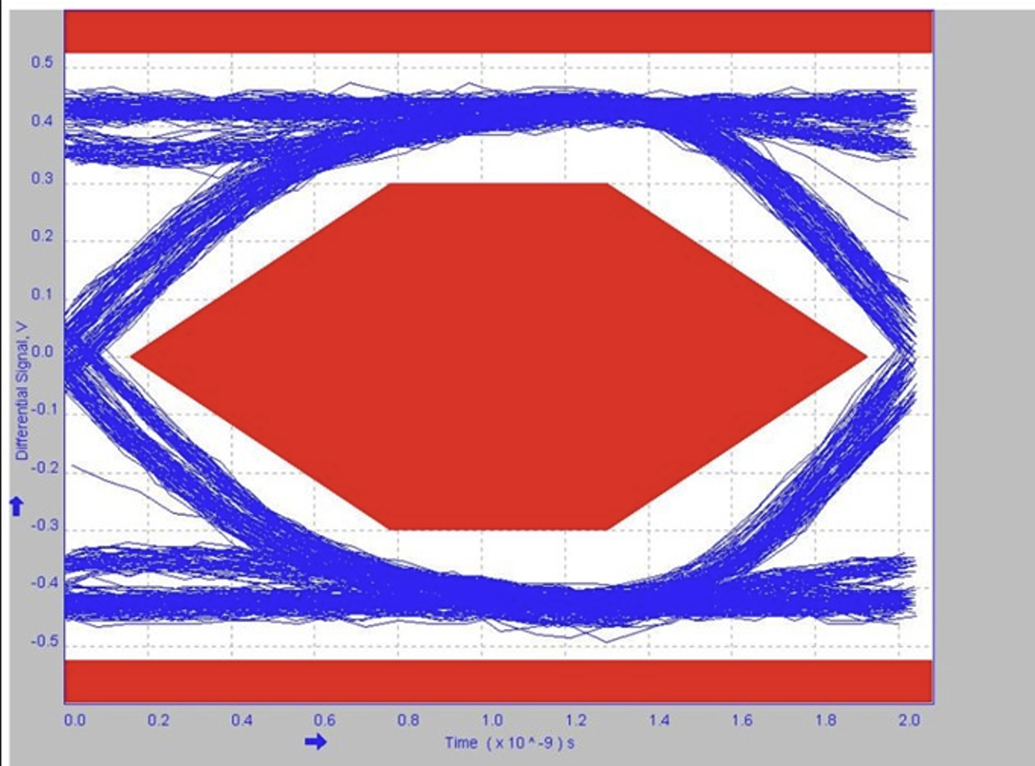
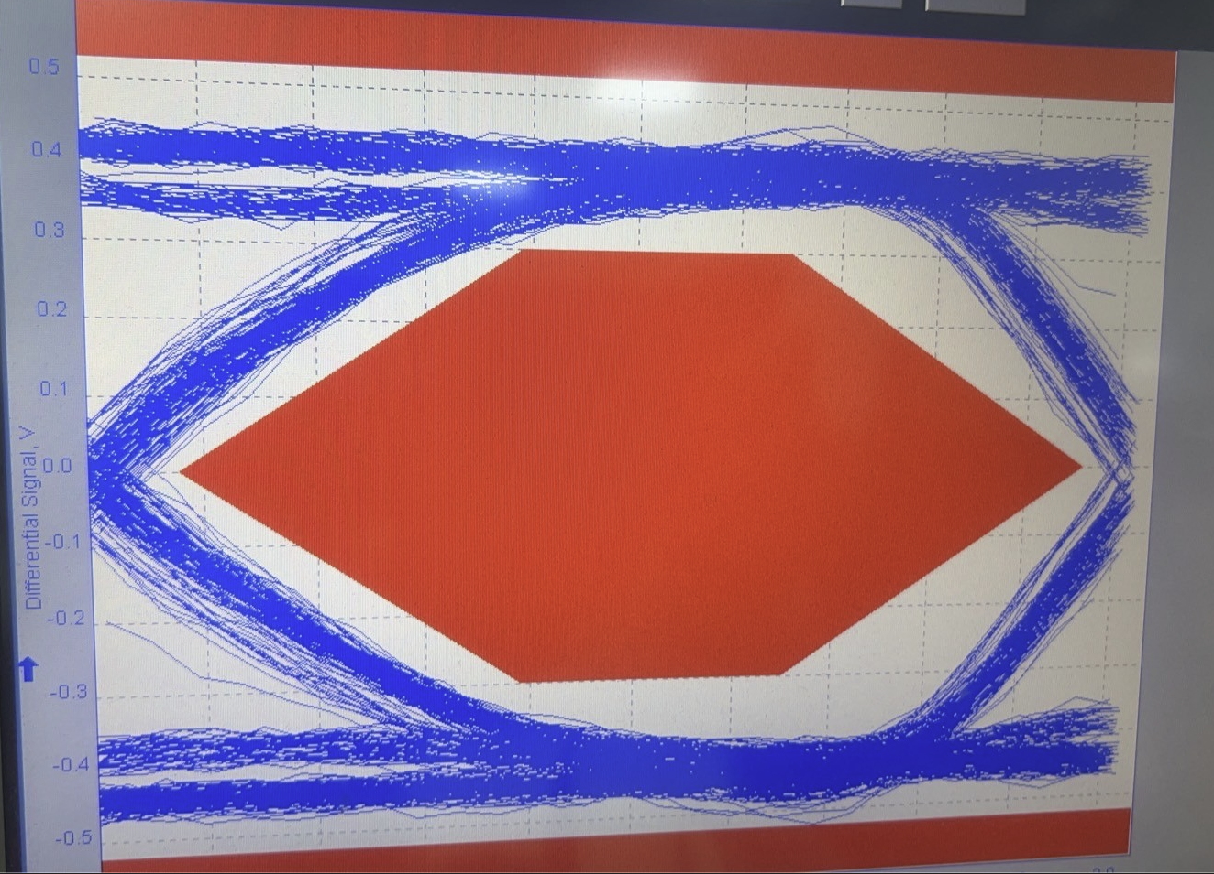
L1 and L2 = 12nH
L1 and L2 = 0nH , short together

