Slide 1
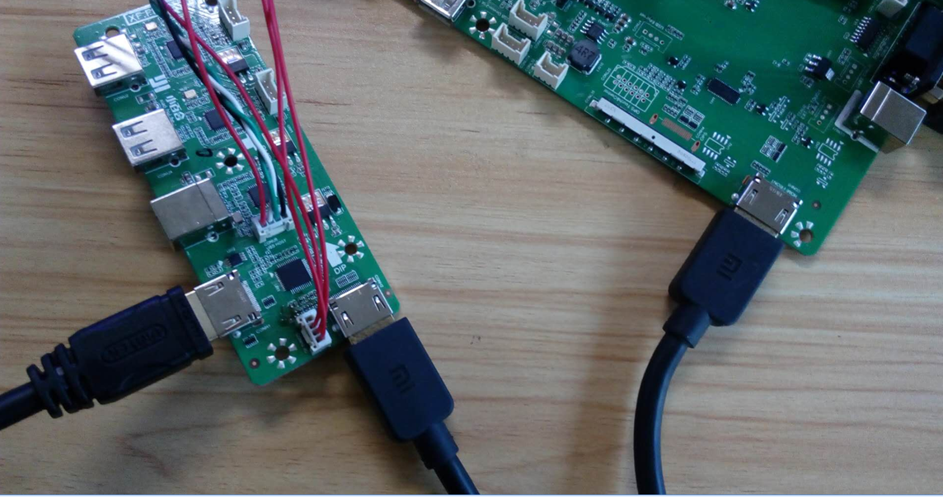
TV Board
TMDS181

