Slide 1
Redriver Placement Training
Vishesh Pithadiya
5/15/2025

Slide 2
Step 1
Understand signal path and loss profiles of the system.
PCB
Internal cable
PCB
8dB loss
1.8dB loss
1dB Loss
1.8dB loss
2dB loss
SoC
Embedded
Connector
Embedded
Connector
External
Connector
TX
TX
RX
RX

Slide 3
Step 2
Understand equalization capabilities of redriver and SoC in use
redriver used is TUSBxxxx (9.2 dB EQ post-channel 10.8dB EQ pre-channel)
8dB loss
1.8dB loss
1dB Loss
1.8dB loss
2dB loss
SoC
Embedded
Connector
Embedded
Connector
External
Connector
TX
TX
RX
RX
23dB EQ

Slide 4
Step 3
Determine the pre-channel placement based off of the max EQ values of the redriver (TUSBxxxx) and the SoC
Redriver max EQ is 10.8dB and SoC max EQ is 23dB. Between the two, the redriver has the lower EQ. Thus the maximum pre-channel loss has to be <10.8 dB
Max EQ capability of redriver
8dB loss
1.8dB loss
1dB Loss
1.8dB loss
2dB loss
SoC
Embedded
Connector
Embedded
Connector
External
Connector
TX
TX
RX
RX
23dB EQ

Slide 5
Step 4
We have determined the farthest location from the SoC the redriver can be. This would be the ideal place to put the redriver, however we must place the redriver on the PCB. We must move closer to the SoC until we can place the redriver on a PCB.
Ideal location for redriver
8dB loss
1.8dB loss
1dB Loss
1.8dB loss
2dB loss
SoC
Embedded
Connector
Embedded
Connector
External
Connector
TX
TX
RX
RX
23dB EQ

Slide 6
Step 5
Now that we have determined the ideal location for the redriver for pre-channel compensation we must make sure the post-channel compensation is within spec as well.
Redriver max downstream facing EQ is 9.2dB. The total post channel loss is 0.5dB+1.8dB +1dB+1.8dB+2dB = 7.1dB. This is less that 9.2dB so the placement is ok.
Best practice for placement is to have the post channel as short as possible while remaining within spec.
For example if maximum post channel EQ is 10dB, but minimum post channel EQ is 8dB, then our post-channel loss would be out of spec as our post channel is lower than the minimum post channel EQ. This TUSB1046A minimum post channel EQ is -3.9dB. So the TUSBxxxx can be as close to the connector as possible without violating spec.
8dB loss
<1dB loss
1.8dB loss
1dB Loss
1.8dB loss
2dB loss
SoC
TUSB1046
Embedded
Connector
Embedded
Connector
External
Connector
TX
EQ
TX
RX
EQ
RX
23dB EQ

Slide 7
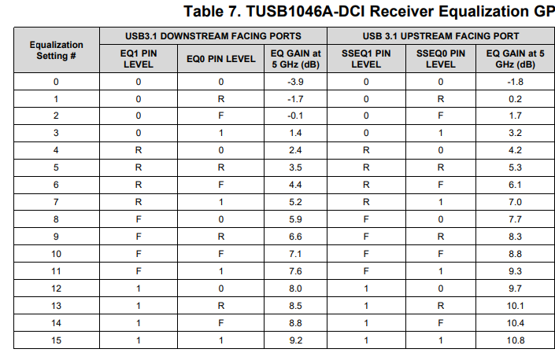
Step 6
Now that we have confirmed that the placement of the redriver is correct we must tune the EQ of the redriver to be appropriate for the system.
The Pre-channel loss is 8dB, that post-channel loss is 7.1 dB. Using the table found in the TUSBxxxx datasheet.
pre-channel (Upstream) EQ setting 9
post-channel (Downstream) EQ setting 10
The SoC EQ should be set to the pre-channel loss
8dB loss
<1dB loss
1.8dB loss
1dB Loss
1.8dB loss
2dB loss
SoC
TUSB1046
Embedded
Connector
Embedded
Connector
External
Connector
TX
EQ 9
TX
RX
8dB EQ
EQ 10
RX

