Slide 1
DS90UB934 Schematic Review
FPD-Link Applications Team

Slide 2
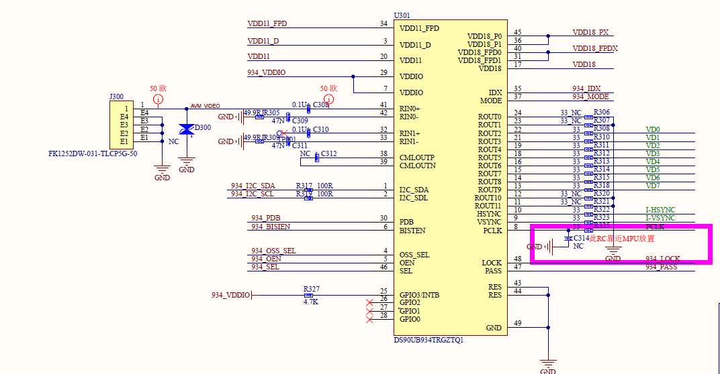
Bypass capacitors needed on pins 45, 36, 40, and 31 instead of being shorted
Separate bypass capacitors needed on pins 29 and 7
Ensure caps on pins 41, 42, 32 and 33 are rated for 2x the voltage of PoC
Unused ROUT are recommended to be left open. Make sure corresponding serializer matches use.
Typical applications do not have 33 Ohm resistor
Recommended caps on pin 38 and 29 = 100nF
No test pads ?
Missing 4.7k pull up resistors on SDA and SCL lines. VI2C must equal VDDIO.
GPIO3 INTB permanently pulled high but no other connections are seen

Slide 3
Customer should ensure LDO operates as expected, datasheet denotes minimum output current of 1.5A

Slide 4
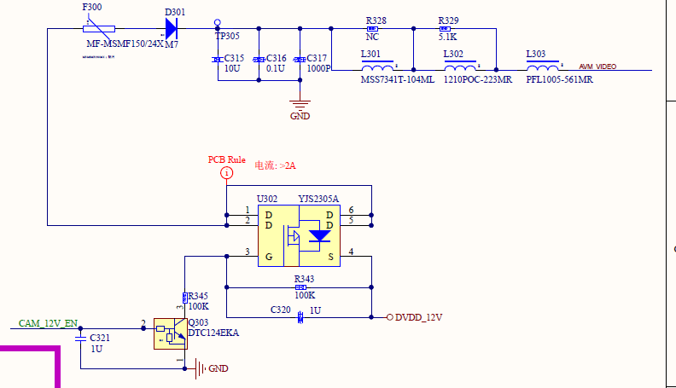
Not a datasheet approved PoC solution, should verify the correct power specifications are followed

Slide 5
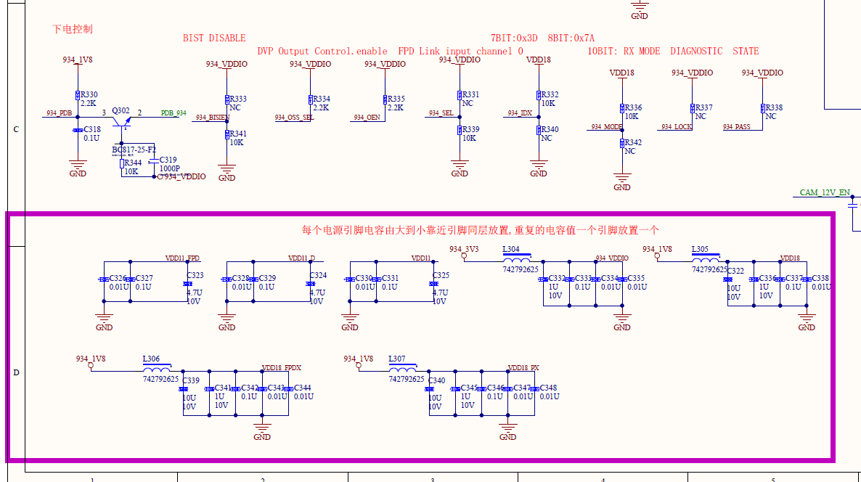
10uF recommend but 0.1uF is ok if power sequencing is followed
Missing caps on IDX and MODE pins
Permanently pulled high
IDX
0x7A 8-bit
0x3D 7-bit
RAW10
Coax
Why are lock and pass pulled high?
Missing caps on IDX and MODE pins
Bypass caps that were missing before shorts are here but should be placed close to the device

Slide 6
Important notice and disclaimer
TI PROVIDES TECHNICAL AND RELIABILITY DATA (INCLUDING DATASHEETS), DESIGN RESOURCES (INCLUDING REFERENCE DESIGNS), APPLICATION OR OTHER DESIGN ADVICE, WEB TOOLS, SAFETY INFORMATION, AND OTHER RESOURCES “AS IS” AND WITH ALL FAULTS, AND DISCLAIMS ALL WARRANTIES, EXPRESS AND IMPLIED, INCLUDING WITHOUT LIMITATION ANY IMPLIED WARRANTIES OF MERCHANTABILITY, FITNESS FOR A PARTICULAR PURPOSE OR NON-INFRINGEMENT OF THIRD PARTY INTELLECTUAL PROPERTY RIGHTS.
These resources are intended for skilled developers designing with TI products. You are solely responsible for (1) selecting the appropriate TI products for your application, (2) designing, validating and testing your application, and (3) ensuring your application meets applicable standards, and any other safety, security, or other requirements.
These resources are subject to change without notice. TI grants you permission to use these resources only for development of an application that uses the TI products described in the resource. Other reproduction and display of these resources is prohibited. No license is granted to any other TI intellectual property right or to any third party intellectual property right. TI disclaims responsibility for, and you will fully indemnify TI and its representatives against, any claims, damages, costs, losses, and liabilities arising out of your use of these resources.
TI’s products are provided subject to TI’s Terms of Sale or other applicable terms available either on ti.com or provided in conjunction with such TI products. TI’s provision of these resources does not expand or otherwise alter TI’s applicable warranties or warranty disclaimers for TI products.

