Slide 1
DS90UB947/948 Application Issue

Slide 2
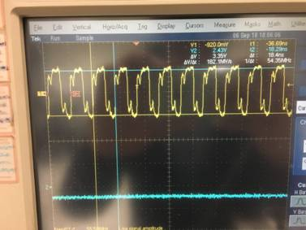
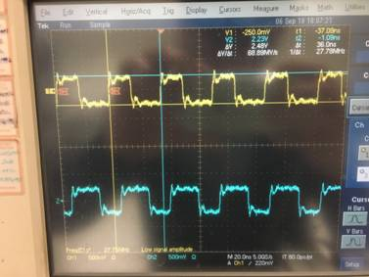
LVDS Signal
LVDS signal in Frequency is 54.35MHz
LVDS signal in Frequency is only 27.78MHz

Slide 3
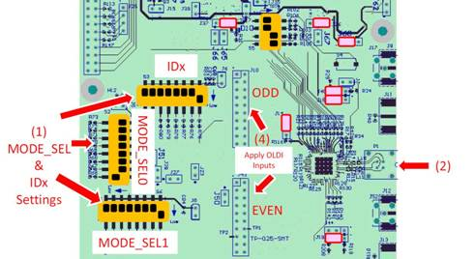
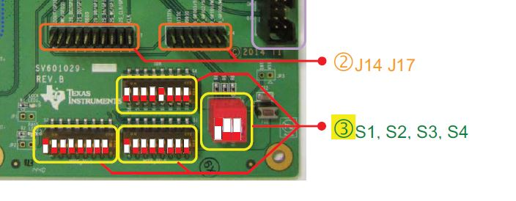
EVMs Setting Conditions
DS90UB947
DS90UB948

