Slide 1
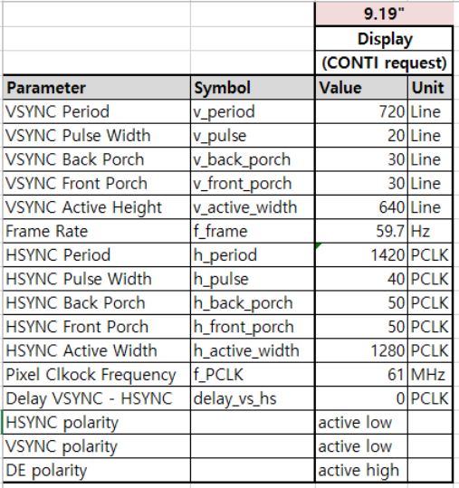
Display timing info

Slide 2
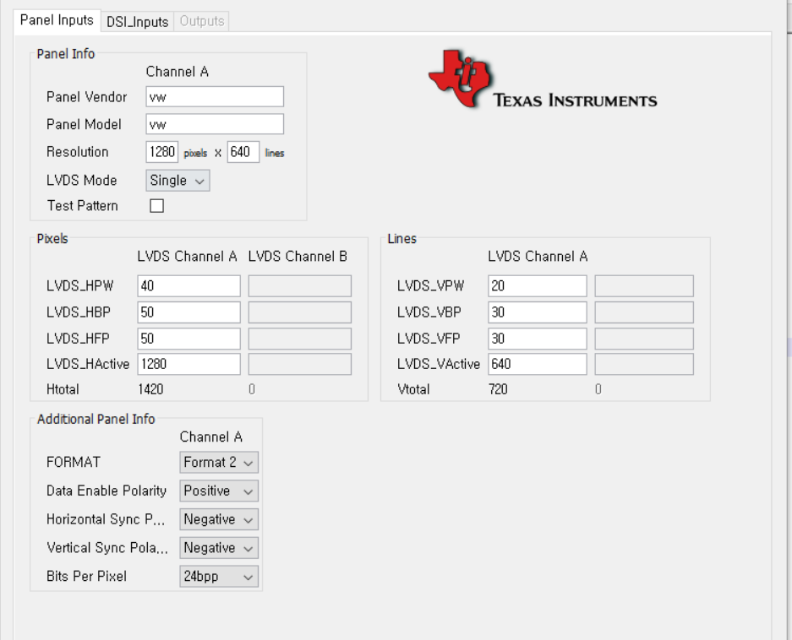
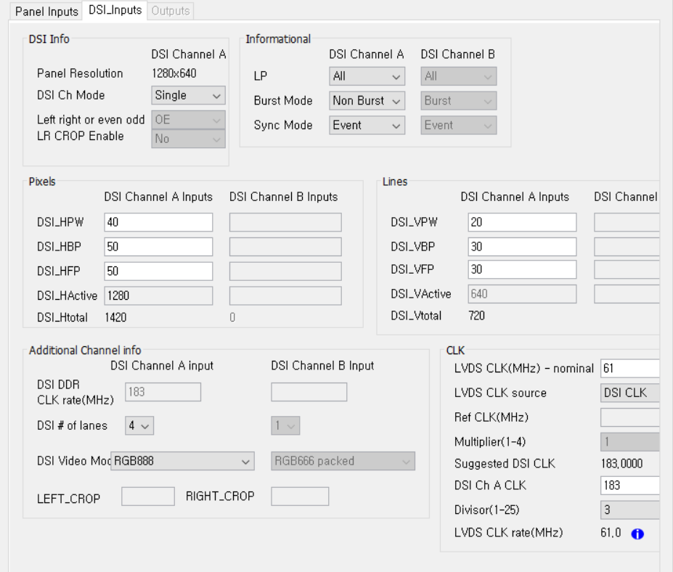
install DSI Tuner 2.0.exe
java -jar "DSI Tuner.jar"

