Slide 1
ASRock Layout Review
December 2023

Slide 2
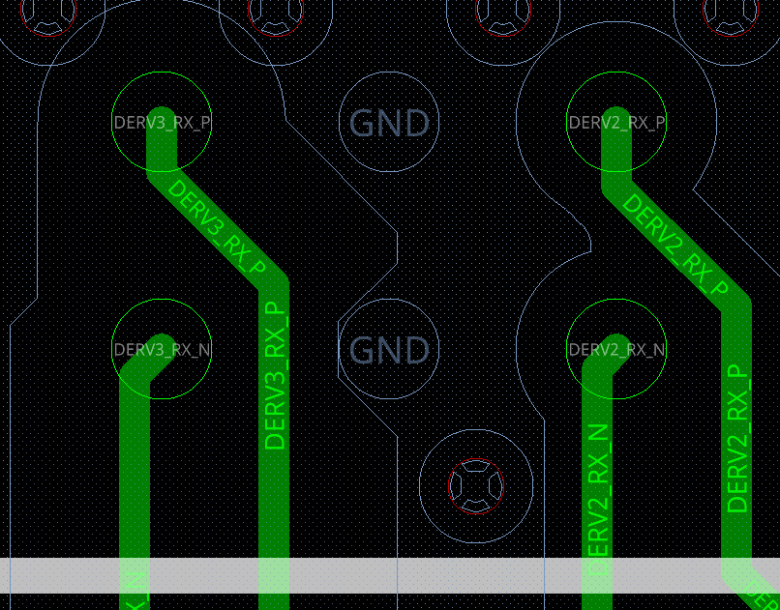
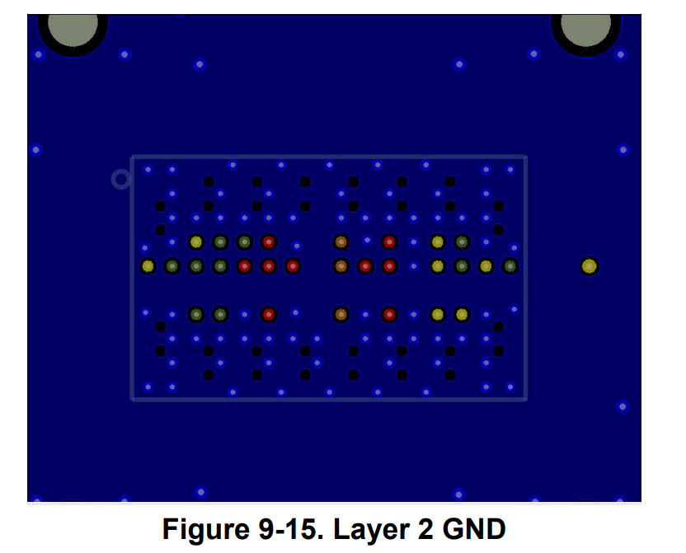
High Speed Signal Pads should have anti-pads on L2, as shown in datasheet.

Slide 3
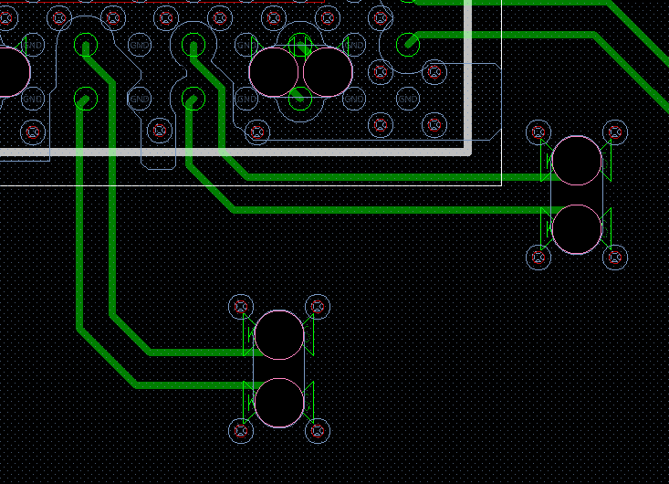
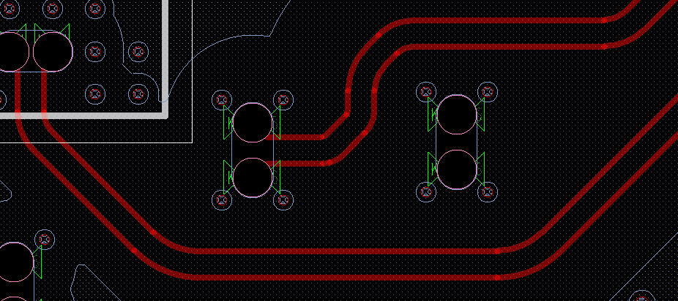
High speed traces should have smooth curves, not 135 degree turns.
Not Good
Good

Slide 4
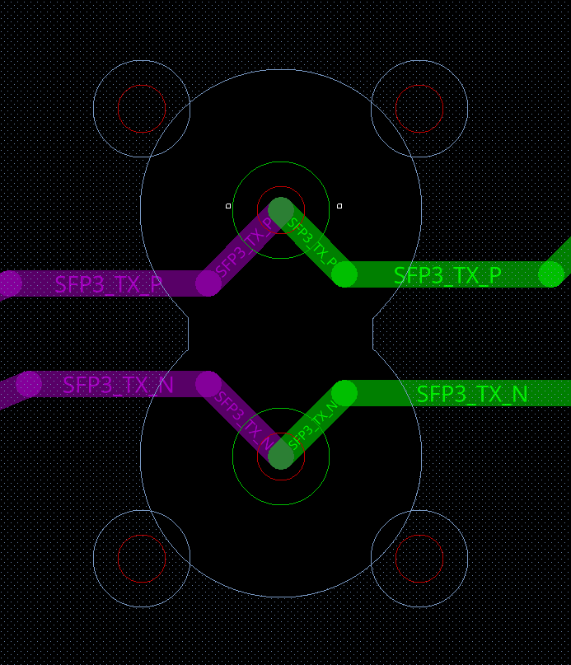
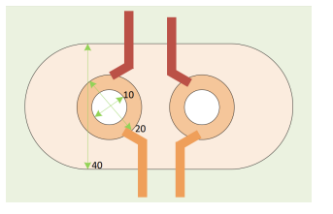
Typically, we recommend a ratio of 1x, 2x, 4x for via drill, pad, and void. Please evaluate if this ratio should be used.

Slide 5
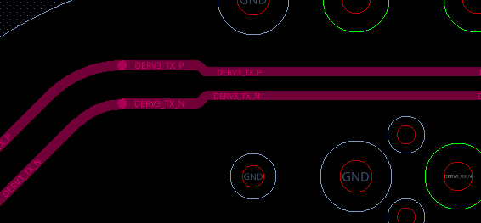
Noticed trace distance change
This will change characteristic impedance. Can you verify that the traces are 100 Ohm differential traces? Is the purpose of the reduction in trace distance to avoid change in Z0 from nearby vias?

