Slide 1
Basic Check-out of a Controller Area Network (CAN) Bus
Industrial Interface Applications
December 2016

Slide 2
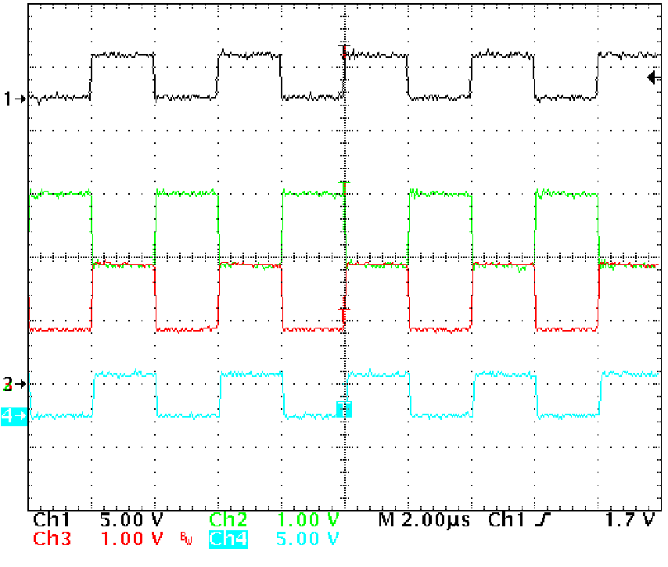
ISO 11898-2 High Speed CAN Basic Waveforms
Signal descriptions
Ch. 1 (black): TXD input
Ch. 2 (green): CANH
Ch. 3 (red): CANL
Ch. 4 (blue): RXD output
The CAN bus should be dominant (CANH pulled high, CANL pulled low) when TXD is low on any transceiver and should be recessive (CANH = CANL) when TXD is high on all transceivers.
The RXD output should be low when the bus is dominant and high when the bus is recessive.
A square wave pattern is pictured here, but in an actual application a data pattern following the CAN frame structure will be observed.

Slide 3
Check VOD(Dominant)
The differential signal amplitude (difference between CANH and CANL voltages) should be greater than 1.5 V during the dominant state.
If the signal is too low, check the resistance between CANH and CANL. It should be close to 60 Ohms due to the termination resistances (two 120-Ohm resistors placed at the distal ends of the bus).
If a large number of nodes share the bus, the leakage currents of the CAN transceivers may further load the signal. Make sure that the transceivers used have a high enough input impedance to support the node count needed.

Slide 4
Check Recessive Voltages
The differential signal amplitude should be less than 500 mV when the bus is recessive, and the single-ended CANH and CANL voltages should be about halfway between their respective dominant voltage levels.
If the recessive level is too large, check to make sure the bus is properly terminated. (The recessive state is not driven by the CAN transceiver, so external resistances are required to pull CANH and CANL together).
If the CANH and CANL voltages are not centered in the recessive state, CAN communication will likely still work. However, there may be some short circuits or leakage paths on the bus or an improper bus configuration (such as a mix of active and unpowered/inactive transceivers).

Slide 5
Check Bit Timing
Measure the width of a dominant and recessive bit. They should be similar in duration.
If a bus is improperly terminated or if there is a lot of capacitive loading, the dominant-to-recessive edge can become much larger than the recessive-to-dominant edge. This can result in dominant bits that last longer than recessive bits, which can degrade the system’s timing margin.

Slide 6
Other Items to Note
When observing signals, be careful that the measurement set-up does not interfere with the signals themselves. Ideally the CAN bus will be measured using high-impedance oscilloscope probes with active tips. This avoids additional loading of the signal (e.g., due to 50-Ohm oscilloscope inputs) and avoids introducing a long “stub” (unterminated cable branch) to the bus.
Some CAN buses will show ringing/oscillation following the dominant-to-recessive edges. This is more common in non-ideal network topologies that feature several long stubs. This can be tolerated to an extent by a CAN controller, since the ringing results in glitches in the early part of the recessive bit but the sampling occurs in the last quarter of the bit. If the ringing lasts too long, though, bit errors can result. Shortening stubs is the best solution, and implementing partial termination on the stubs (e.g., ~1 kOhm resistances) can help as well.
During the beginning (arbitration) and end (acknowledgement) of a CAN frame, it is possible for multiple transceivers to drive dominant levels at the same time. This tends to create dominant bits with increased amplitude. The larger amplitude is expected and does not create a problem.
The CAN controller should have transmit and receive error counters. These can be read at each node to see whether communication is healthy, and if issues arise these counters can help indicate which node is problematic for the bus.

