Slide 1
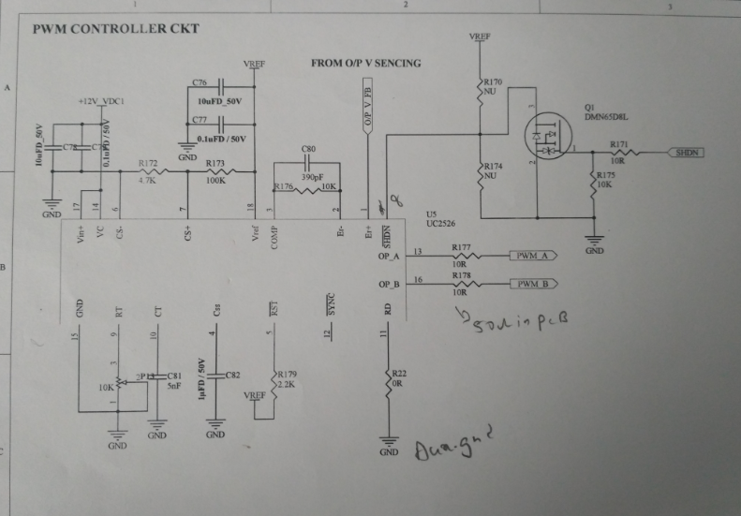
PWM IC Circuits

Slide 2
PWM Driver IC Circuits

Slide 3
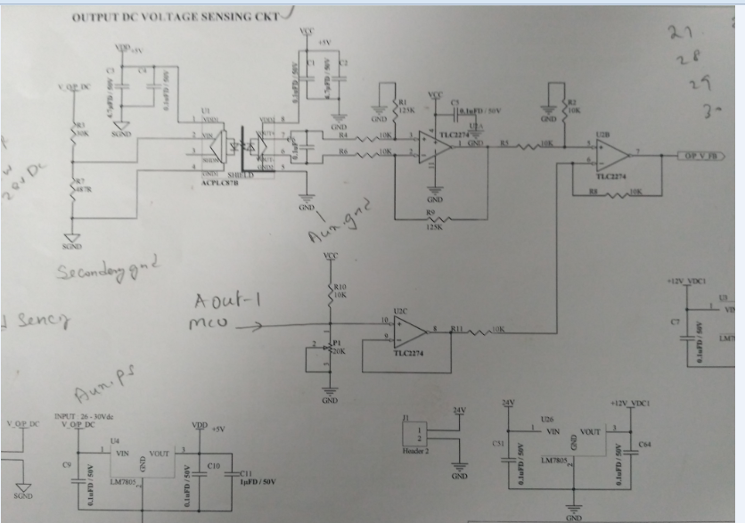
Feedback circuits

Slide 4
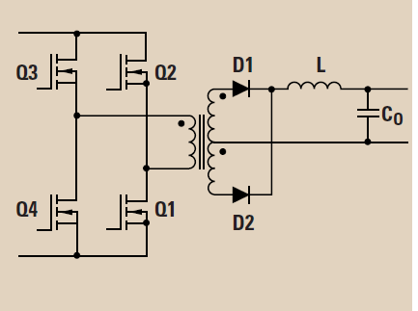
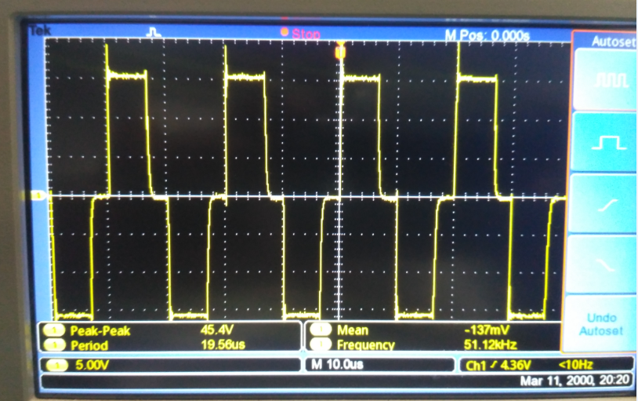
Wave form at resistive load at H-bridge
Instead of transformer resistance 220 ohms connected refer marked arrows

Slide 5
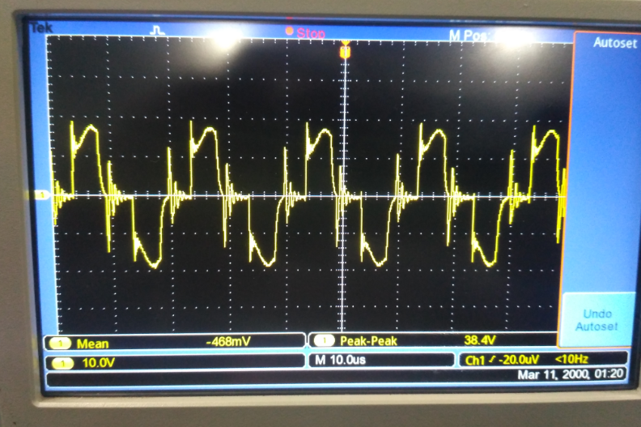
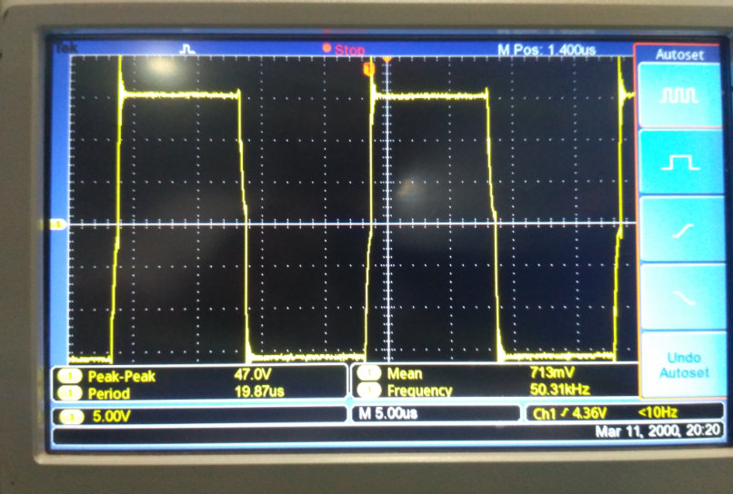
Wave form at Transformer load at H-bridge
Min PWM condition fig 1
MAX PWM condition
Note: When transformer is connected the there is PWM No variations at minimum PWM waveforms comes in fig 1 , no snubber added.

Slide 6
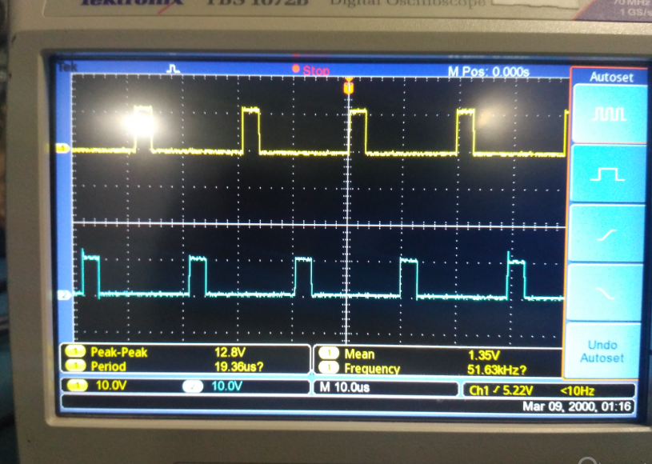
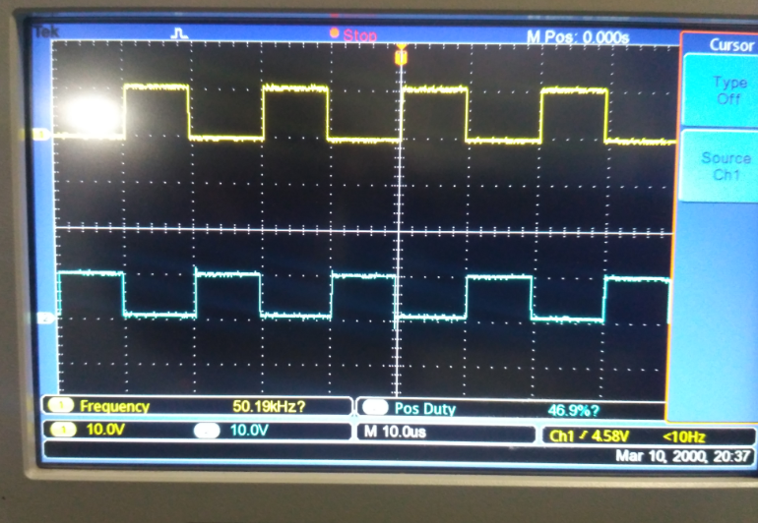
Wave form at IC UC 2526
Min PWM condition A and B
Max PWM condition A and B

Slide 7
Inputs
FSW 50Khz
Trim pot connected at pin no:11 of UC 2526 IC for PWM variation
Checked at open loop conditions only

Slide 8
Problems
When transformer is connected to H-bridge the PWM go Maximum at minimum PWM the waveform goes as sine wave 50Khz

