Slide 1
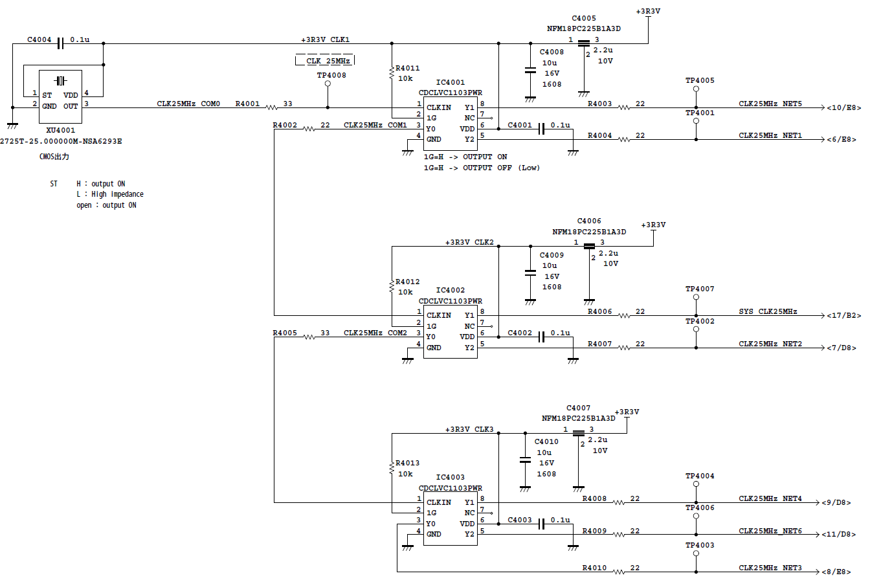
Clock Distribution
2020.12.9
to TEST
to P1
to FPGA
to P2
to P4
to P3

Slide 2
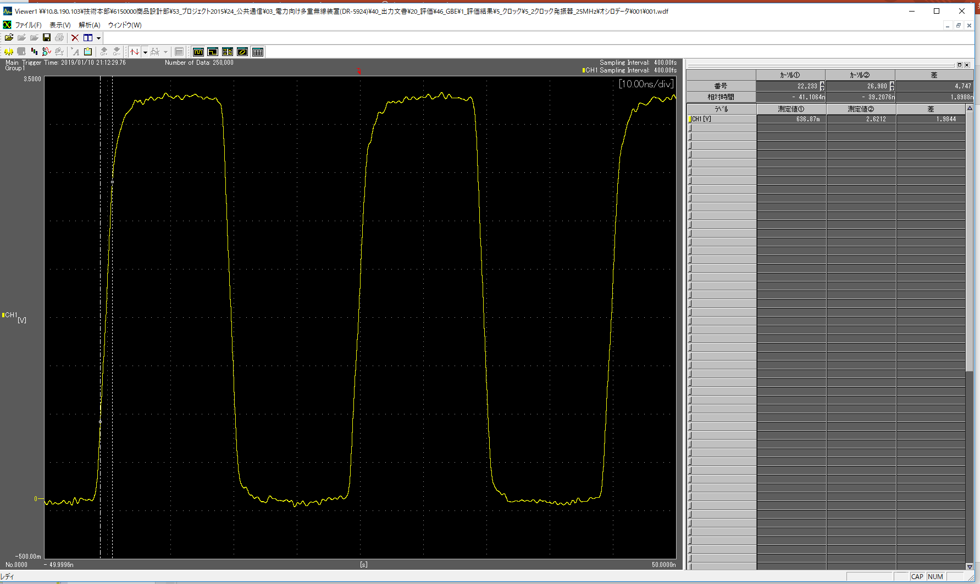
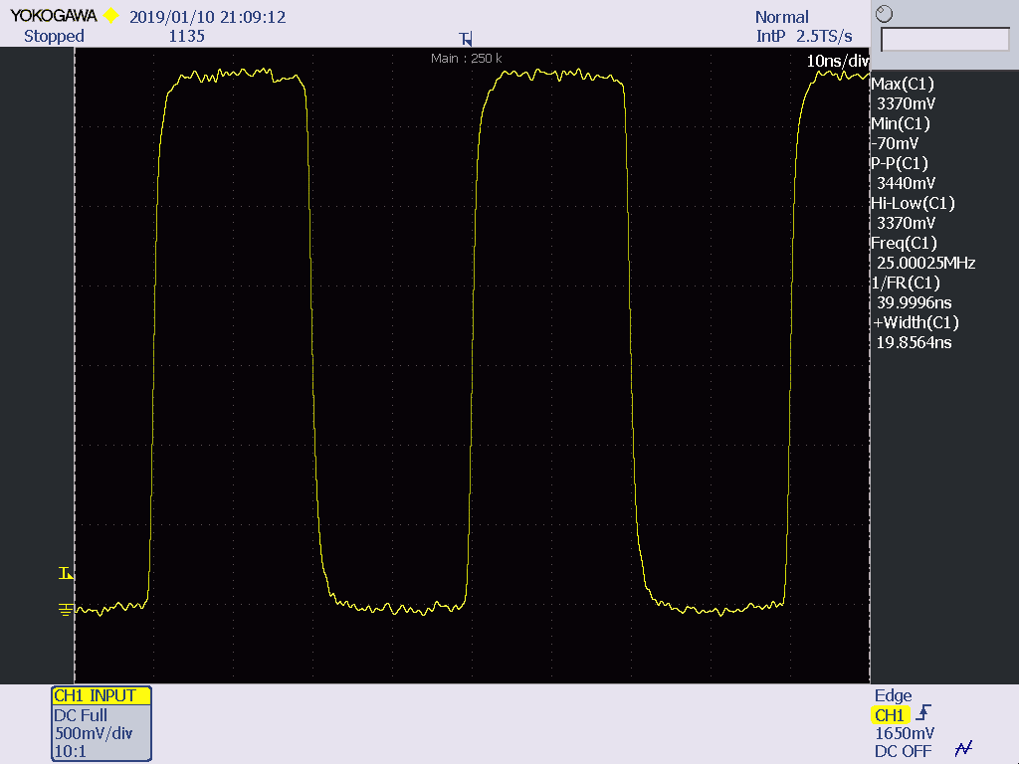
TP4008
Clock Distribution
2020.12.9
TP4001:CLK25MHZ_NET1

Slide 3
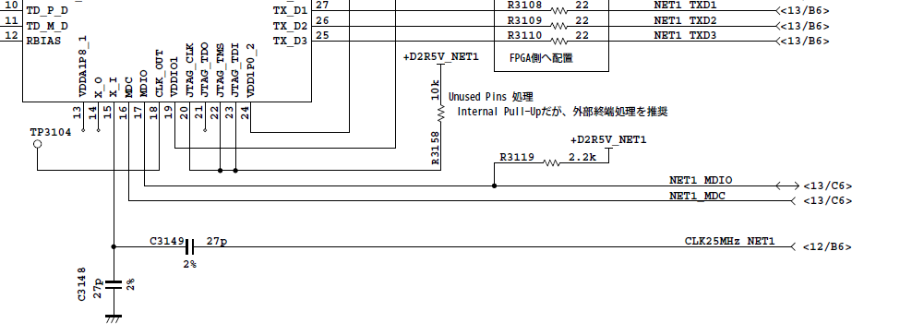
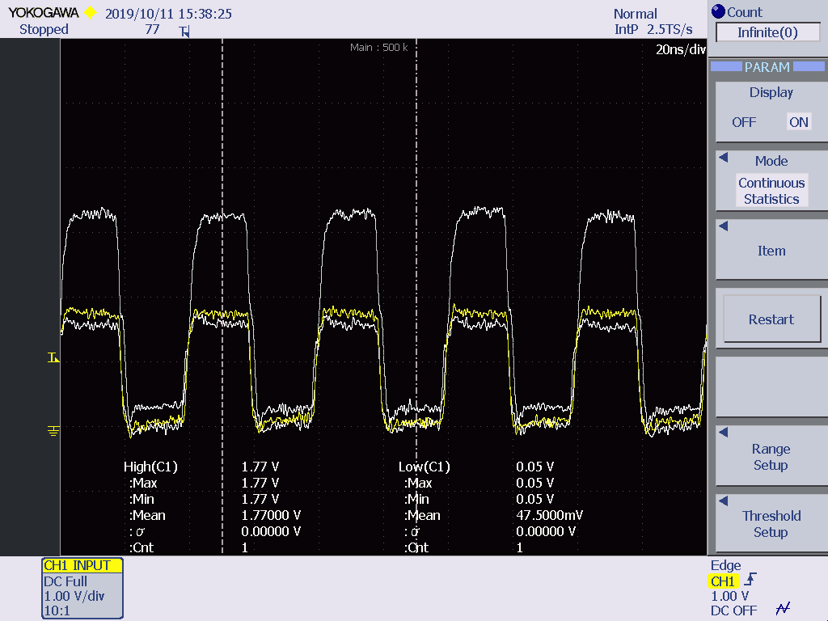
2020.12.9
slit
Yellow
Vh=1.77V
Vl=0.05V

Slide 4
EOF

