Slide 1
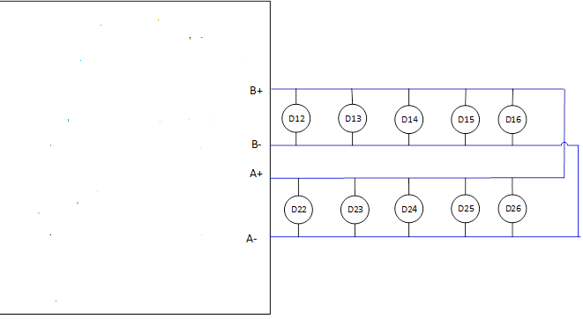
Introduction:
The fire loop protocol is a master-slave, half-duplex and bit oriented protocol. Panel loop card is master and devices act as slaves. Loop card uses different voltage ranges called voltage pulse code modulation (PCM) to send 1 and 0. Devices consume current responding with 1 and 0. Loop card also provides power to devices on two wire bus. Devices have charging capacitor that charges during idle time or startup time. Based on charging, startup time is typically delayed to run loop bus.
Processor
Analog
Front End
Circuit
Smoke or
heat sensors
(251 or 511 nos)
High Level Block Diagram of loop card.

Slide 2
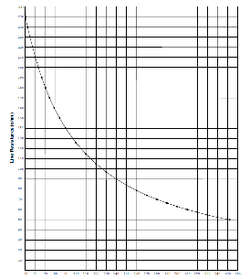
Sensor Power Supply
Protocol
Line Resistance/Sensor Load
Line Resistance/Sensor Load

Slide 3
Fault Protection Requirements:
Fault | Class B | Class A
1 | Short between B+ and B- | Short between B+ and B-
2 | Ground Fault B+ and Earth | Ground Fault B+ and Earth
3 | Ground Fault B- and Earth | Ground Fault B- and Earth
4 | Resistive short between B+ and B- | Resistive short between B+ and B-
5 | Too many devices, two much current will act as short fault | Too many devices, two much current will act as short
6 |  | Short between A+ and A-
7 |  | Ground Fault A+ and Earth
8 |  | Ground Fault A- and Earth
9 |  | Resistive short between A+ and A-
10 |  | Open in B+ (A+) line
11 |  | Open in B- (A-) line

