Slide 1
Use DE pin to control output differential signals
Jun.27,2025

Slide 2
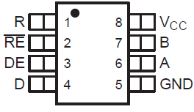
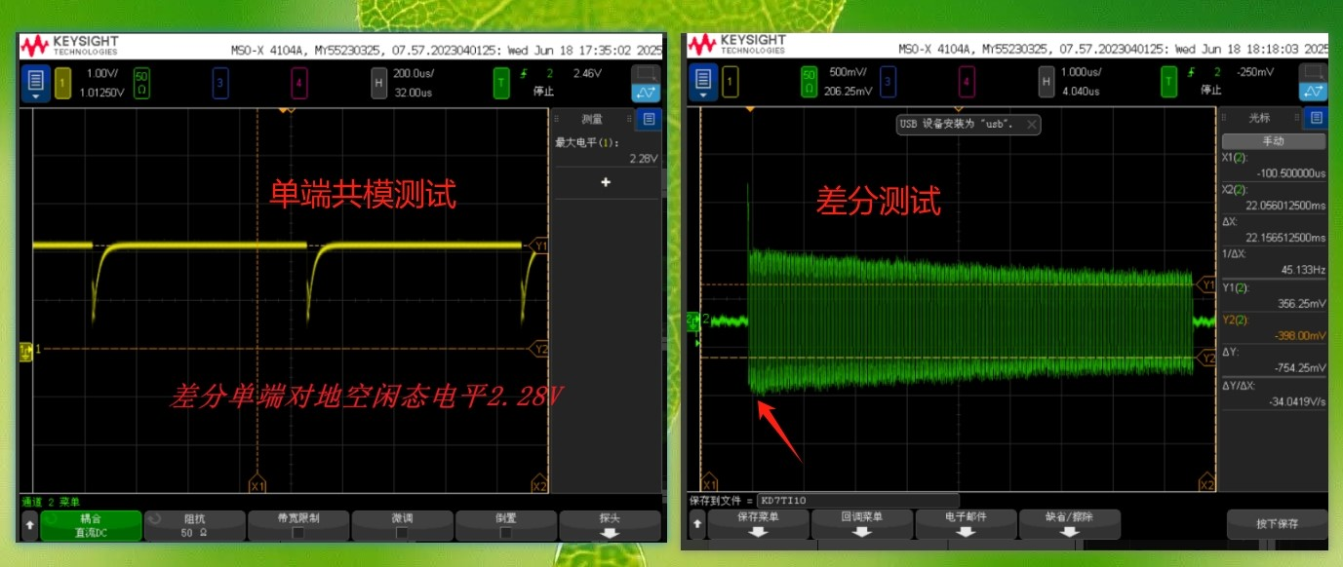
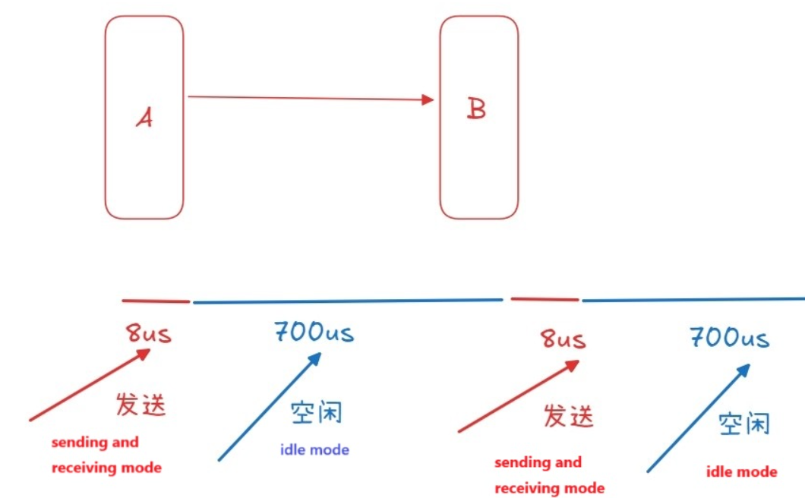
A fixed amplitude clock input signal is always present on the D (PIN4), enable or disable the differential signal output between the AB pins by pulling the DE pins high and low.
Q1: How long is the differential output enabling after DE is high?
Q2: Refer to Fig.01, What is the reason for the differential signal amplitude to decrease over time when the DE is high?
DE
SN65MLVD206D
Transmitter
SN65MLVD206D
Receiver
DE(Pin3)
D(Pin4)
A-B
DE(Pin3):High
DE(Pin3):L
DE(Pin3):High
DE(Pin3):L
Fig 01, Differential output voltage A(pin6)-B(pin7)

Slide 3
DE
A-GND
A-B
Fig 01, output single voltage on A(pin6)-GND
Fig 02, Differential output voltage A(pin6)-B(pin7)

