Slide 1
DELL TUSB1142 Layout Review
7/17/2024
Shane Hauser

Slide 2
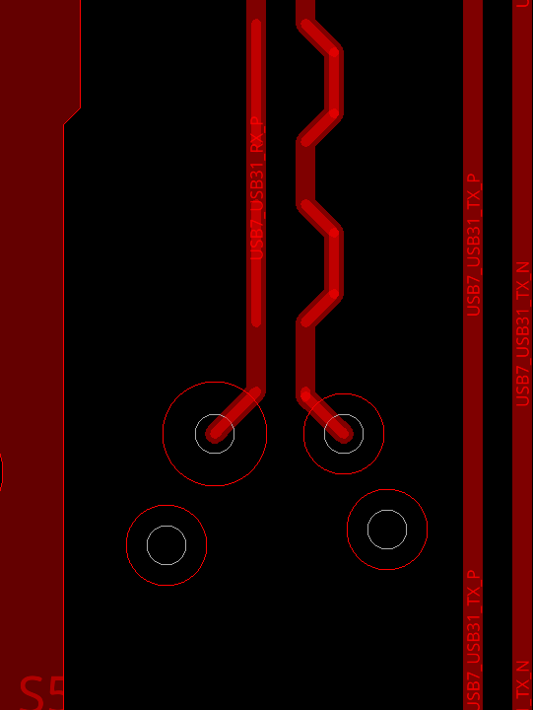
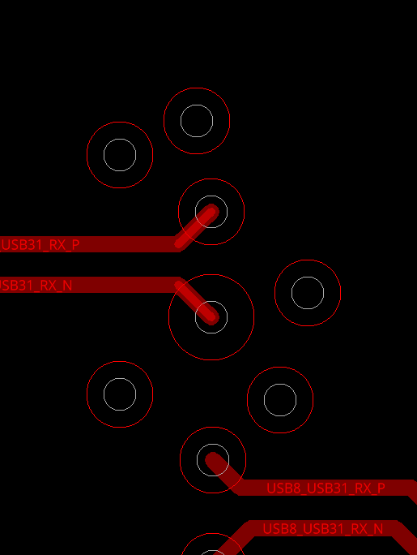
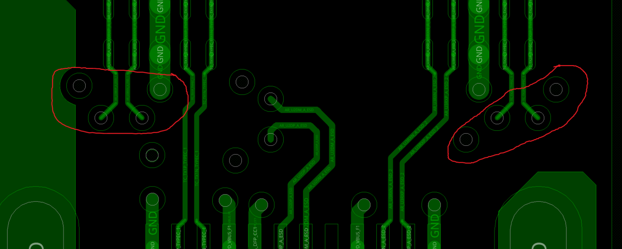
Keep GND vias symmetrical
PASS
Keep GND vias symmetrical to signal vias
This will ensure a strong return path.

Slide 3
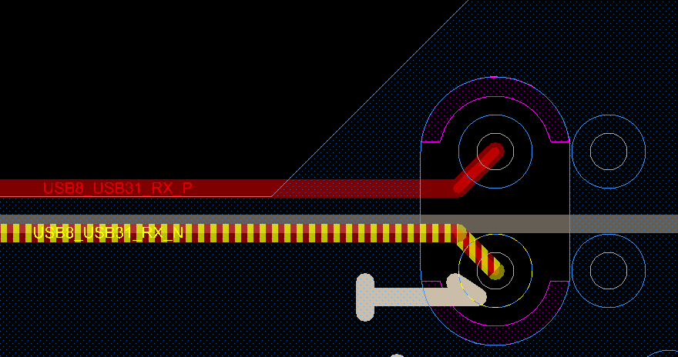
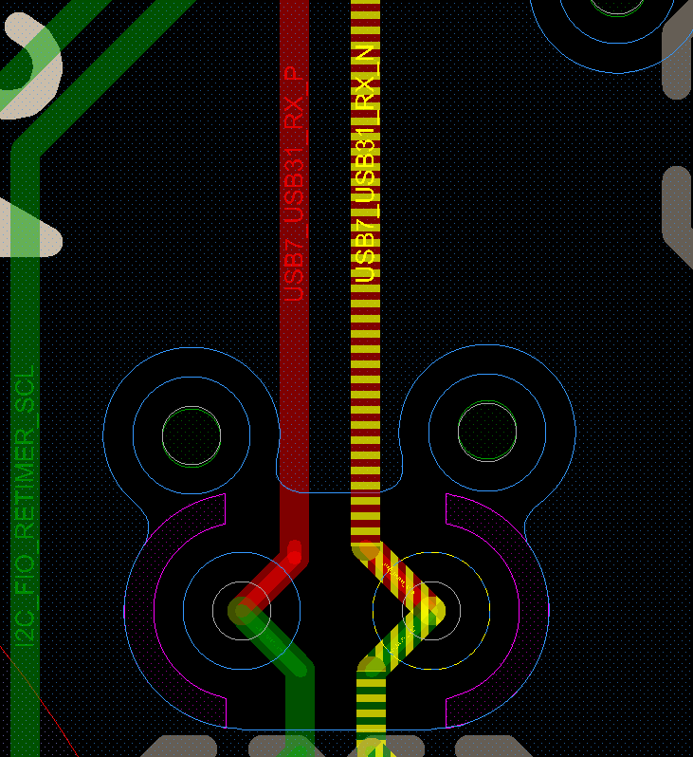
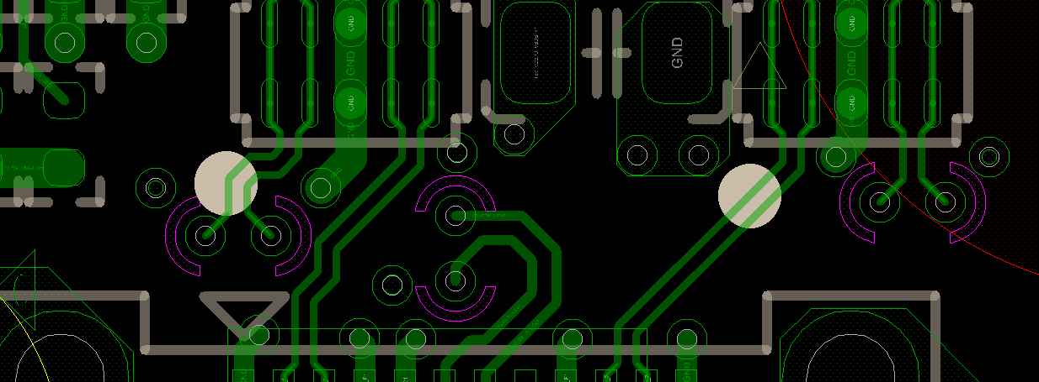

Slide 4
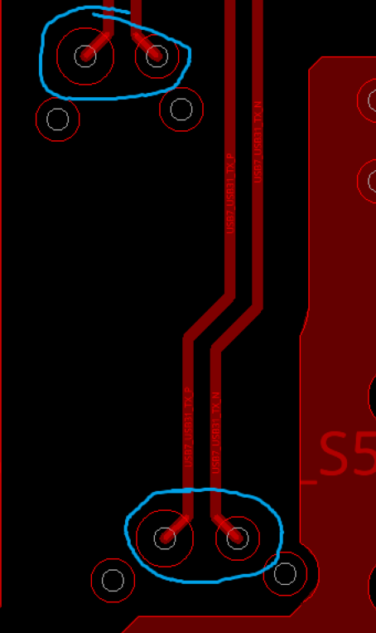
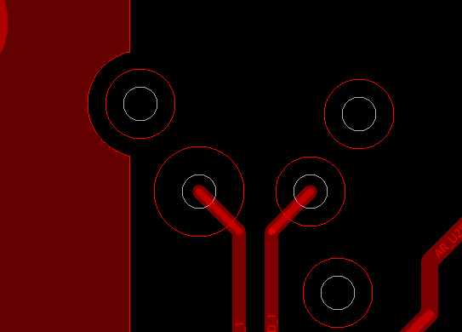
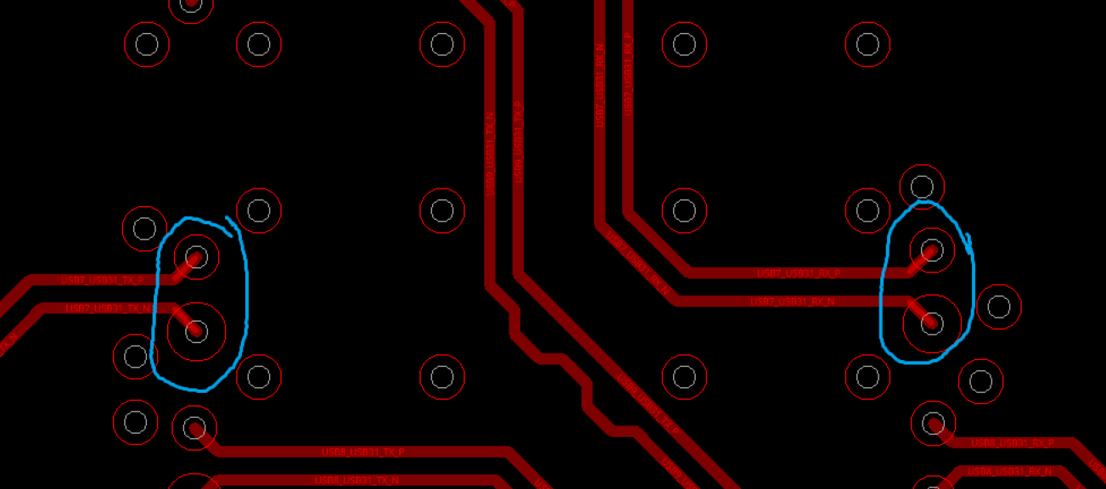
Why is one via larger than the other?
PASS
Signal vias should keep the same size for both p/n lines
I recommend reducing the size on the larger vias to match the smaller vias:

Slide 5
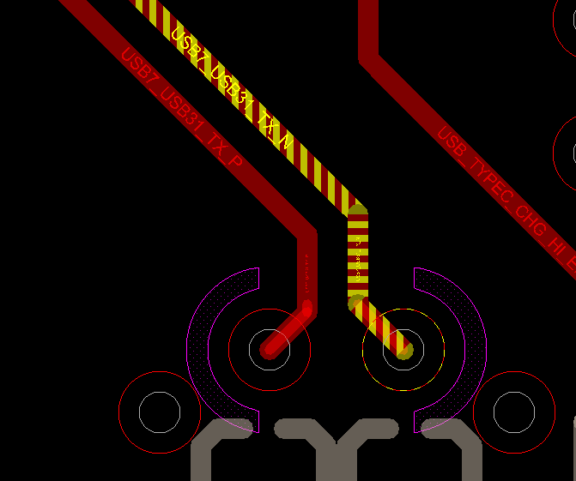

Slide 6
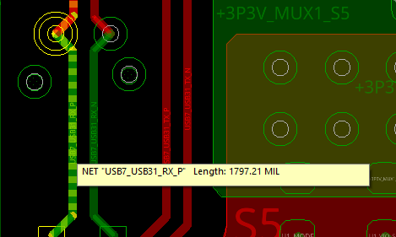
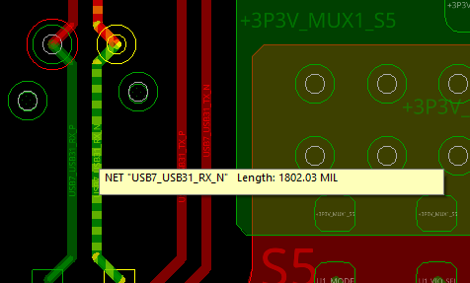
Length match p/n lines
PASS
I recommend matching the lengths of differential pairs to 2 mils maximum
Having different lengths will add jitter to your system
This pair has a difference of 5 mils

Slide 7
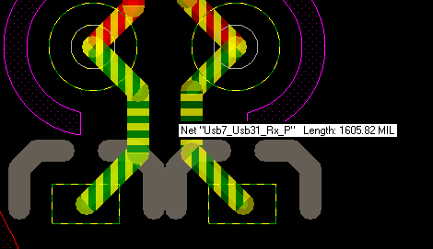
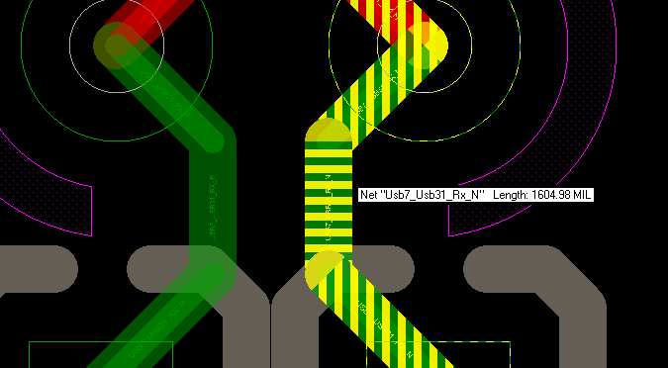

Slide 8
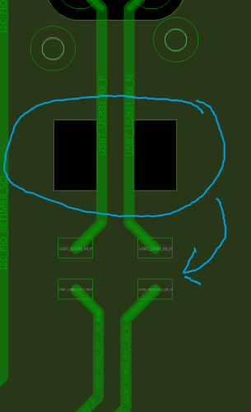
Fix the void alignment
PASS
Align the GND void under the AC coupling capacitors

Slide 9
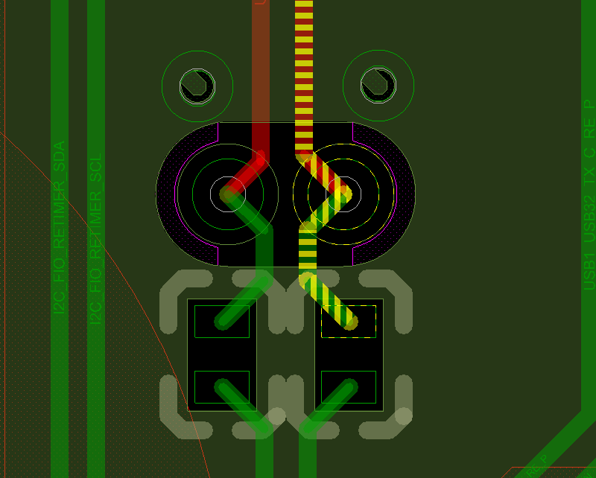

Slide 10
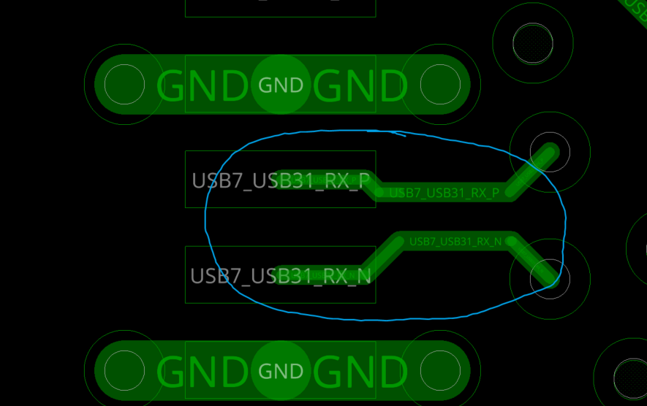
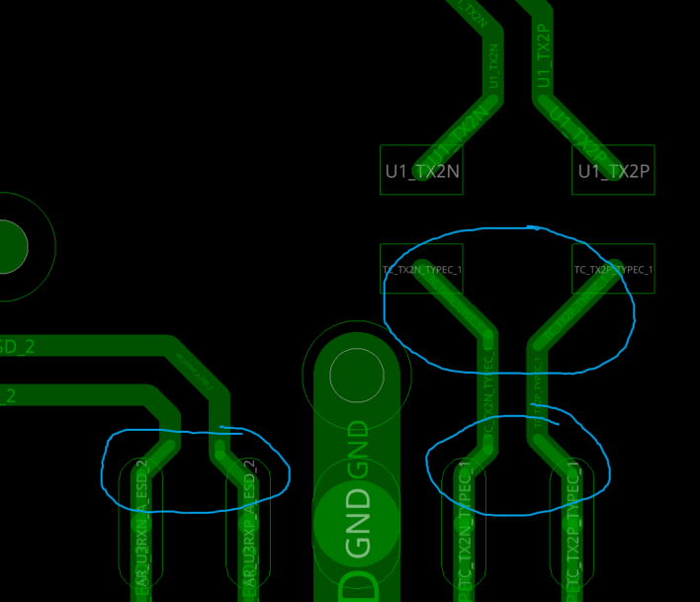
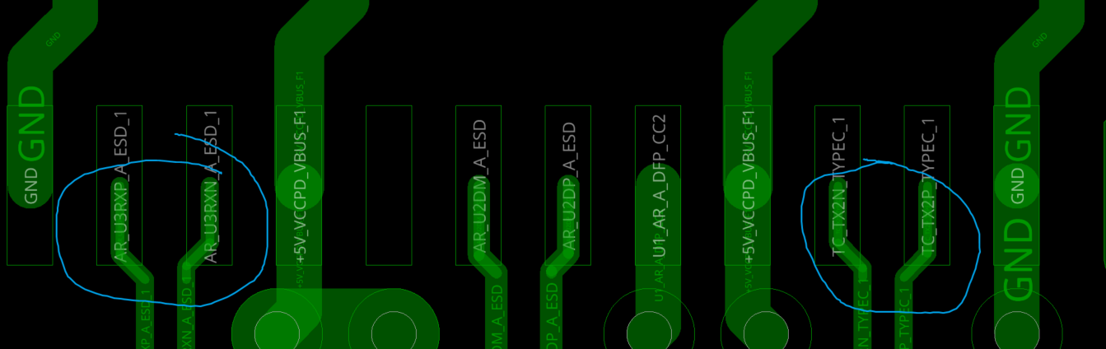
Improve symmetry on SS lines
PASS
I circled areas where the symmetry can be improved on the SuperSpeed lines

Slide 11
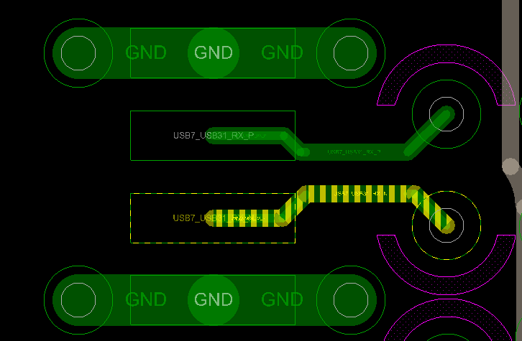
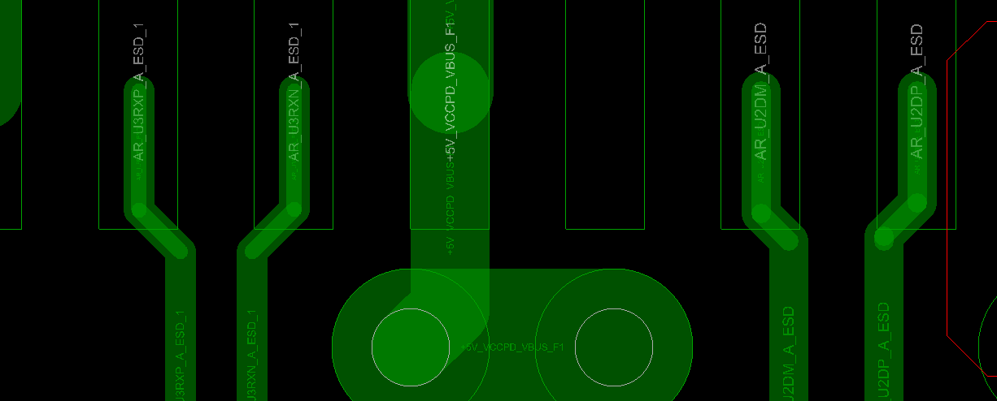

Slide 12
Important Notice and Disclaimer
TI PROVIDES TECHNICAL AND RELIABILITY DATA (INCLUDING DATASHEETS), DESIGN RESOURCES (INCLUDING REFERENCE DESIGNS), APPLICATION OR OTHER DESIGN ADVICE, WEB TOOLS, SAFETY INFORMATION, AND OTHER RESOURCES “AS IS” AND WITH ALL FAULTS, AND DISCLAIMS ALL WARRANTIES, EXPRESS AND IMPLIED, INCLUDING WITHOUT LIMITATION ANY IMPLIED WARRANTIES OF MERCHANTABILITY, FITNESS FOR A PARTICULAR PURPOSE OR NON-INFRINGEMENT OF THIRD PARTY INTELLECTUAL PROPERTY RIGHTS.
These resources are intended for skilled developers designing with TI products. You are solely responsible for (1) selecting the appropriate TI products for your application, (2) designing, validating and testing your application, and (3) ensuring your application meets applicable standards, and any other safety, security, or other requirements.
These resources are subject to change without notice. TI grants you permission to use these resources only for development of an application that uses the TI products described in the resource. Other reproduction and display of these resources is prohibited. No license is granted to any other TI intellectual property right or to any third party intellectual property right. TI disclaims responsibility for, and you will fully indemnify TI and its representatives against, any claims, damages, costs, losses, and liabilities arising out of your use of these resources.
TI’s products are provided subject to TI’s Terms of Sale or other applicable terms available either on ti.com or provided in conjunction with such TI products. TI’s provision of these resources does not expand or otherwise alter TI’s applicable warranties or warranty disclaimers for TI products.

