Slide 1
Brickyard MB TUSB1002A
06/27/2024
Shane Hauser

Slide 2
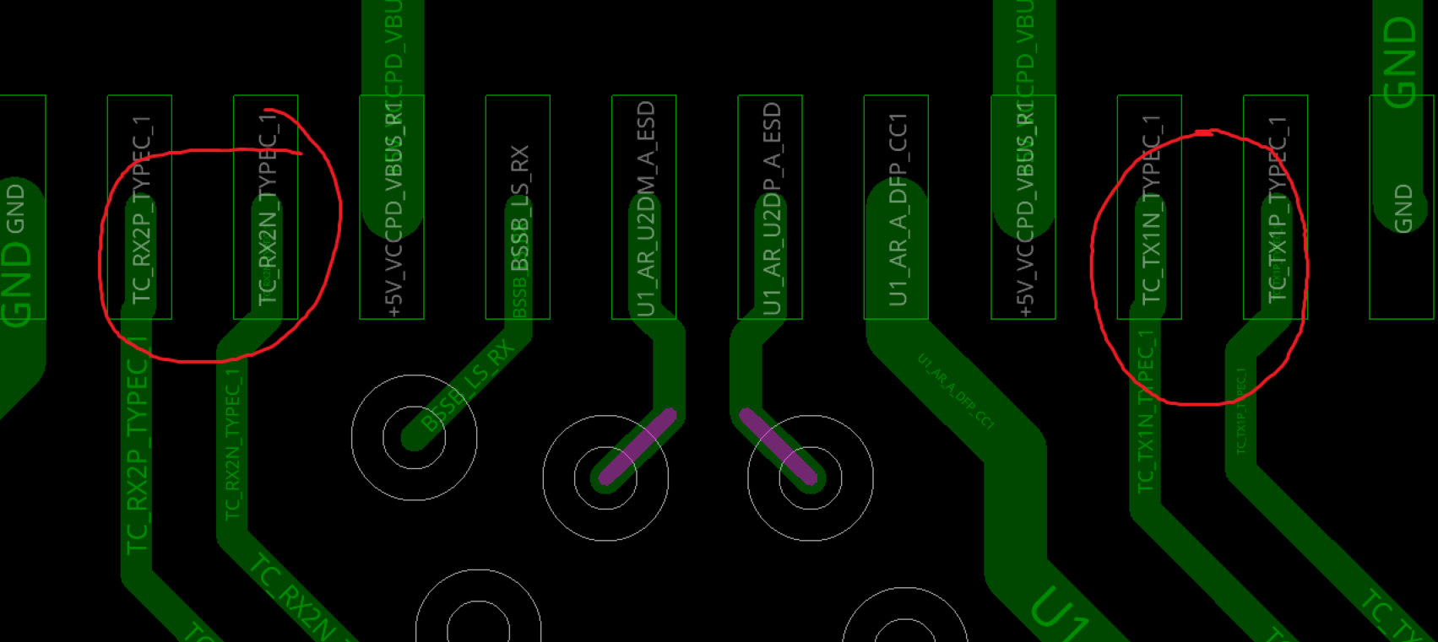
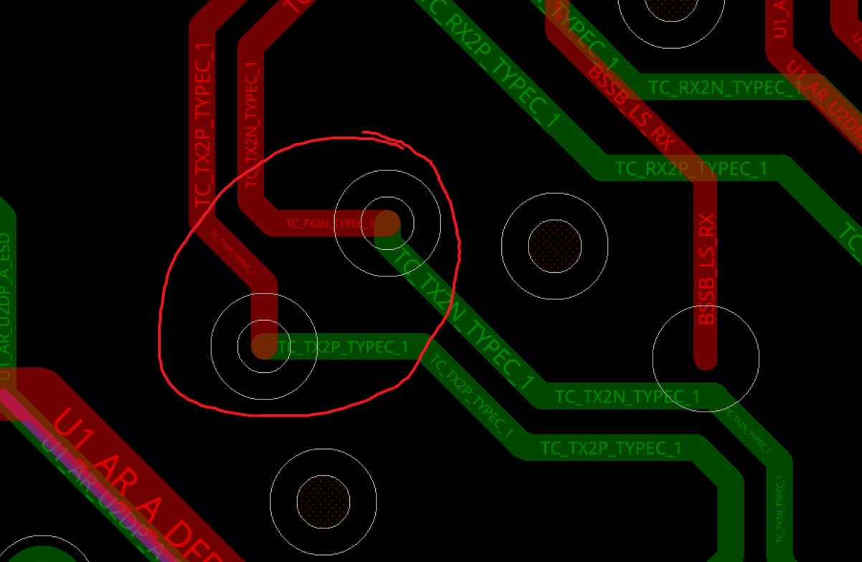
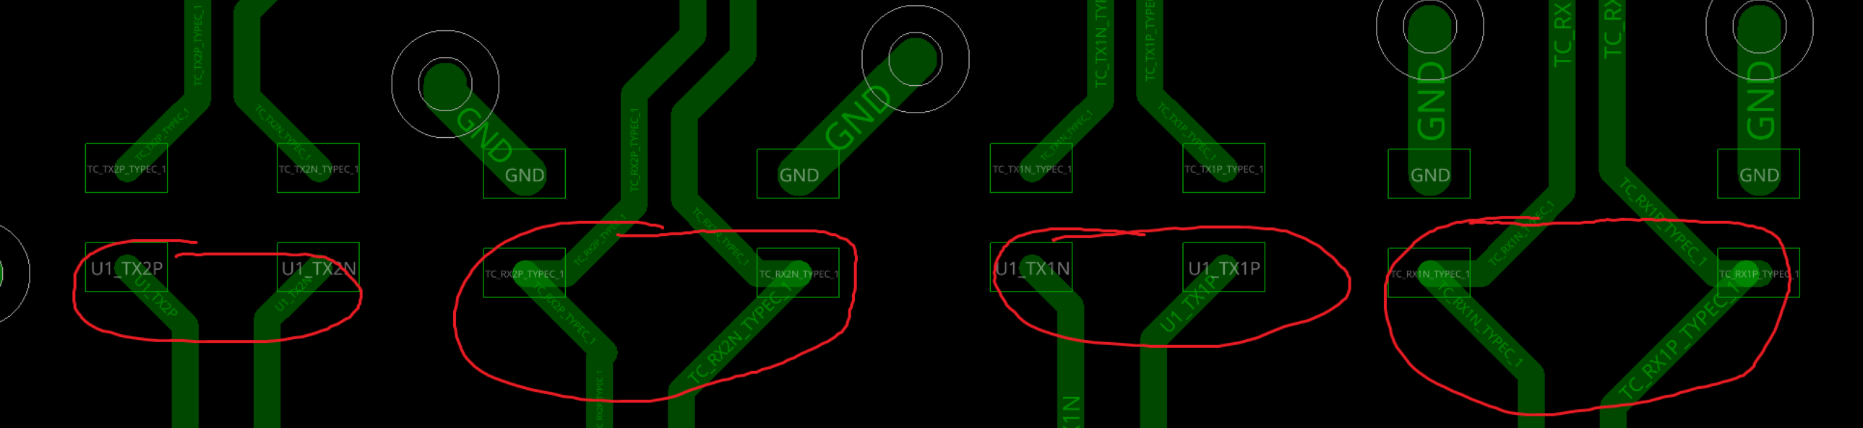
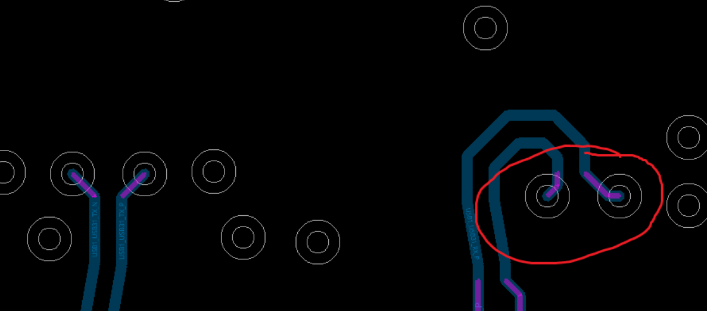
Keep differential pairs symmetrical
I recommend keeping the signal pairs symmetrical where possible.
I circled some areas of non-symmetry that should be improved as examples.

Slide 3
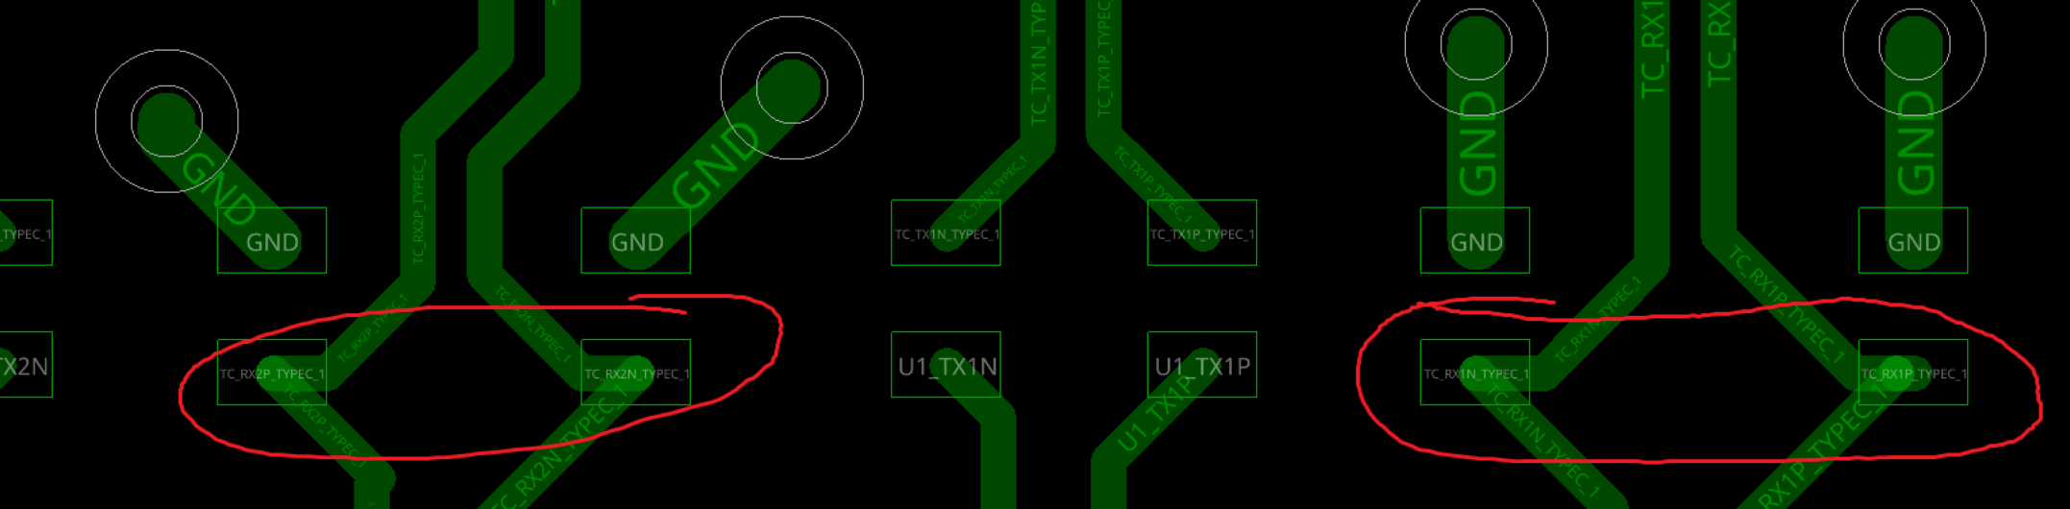
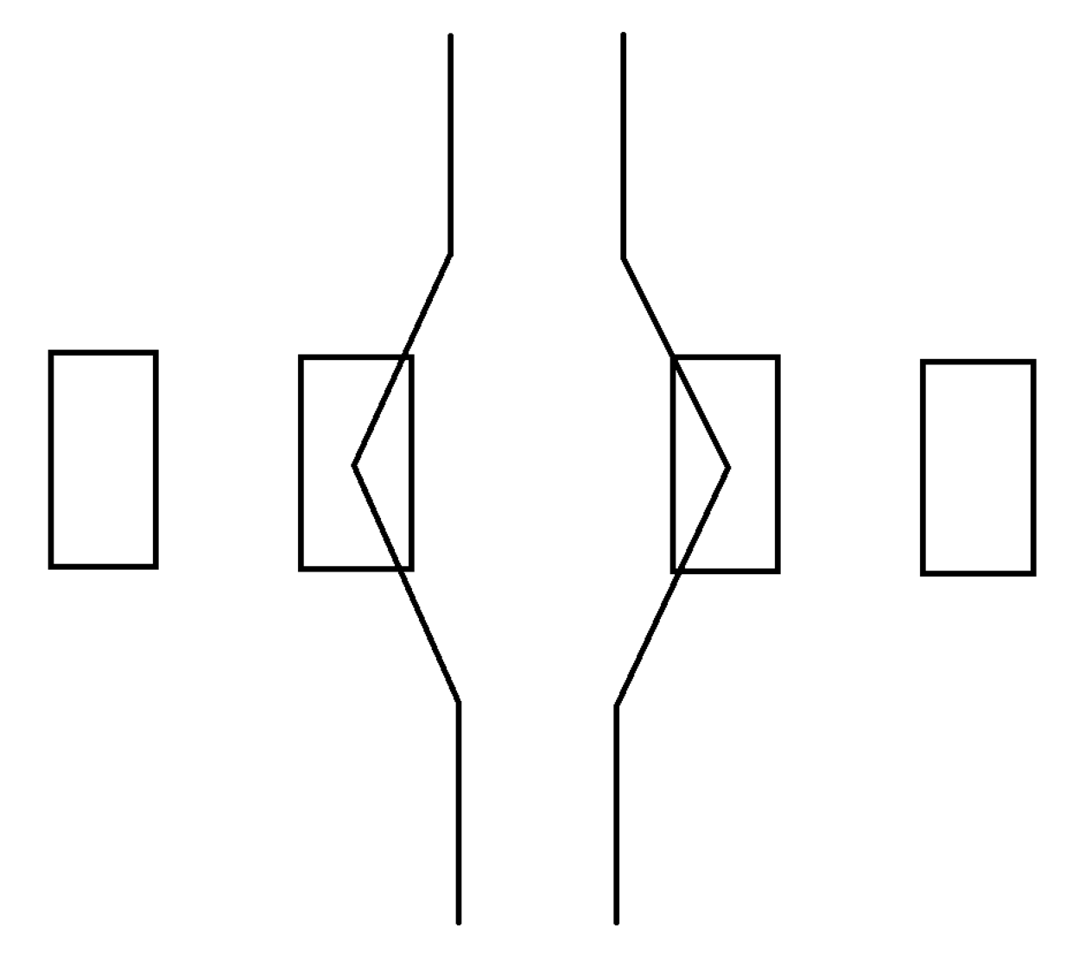
Avoid sharp bends in trace
I recommend lowering the angle on these sharp bends
Routing like this would lower the angle and help with reflections:

Slide 4
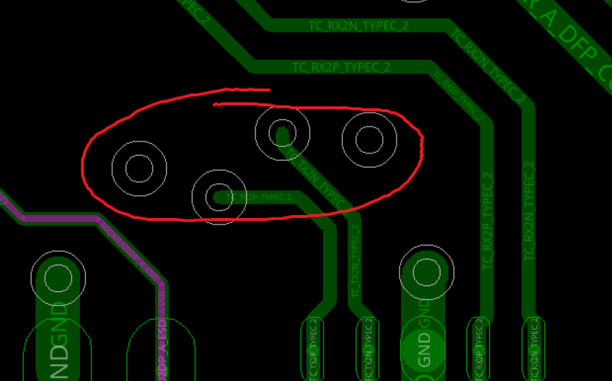
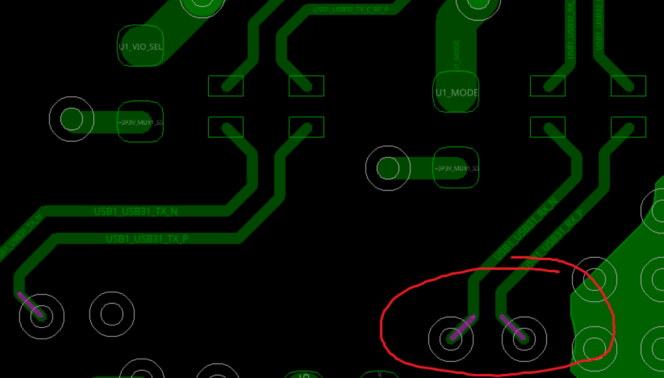
Use symmetrical GND vias
Keep GND vias symmetrical near signal vias

Slide 5
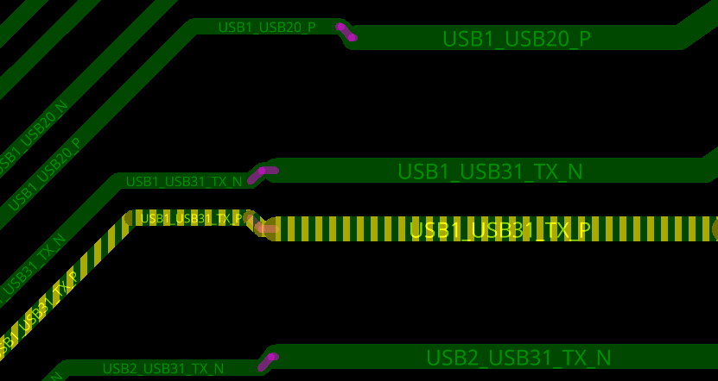
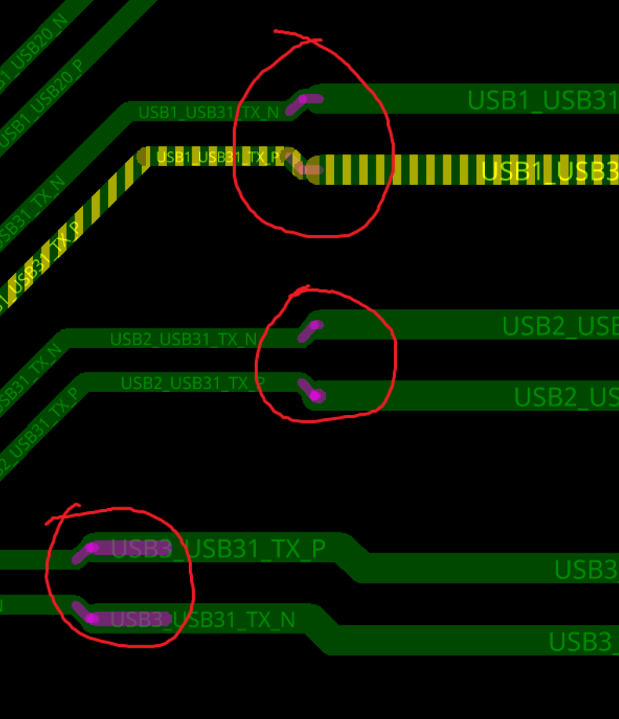
Keep trace size constant
Avoid changing the trace size in the signal path
This can cause reflections in the trace and impact the differential impedance

Slide 6
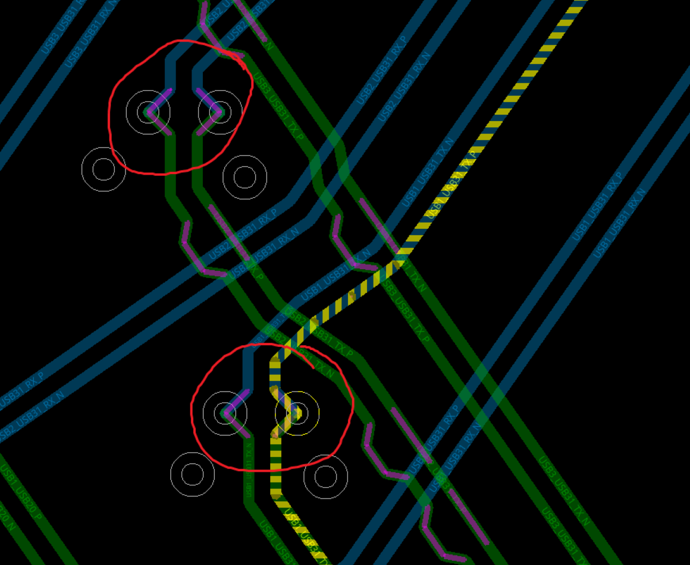
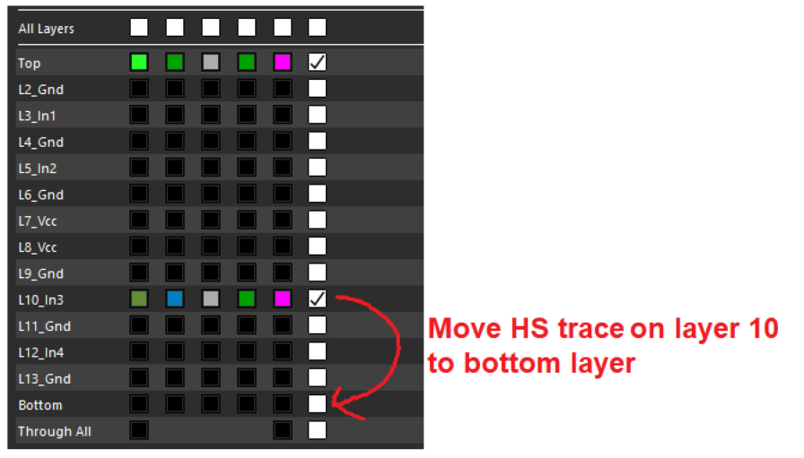
Move trace to bottom layer
If possible, I recommend moving the high speed traces from layer 10 to the bottom layer of the PCB.
This will eliminate the via stub and reduce signal reflection in the trace

Slide 7
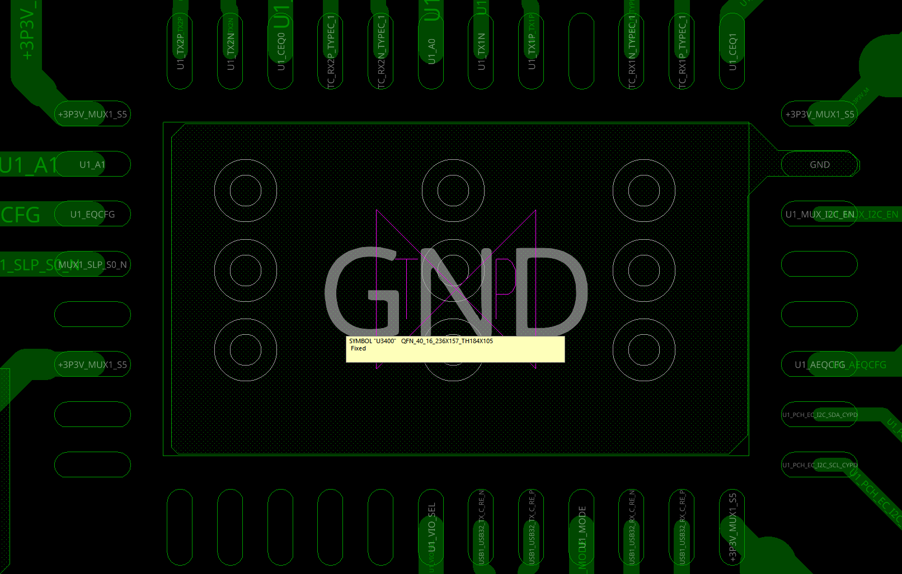
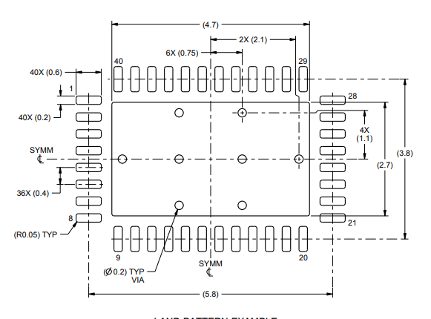
Follow layout stencil
I recommend following the thermal via stencil in the 1142 datasheet:

Slide 8
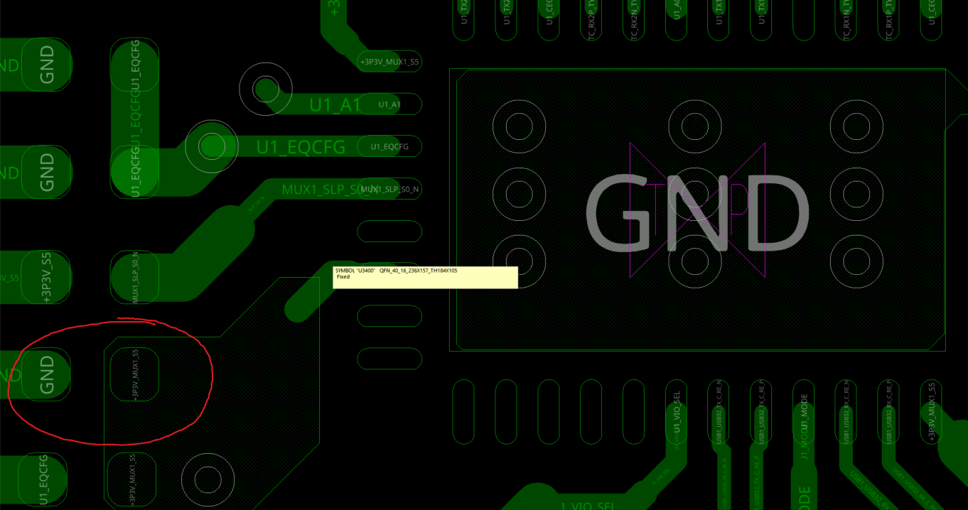
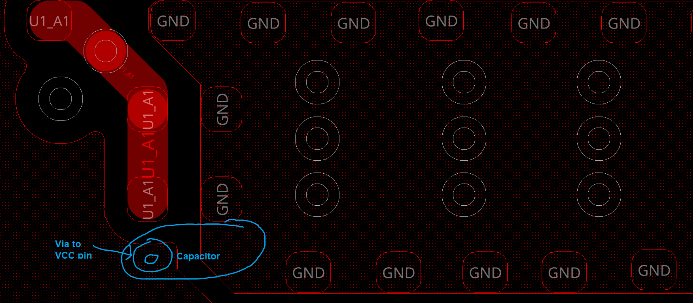
Use thermal PAD as GND for caps
I recommend moving one of your de-coupling capacitors to the bottom layer
Use the GND plane under the 1142 as the GND for this capacitor
Via the VCC pin to the other side of the capacitor
This will make the capacitor more effective at stopping AC noise on VCC line

Slide 9
Important Notice and Disclaimer
TI PROVIDES TECHNICAL AND RELIABILITY DATA (INCLUDING DATASHEETS), DESIGN RESOURCES (INCLUDING REFERENCE DESIGNS), APPLICATION OR OTHER DESIGN ADVICE, WEB TOOLS, SAFETY INFORMATION, AND OTHER RESOURCES “AS IS” AND WITH ALL FAULTS, AND DISCLAIMS ALL WARRANTIES, EXPRESS AND IMPLIED, INCLUDING WITHOUT LIMITATION ANY IMPLIED WARRANTIES OF MERCHANTABILITY, FITNESS FOR A PARTICULAR PURPOSE OR NON-INFRINGEMENT OF THIRD PARTY INTELLECTUAL PROPERTY RIGHTS.
These resources are intended for skilled developers designing with TI products. You are solely responsible for (1) selecting the appropriate TI products for your application, (2) designing, validating and testing your application, and (3) ensuring your application meets applicable standards, and any other safety, security, or other requirements.
These resources are subject to change without notice. TI grants you permission to use these resources only for development of an application that uses the TI products described in the resource. Other reproduction and display of these resources is prohibited. No license is granted to any other TI intellectual property right or to any third party intellectual property right. TI disclaims responsibility for, and you will fully indemnify TI and its representatives against, any claims, damages, costs, losses, and liabilities arising out of your use of these resources.
TI’s products are provided subject to TI’s Terms of Sale or other applicable terms available either on ti.com or provided in conjunction with such TI products. TI’s provision of these resources does not expand or otherwise alter TI’s applicable warranties or warranty disclaimers for TI products.

